Slide 1
The LZ Liquid Scintillator Screener Campaign
Scott Haselschwardt, for the LZ Collaboration
CoSSURF 2017
May 13, 2017

Slide 2
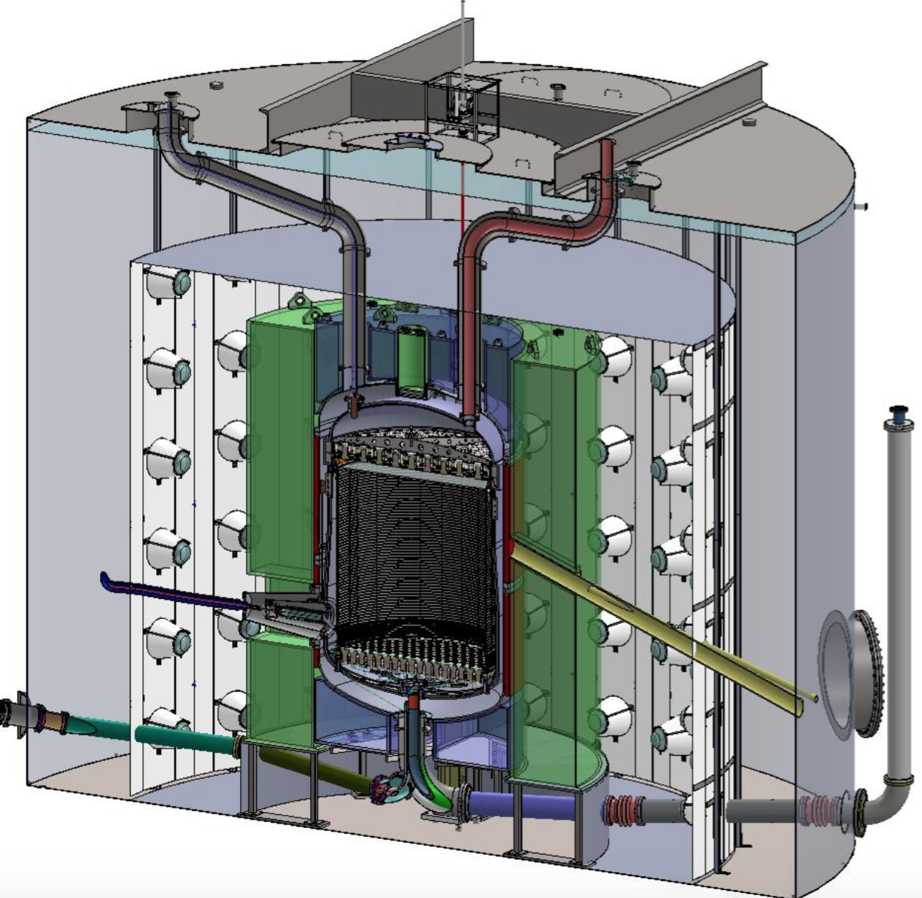
The LZ Experiment
Veto PMTs Inside Tyvek Curtain
Central TPC,
7 tonnes LXe,
494 3” PMTs
DD Neutron Calibration Tubes
High Voltage Feedthrough
Former LUX Water Tank
Liquid Scintillator “Outer Detector” Veto
Xenon Handling Lines

Slide 3
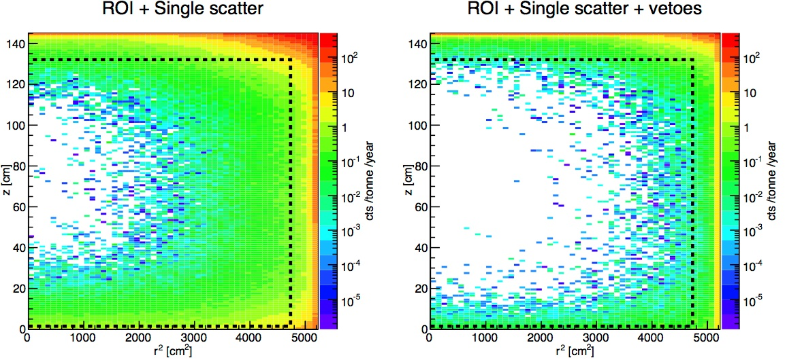
The LZ Outer Detector
9 segmented UVT acrylic tanks
~17 tonnes Gd-loaded, LAB-based LS
Neutrons thermalize and capture on Gd:
n + Gd -> Gd + (3-4x)γ(~8 MeV)
120 8” PMTs in water tank
Surrounded by Tyvek reflector
Together with LXe “skin”, veto gammas and neutrons with high efficiency… 100-200 keV threshold
Reduce WIMP search backgrounds
Simulated neutron background in LZ before and after application of veto cuts

Slide 4
GdLS Purity
OD rate goal drives scintillator purity requirements
Usual suspects: ²³⁸U, ²³²Th & ⁴⁰K
¹⁴C a main concern
LLNL Mass Spec down to 10⁻¹⁵ g/g
Requirement/goal is 10⁻¹⁷-10⁻¹⁸ g/g
Impurity | Goal | Requirement
²³⁸U | 1.3 ppt | 10 ppt
²³²Th | 4.5 ppt | 20 ppt
⁴⁰K | 0.8 ppt | 3 ppt
¹⁴C | 1.3 x 10⁻¹⁷ g/g | 1.5 x 10⁻¹⁷ g/g

Slide 5
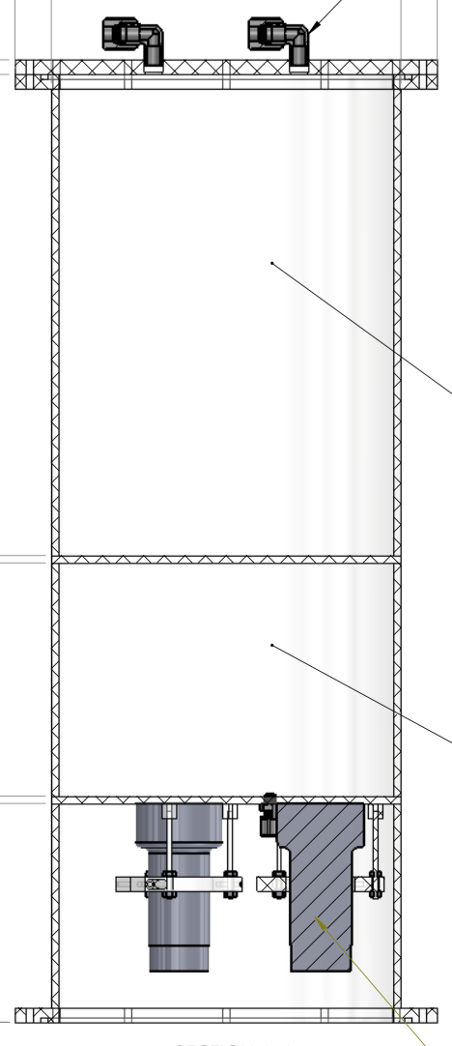
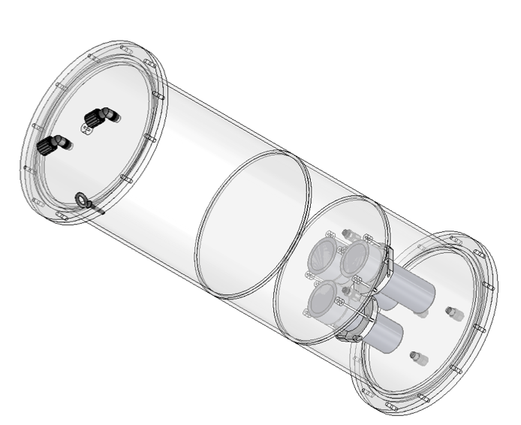
The LS Screener
Made of Reynolds UVT acrylic (same as OD)
~ 24 kg GdLS
~1/700 of OD LS
Produced by Minfang Yeh at BNL
14 kg water shield
3 R11410-20 PMTs
Very radiopure
LZ PMT bases
Wrapped in Tyvek reflector
GdLS
Water

Slide 6
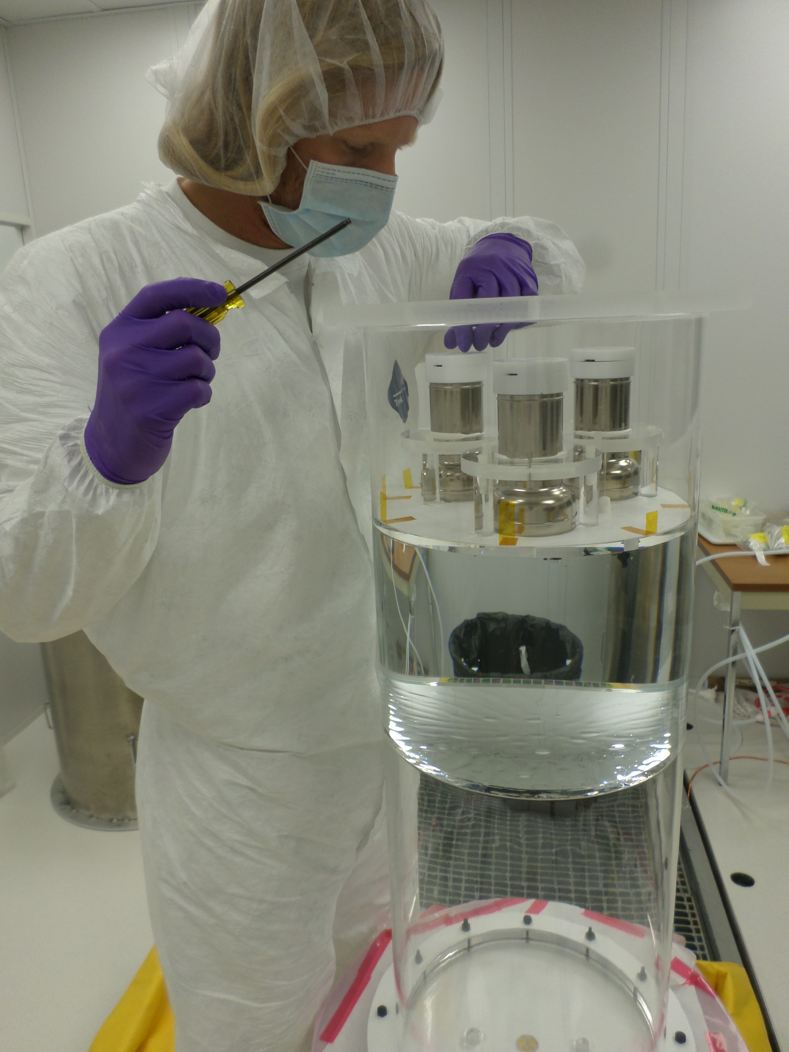
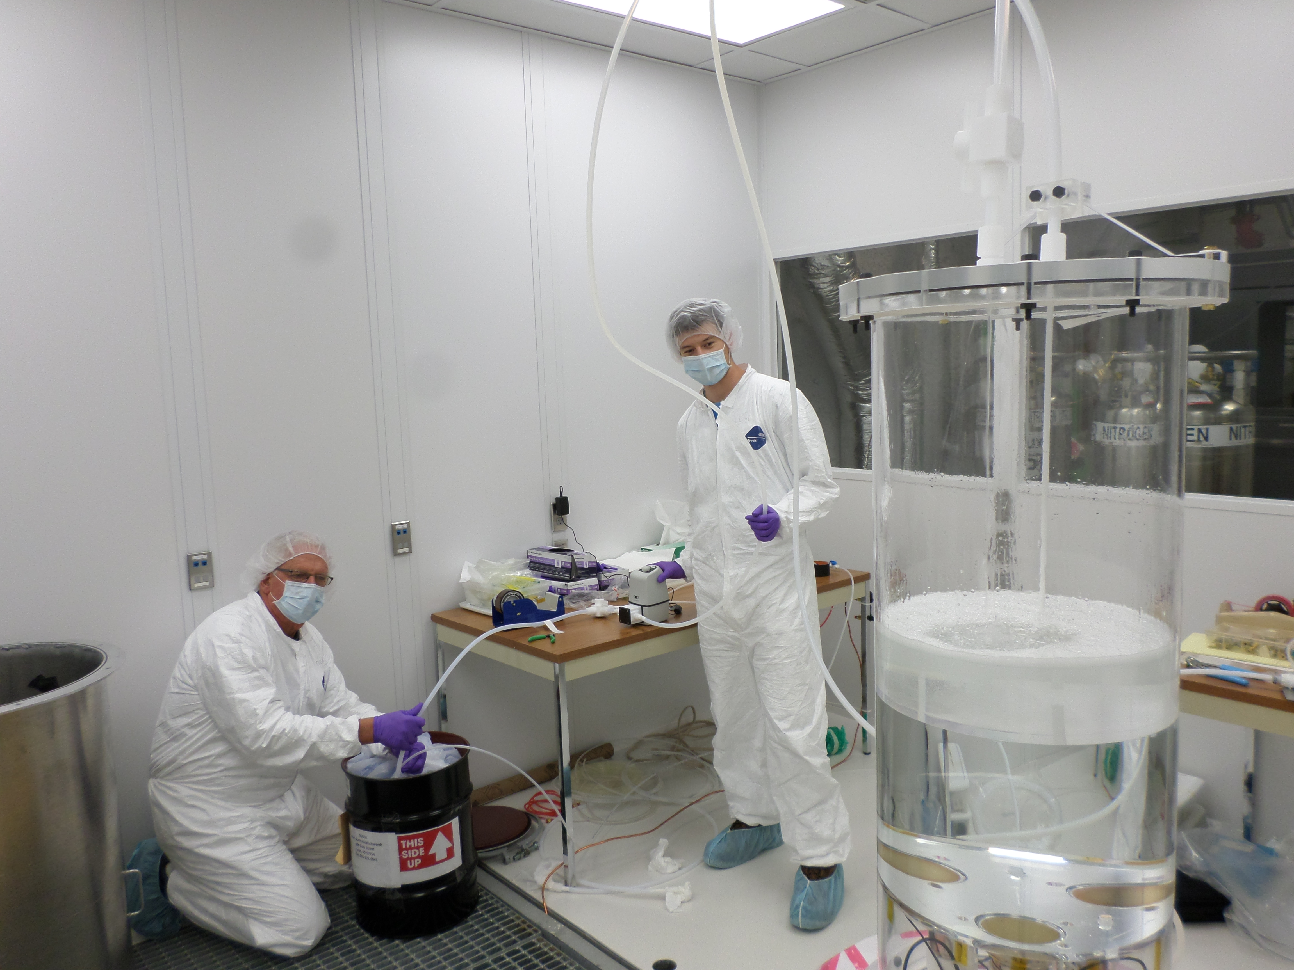
Underground Commissioning, Nov. 2016
Water volume full, mounting PMTs
GdLS filling in underground cleanroom

Slide 7
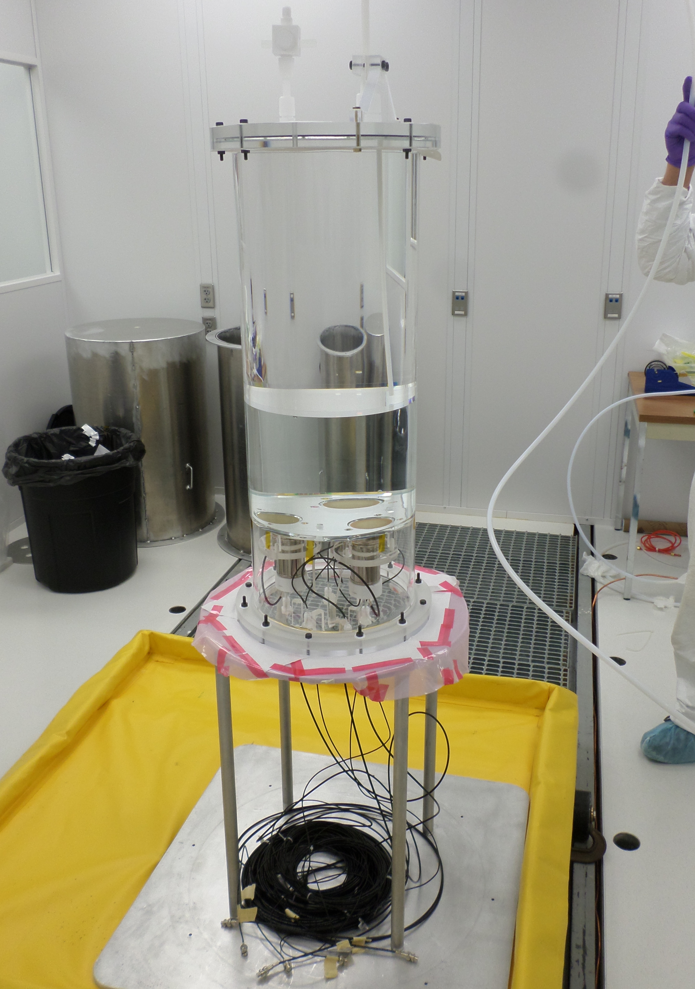
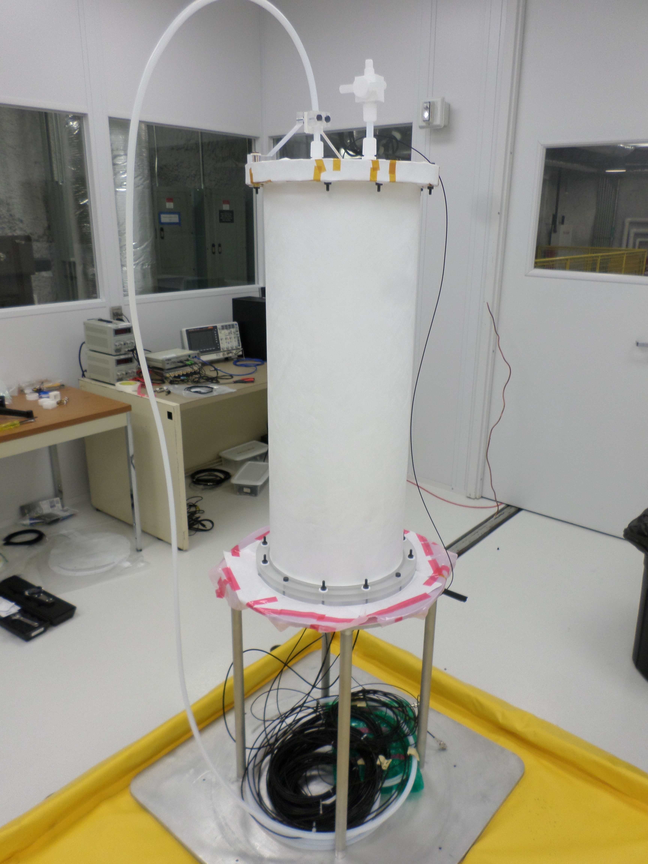
Ready for Water Tank Deployment
Wrapped in single layer tyvek, ready for deployment:
Filled w/ GdLS and water. PMTs mounted:
Teflon tube for thoron calibration

Slide 8
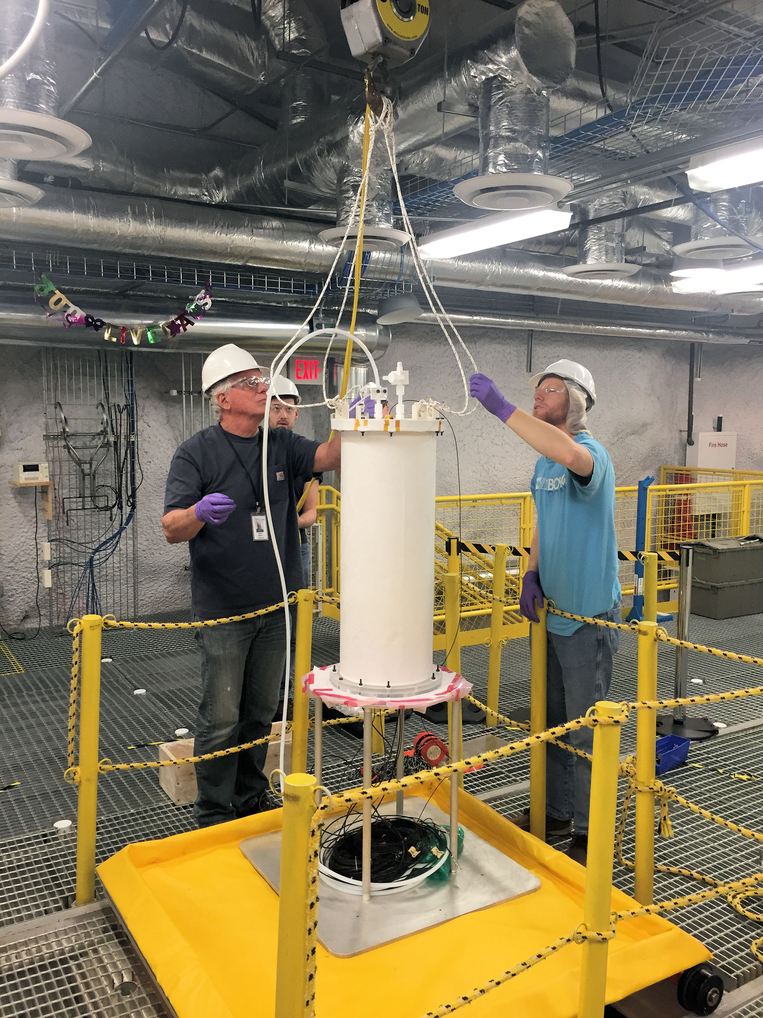
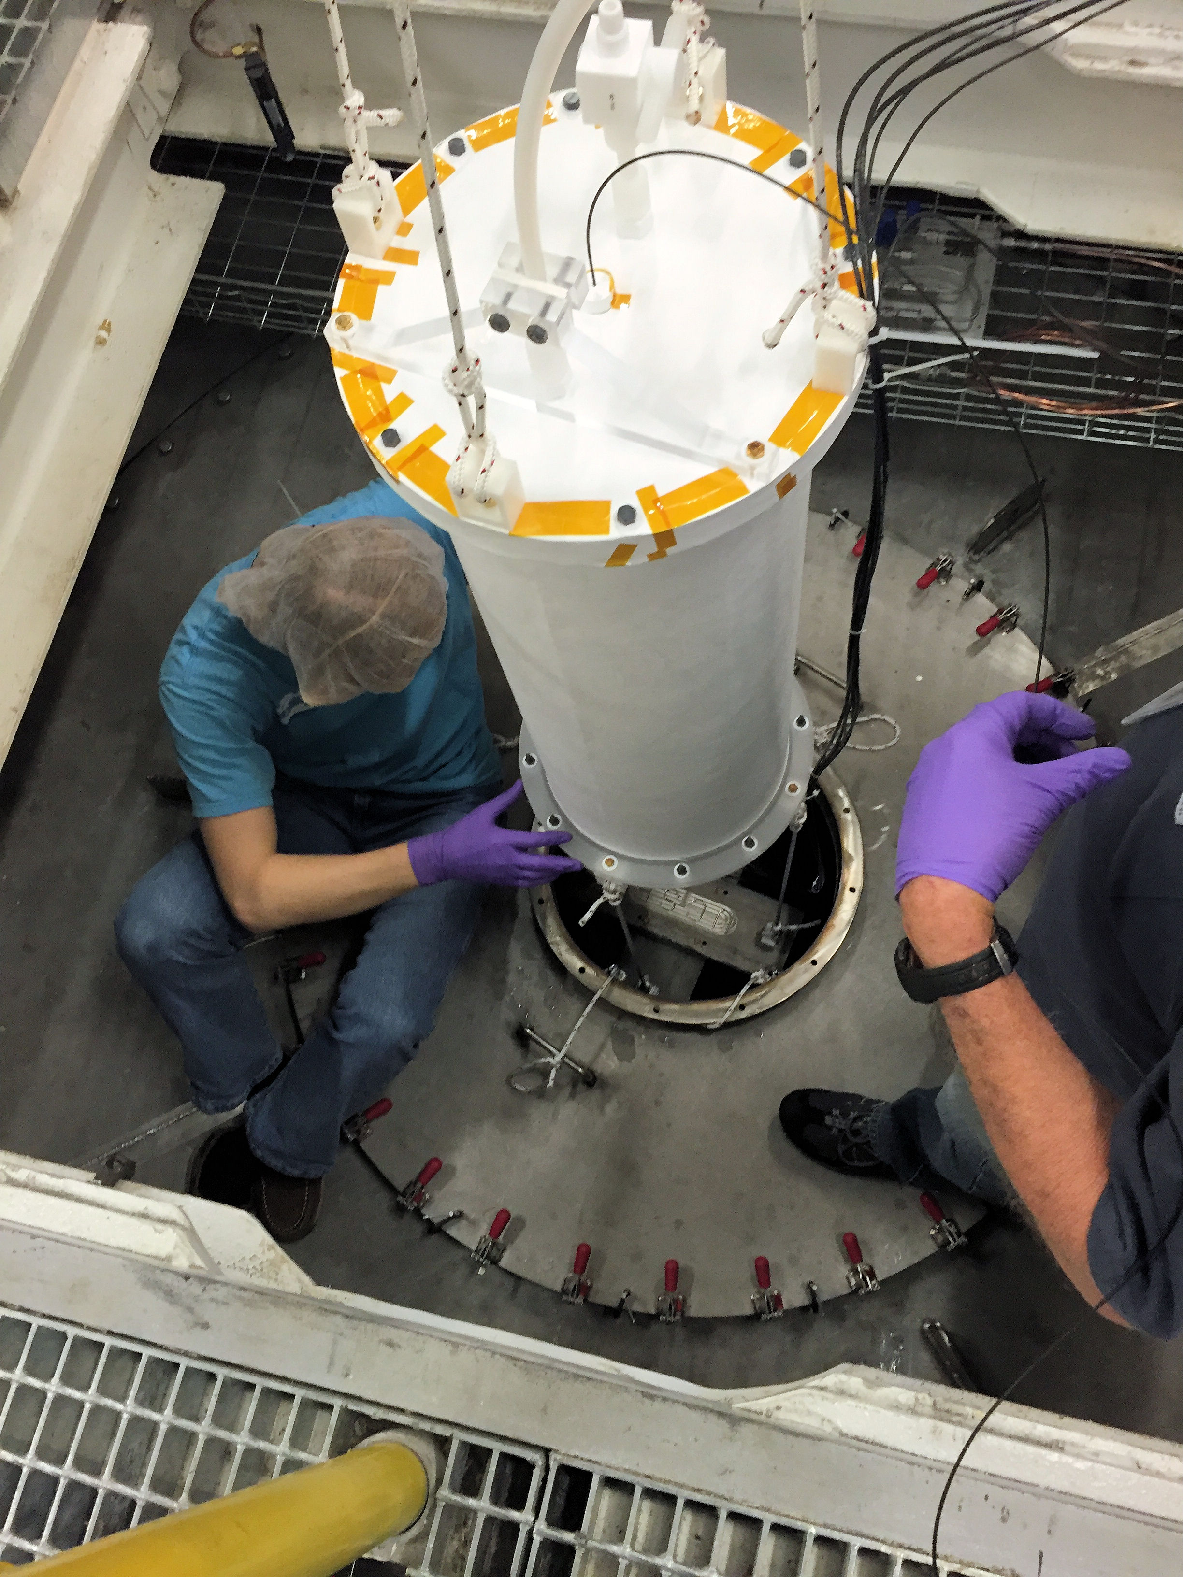
Water Tank Deployment

Slide 9
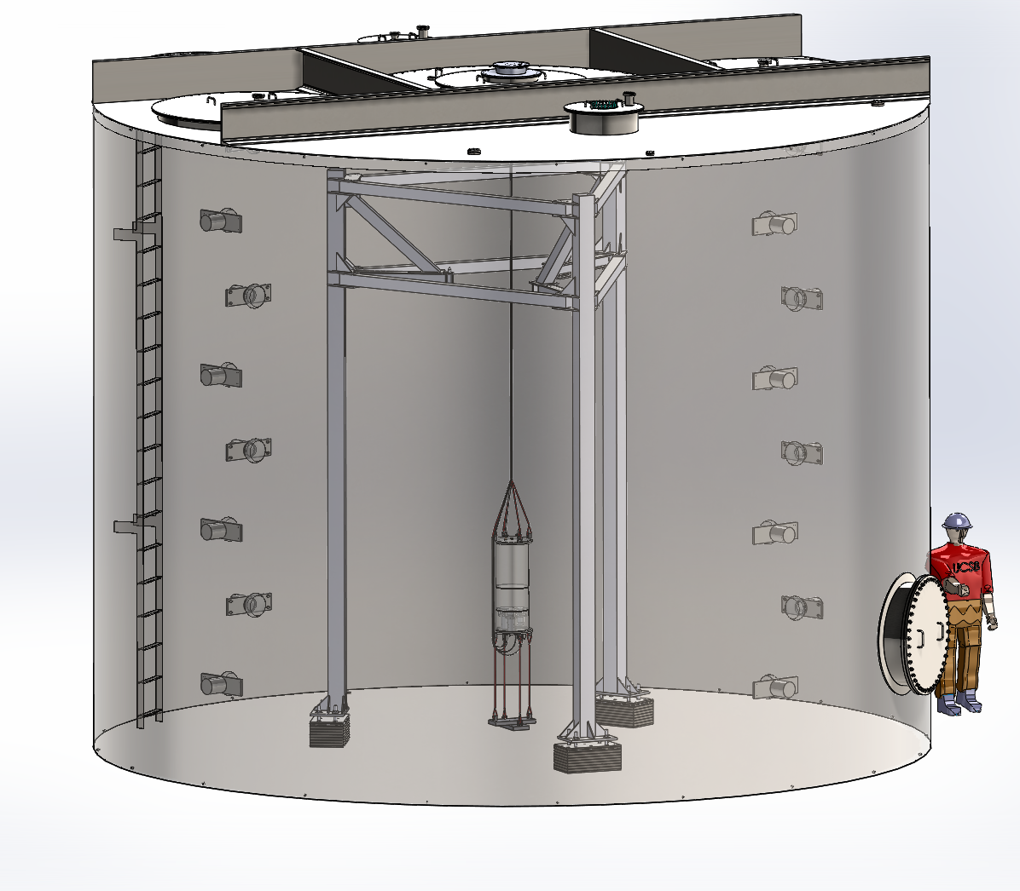
Data Taking Overview
Deployed in LUX water shield
LUX support stand still present
Pulses amplified & digitized by LZ electronics
Run 1: GdLS
Mid Nov 2016 – Early Jan 2017
Run2: No Gd-loading
Late Jan 2017 – Late Feb 2017
~Weekly PMT gain monitor
Calibrations end each run:
γ: ¹³⁷Cs, ²²Na, ⁴⁰K, ²²⁸Th
α&β: Thoron bubbling
End of each run “z-scan”

Slide 10
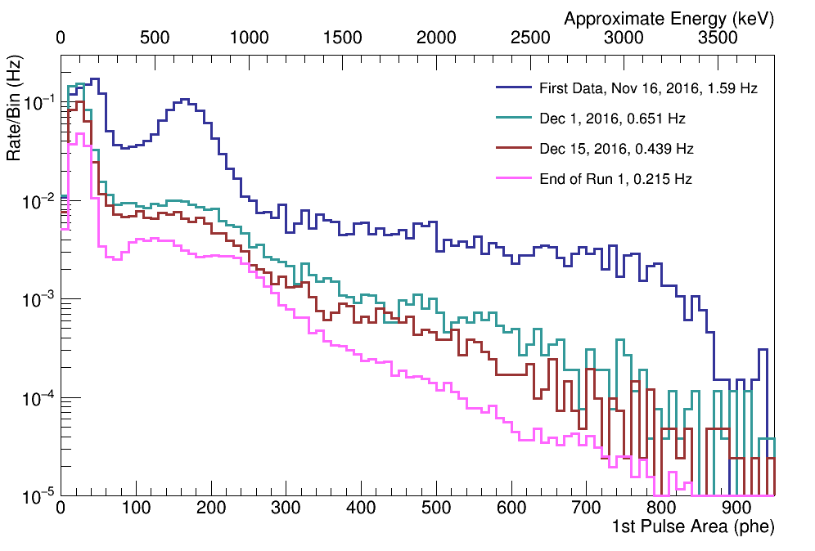
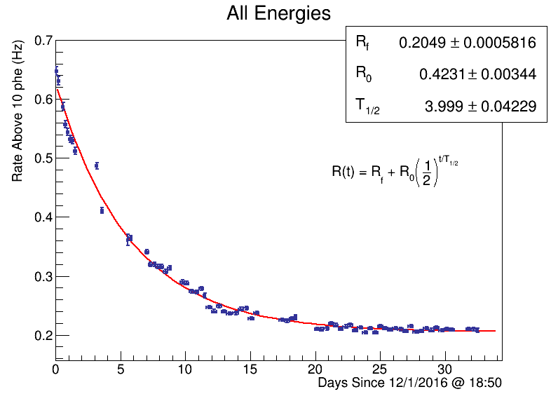
Run 1 – First Data
We see α’s, β’s and Compton deposits from ɣ’s
Rate plateau after ~ 3 weeks
0.25 phe/keV → 3-fold coinc of > 2 phe → 24 keV threshold
Acceptance for ~70% of ¹⁴C beta spectrum
¹⁴C + ¹⁵²Gd α
Radon α peak decays…
U, Th α’s leftover

Slide 11
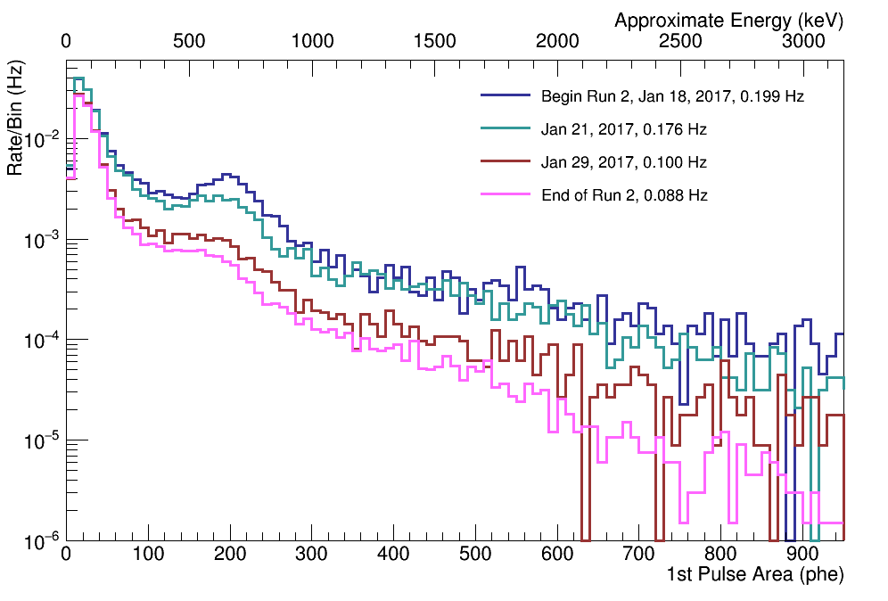
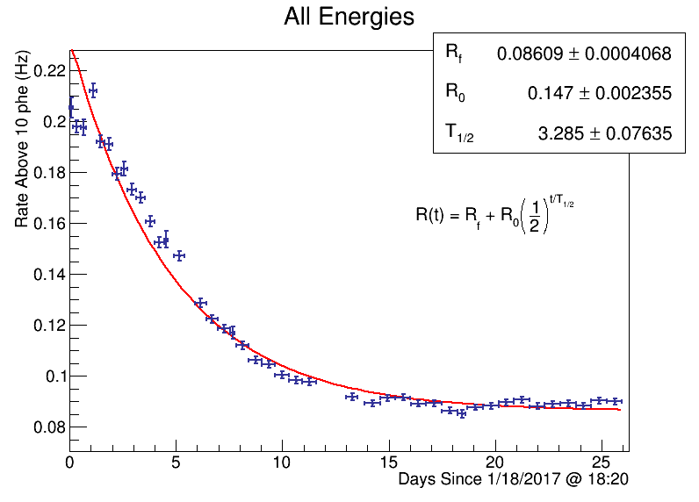
Run 2 – No Gd
Same cocktail without Gd
Less exposure during LS fill
Rate plateau after ~ 2 weeks
Higher light yield, ~0.3 phe/keV
¹⁴C, no Gd
Radon α peak decays…
U, Th α’s leftover

Slide 12
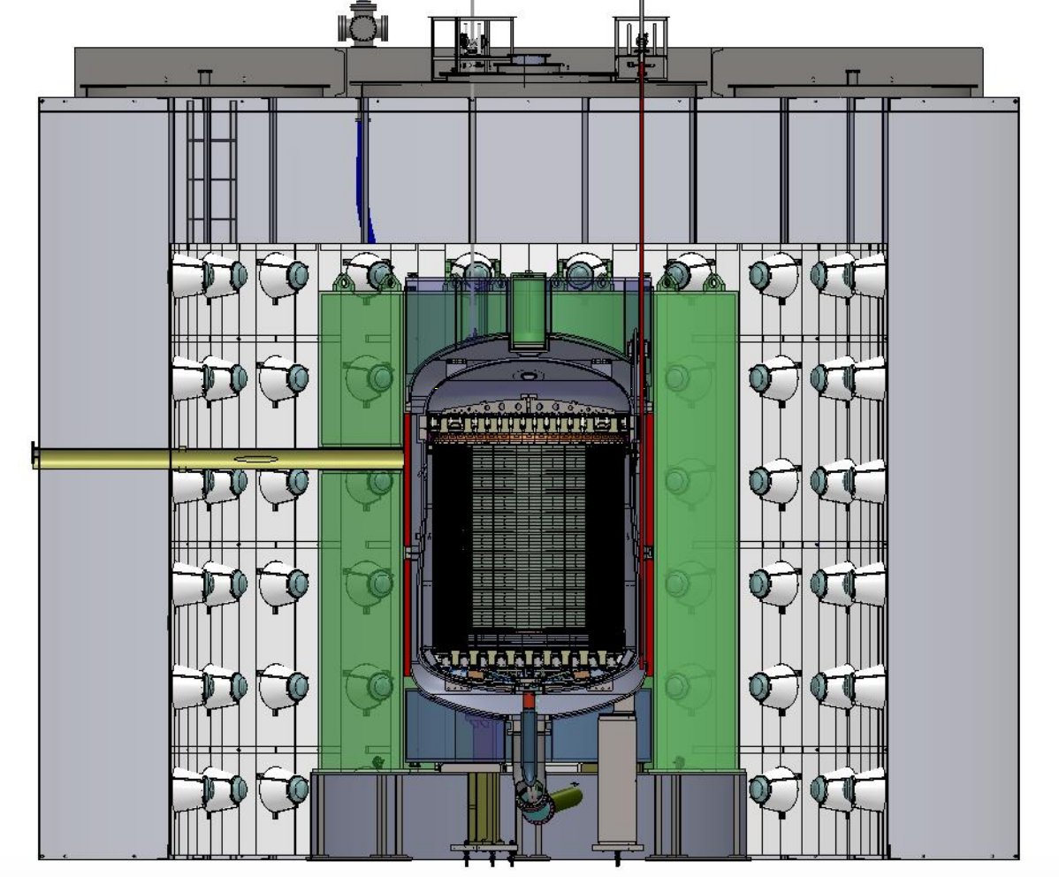
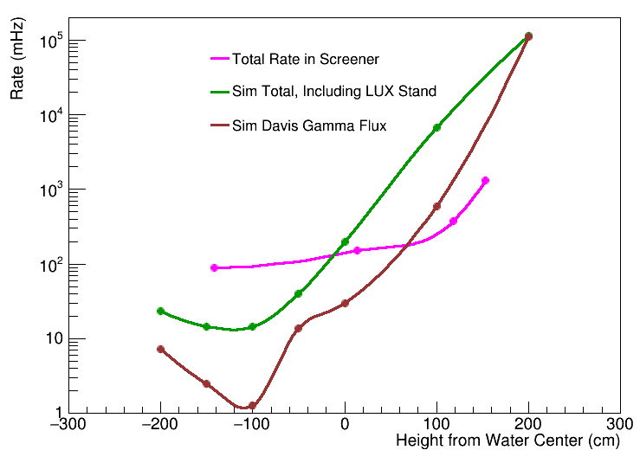
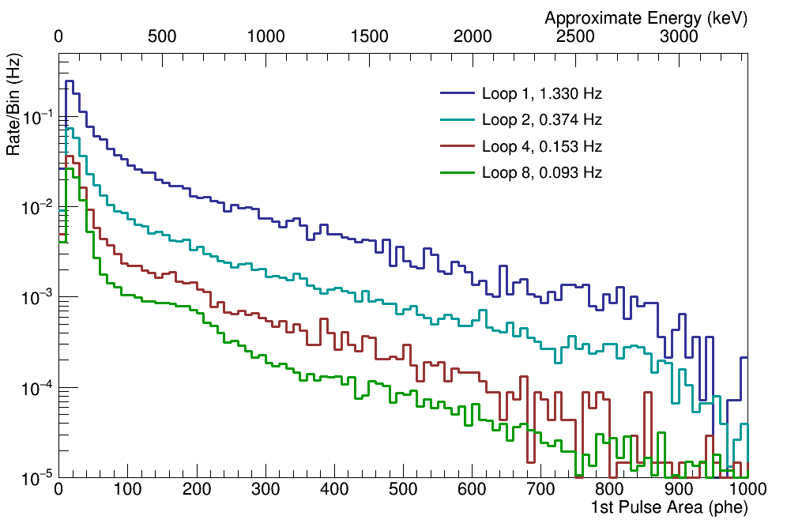
End of Run Z-Scan
Wanted to probe here!
Rate in OD from cavern environment a concern
End of each run, moved Screener vertically
Low rate spot
OD bottom
OD top
Top of OD acrylic….
4-5x lower than sim!

Slide 13
Background Simulations
Detailed geometry in Geant4-based LUXSim code
U, Th, K and Co simulated in:
Tyvek
Ropes
Titanium Ballast
PMTs and bases
PMT mounting structures
PMT cabling
Flange bolts
Acrylic vessel
LUX support stand
Davis Cavern rock
In LS volume: U, Th, K, ¹⁴C and ¹⁵²Gd
Direct screening results or LZ database for normalizations

Slide 14
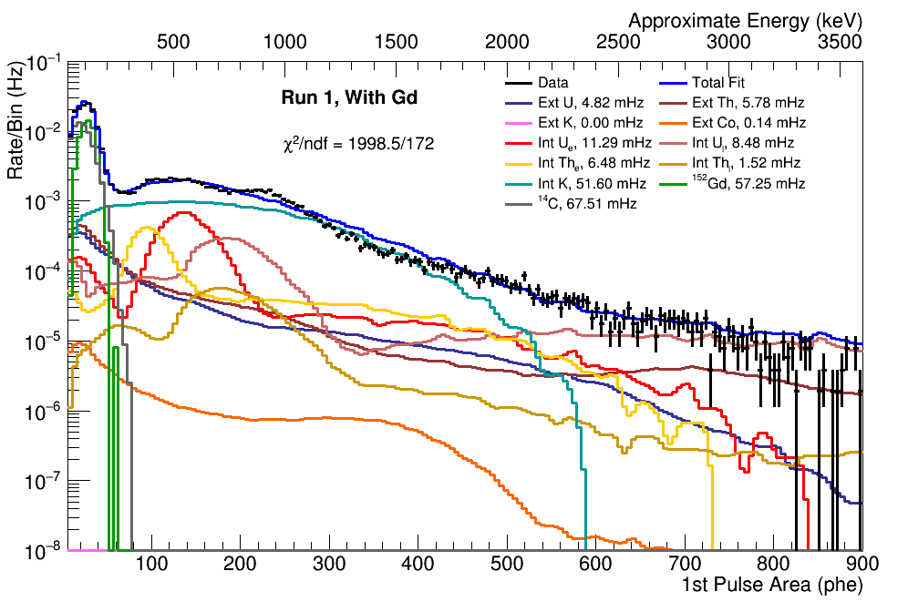
First Fit to Run 1 Data
Simulated spectra -> RooFit PDFs grouped by internal or external to LS
Constraints: External U, Th, K & Co from counting, ¹⁵²Gd rate from known concentration & late chain U & Th from BiPo rate
Preliminary

Slide 15
Impurity Estimates from Run 1
Impurity | Level Estimate | Comes From | Goal | Requirement
²³⁸U | 6.5 ± 1.5 ppt early 3.1 ± 0.3 ppt late | Fit early, BiPo late | 1.3 ppt | 10 ppt
²³²Th | 22 ± 5 ppt early 1.3 ± 0.4 ppt late | Fit early, BiPo late | 4.5 ppt | 20 ppt
⁴⁰K | 12 ± 1 ppt | Fit | 0.8 ppt | 3 ppt
¹⁴C | (2.7 ± 0.1) x 10⁻¹⁷ g/g | Fit | 1.3 x 10⁻¹⁷ g/g | 1.5 x 10⁻¹⁷ g/g
Close to requirement on ¹⁴C
Crude fit to Run 2 within factor of 2
U, Th okay…
Evidence for non-equilibriated sub-chains
HPGe screening of GdCl₃ underway
⁴⁰K expected to drop with updated fit

Slide 16
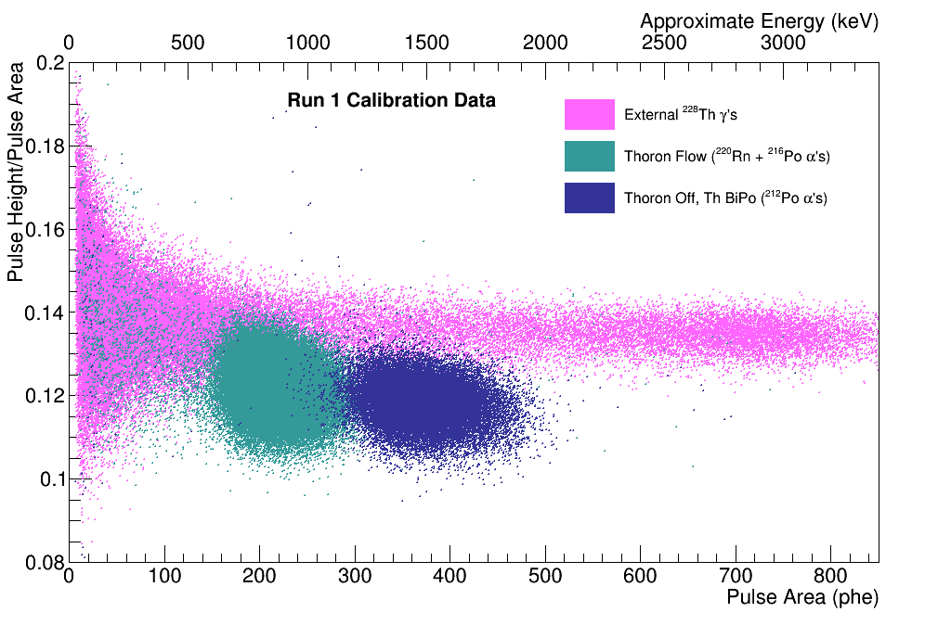
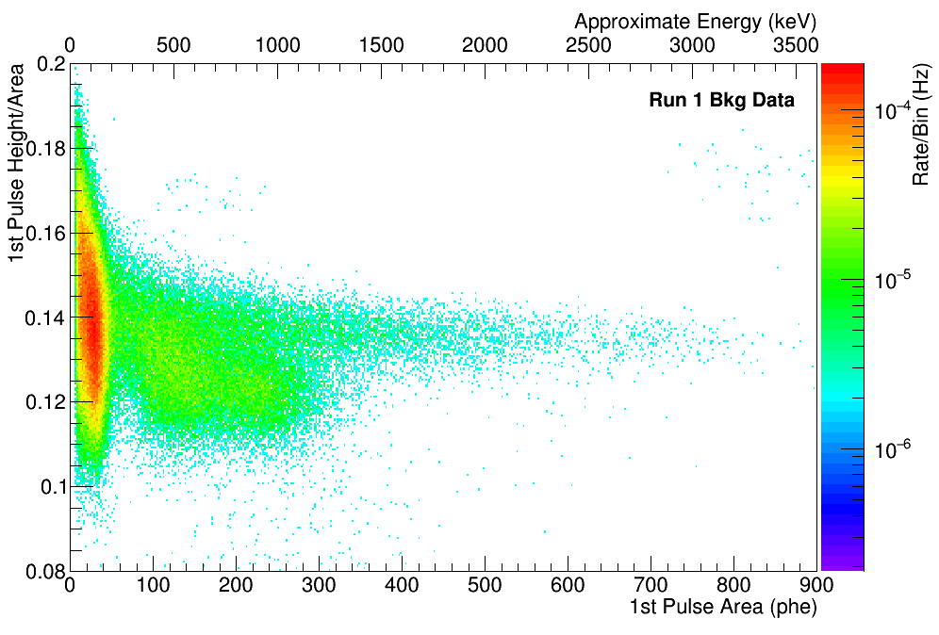
Next Steps
Run 2 fits
Pulse shape discrimination
Constrain U & Th alphas
Z-scan analysis
Mix of U and Th α’s

Slide 17
Conclusions
Screener campaign a success!
Providing useful feedback to LZ
Operational experience with GdLS
GdLS production modifications for lower backgrounds
We are close to our purity requirements for the GdLS
Z-scan constrain Davis Cavern gamma rate

Slide 18
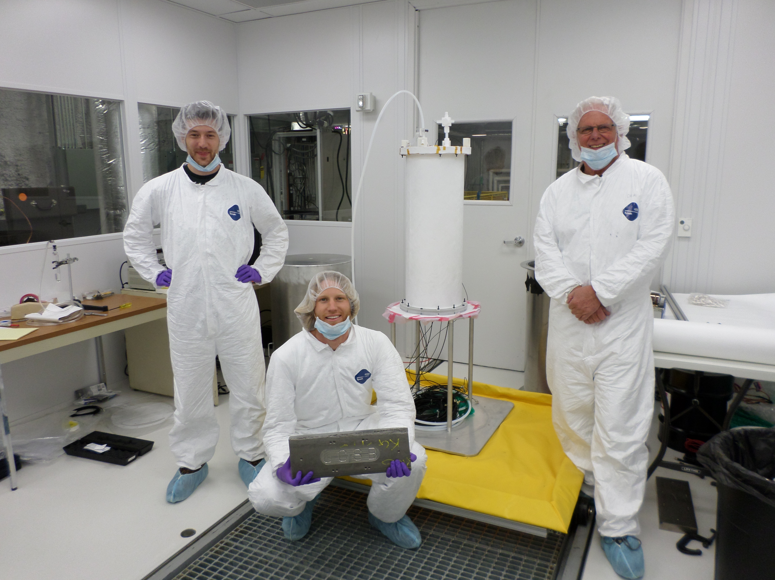
Thank You!
Dean White
Susanne Kyre
Harry Nelson
Mike Witherell
Curt Nehrkorn
Melih Solmaz
Sally Shaw
Minfang Yeh
Simon Fiorucci
Markus Horn
Dave Taylor
SURF personnel
U. Rochester
Brown U.
U. Davis
LZ Screening Crew

Slide 19
Extra Slides

Slide 20
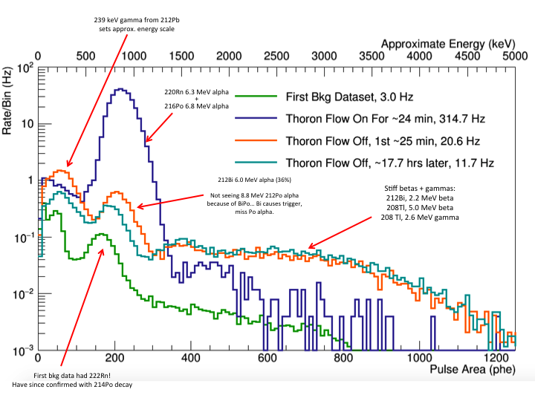
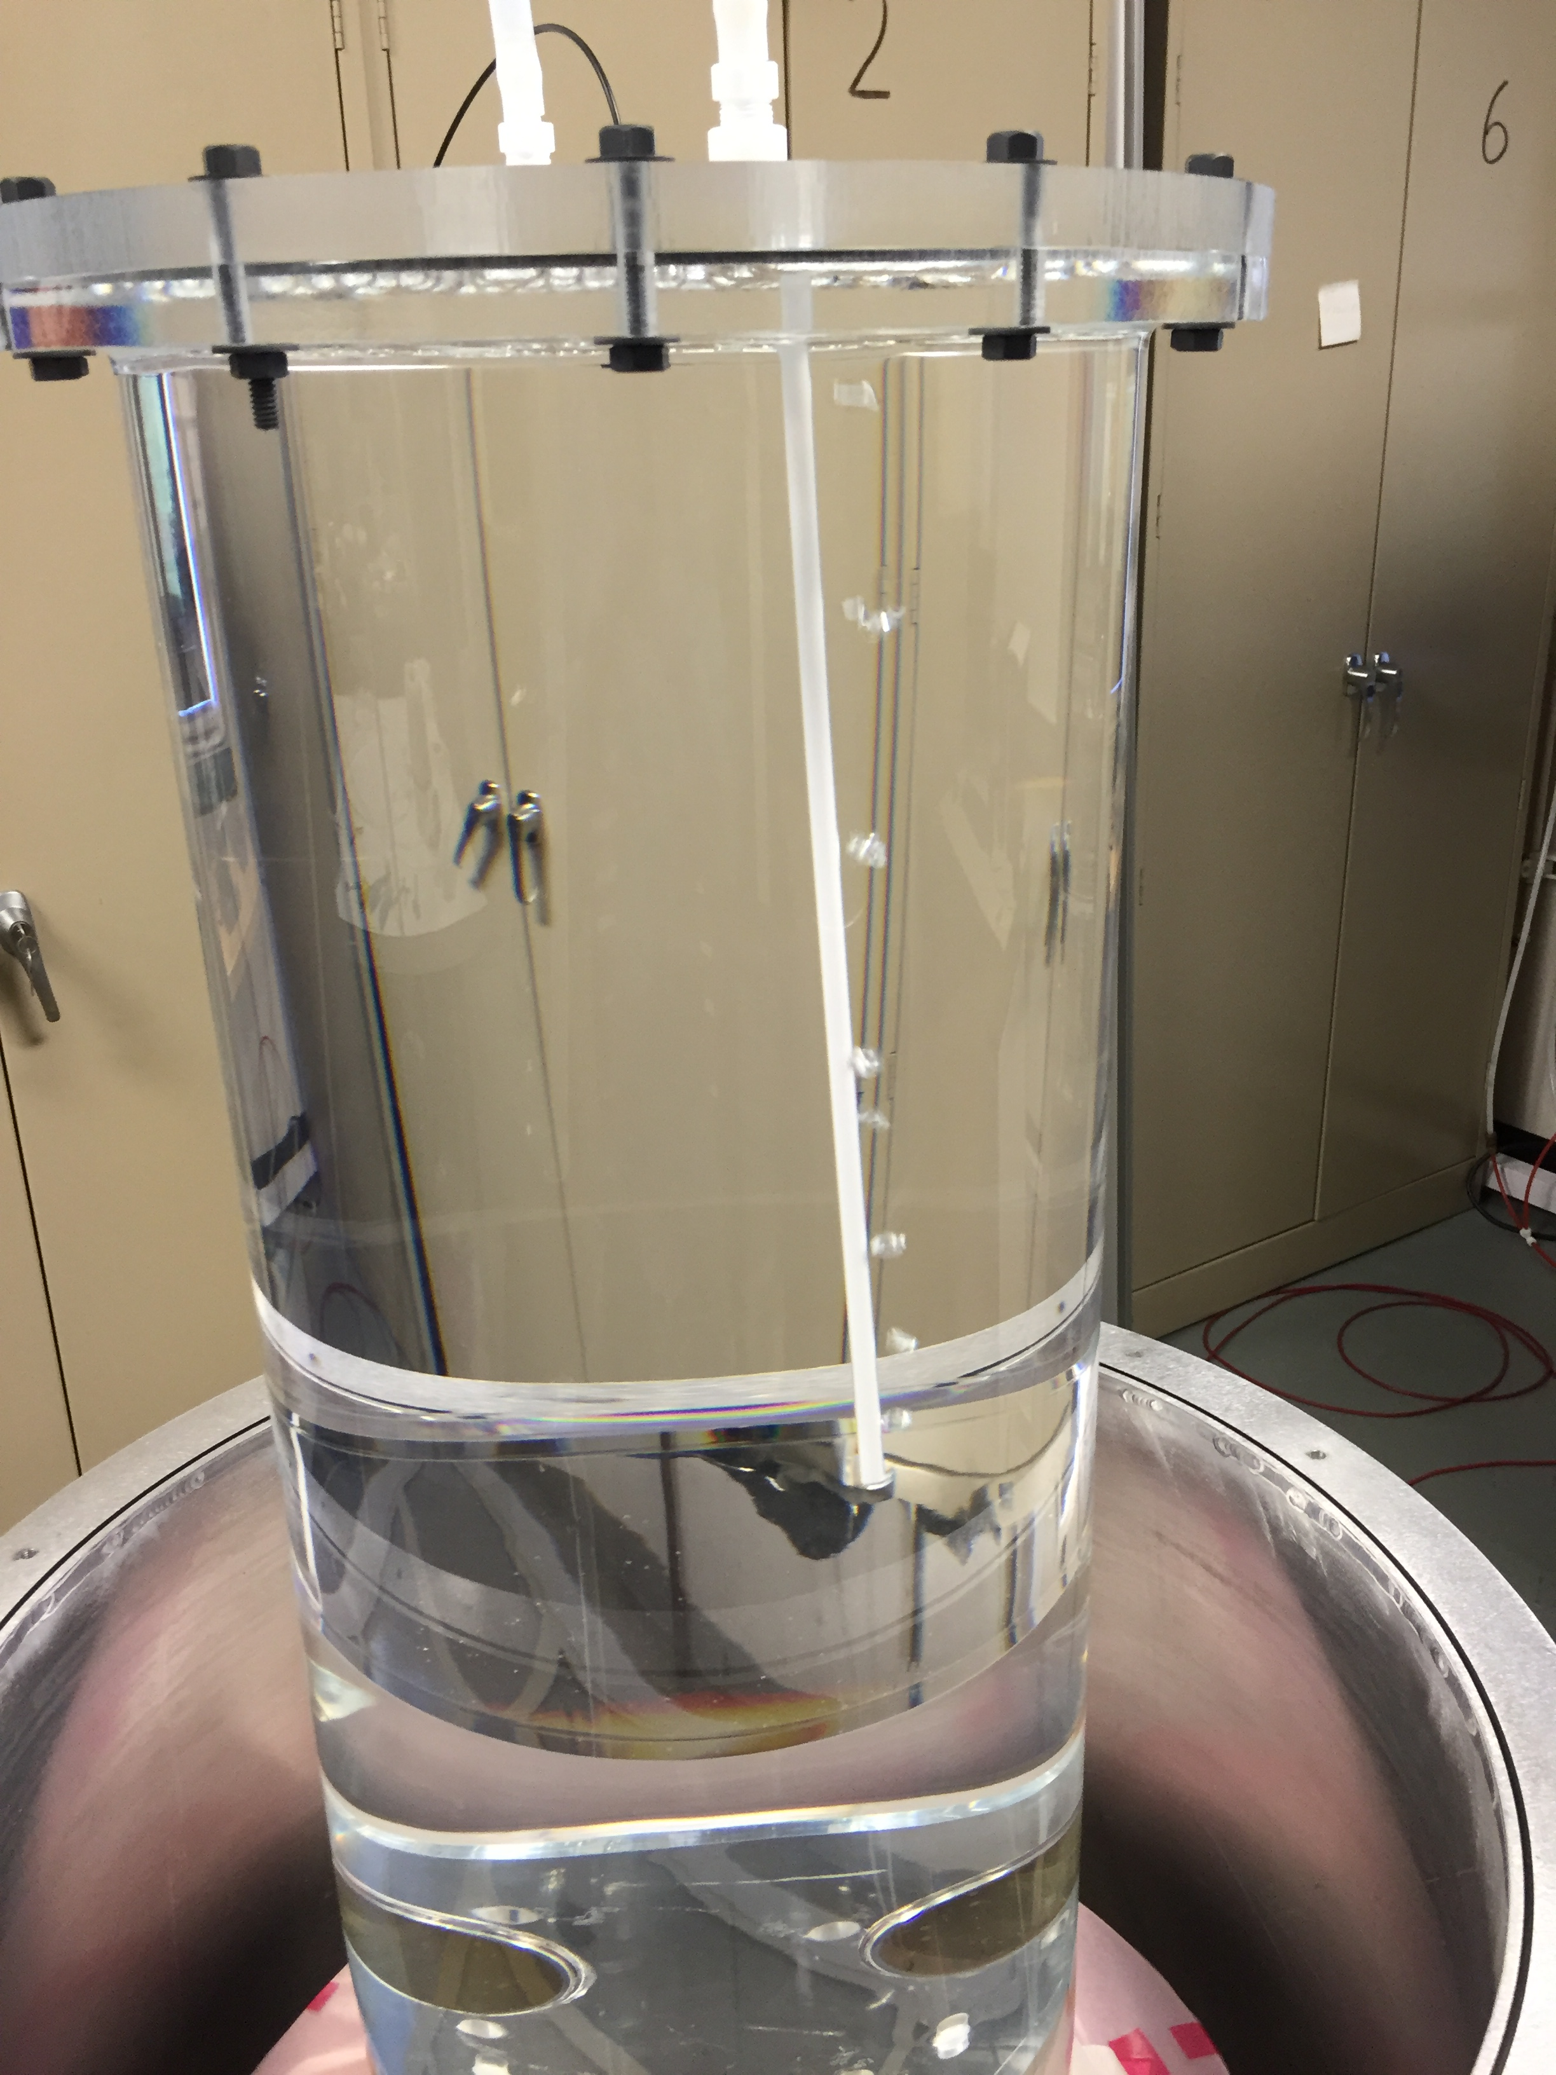
Thoron Calibration
Bubble N₂ past ²²⁸Th source into LS
Vents through concentric tubing to bubbler outside water tank
Testing at UCSB

Slide 21
1.06.04 – Gd-LS Impurities 2/20/2017
Yellow are measurements (ICPMS/HPGe), blue screener
Component | Raw Values (ppt) |  |  |  | Gram per Liter Gd-LS | 0.1% Gd-LS in veto (ppt)
 | ²³⁸U | ²³²Th | ⁴⁰K | ¹⁴C |  | ²³⁸U | ²³²Th | ⁴⁰K | ¹⁴C
LAB | 0.004 | 0.007 | 0.5 | 12 × 10⁻⁶ | 860 | 0.004 | 0.007 | 0.5 | 12 × 10⁻⁶
Gd | 100 | 100 | 52 |  | 0.86 | 0.17 | 0.17 | 0.09
PPO | 150 | 640 | 27 | 110 × 10⁻⁶ | 3 | 0.5 | 2.2 | 0.09 | 0.37 ×10⁻⁶
TMHA | 180 | 650 | 27 | 140 × 10⁻⁶ | 3 | 0.6 | 2.1 | 0.09 | 0.44 ×10⁻⁶
bis-MSB | 210 | 190 | 50 | 19 × 10⁻³ | 0.015 | 0.004 | 0.003 | 0.001 | 0.32 ×10⁻⁶
Total/Goal |  |  |  |  | 867.2 | 1.3 (≈3.1BiPo) | 4.5 | 0.8 | 13 (≈27)×10⁻⁶
Rate (Hz) |  |  |  |  |  | 3.75 | 3.75 | 3.75 | 3.75
Requirement |  |  |  |  |  | 10 | 20 | 3 | 15 × 10⁻⁶
Rate (Hz) |  |  |  |  |  | 30 | 17 | 14 | 4.3
Daya Bay |  |  |  |  |  | 20 | 4 | 7
Daya Bay levels from one-pass purification of Gd and PPO; ⁴⁰K from water or contamination
⁸⁵Kr – if like KAMLAND, <20 counts per day

