Slide 1




Searches for New Physics at the Large Hadron Collider
Lecture 3: odd things
Scottish Universities Summer School in Physics, St. Andrews, 19 August – 1 September 2012
Jeffrey D. Richman
Department of Physics
University of California, Santa Barbara

Slide 2
Outline
SUSY signatures with leptons; direct (EW) production of neutralinos & charginos
  Charginos hiding in plain sight?
Hiding SUSY (“exotic models”)
  Long lived particles (e.g., long-lived gluinos in split SUSY)
  R-parity violating SUSY searches
Large extra dimensions (monojets...)
Black holes
Conclusions

Slide 3
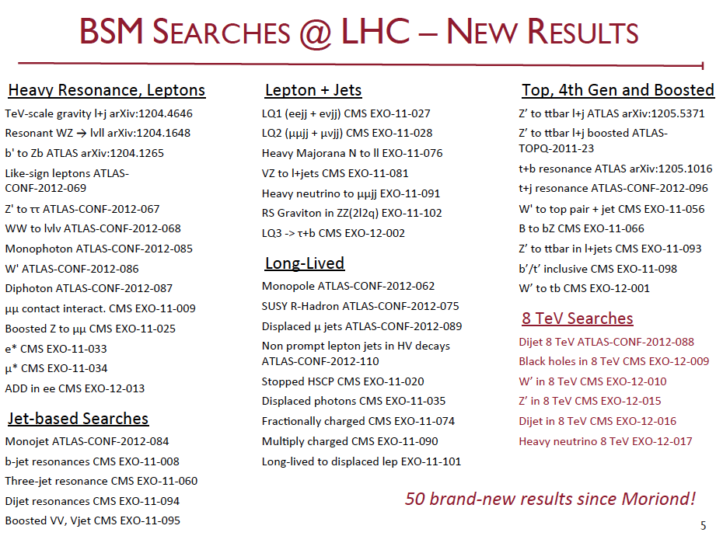
Exotica - from a review talk at ICHEP
Steve Worm – Searches for Physics Beyond the Standard Model, ICHEP
Several key topics covered in other talks at this school (e.g.,
SM physics): dijet mass & angular distrib, Z’ → l+l-, ttbar

Slide 4
Thinking about EW production (√s=8 TeV)
Courtesy T. Plehn (http://www.thphys.uni-heidelberg.de/~plehn/)

Slide 5
Thinking about EW production (√s=8 TeV)
As we push up the allowed mass range for the strongly interacting SUSY particles (gluinos & squarks), searches for potentially lower mass EW SUSY particles become competitive.
Courtesy T. Plehn (http://www.thphys.uni-heidelberg.de/~plehn/)

Slide 6
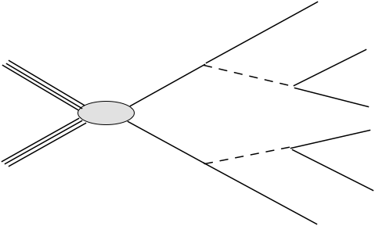
The famous neutralino dilepton cascade
Opposite-sign, same flavor leptons
The can be produced in any process, not just direct EW
production.

Slide 7
The famous SUSY trilepton signature
The can be produced in any process, not just direct EW
production. Extensive searches for trilepton signatures,
including tau leptons.

Slide 8
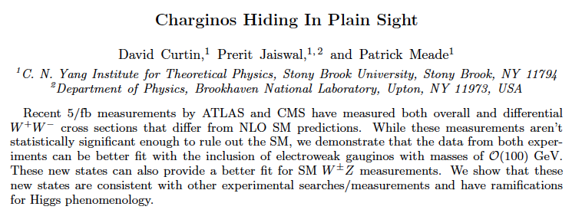
For amusement...
http://arxiv.org/abs/1206.6888
 | ATLAS: σ(pb) | CMS: σ(pb)
Measured cross sec. | 53.4 ±2.1± 4.5± 2.1 | 52.4 ±2.0 ±4.5± 1.2
Theory cross sec. NLO | 45.1±2.8 | 47.0±2.0

Slide 9
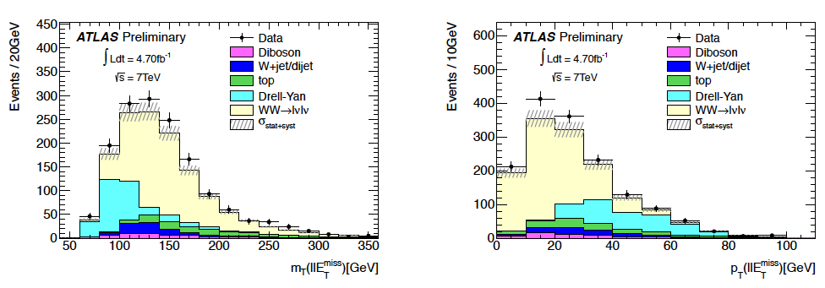
pp→W⁺W⁻ kinematic distributions
http://cdsweb.cern.ch/record/1430734/files/ATLAS-CONF-2012-025.pdf
Main selection requirements
Opposite-sign dileptons (ee, emu, mumu), leading lepton pT>25 GeV
No additional leptons
Exclude Z mass window (±15 GeV) for same flavor leptons
No jets with pT > 25 GeV (suppresses ttbar); no b-jets pT>20 GeV
ETmiss_Rel > 25 -55 GeV

Slide 10
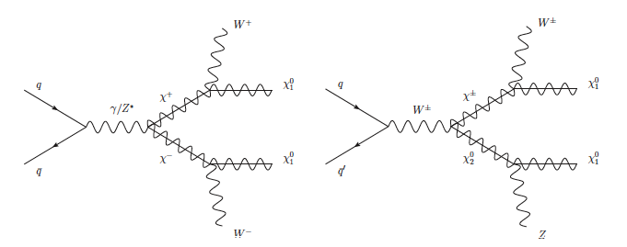
EWK SUSY can contribute a “background” to pp → W⁺W⁻
parameters used for plots

Slide 11
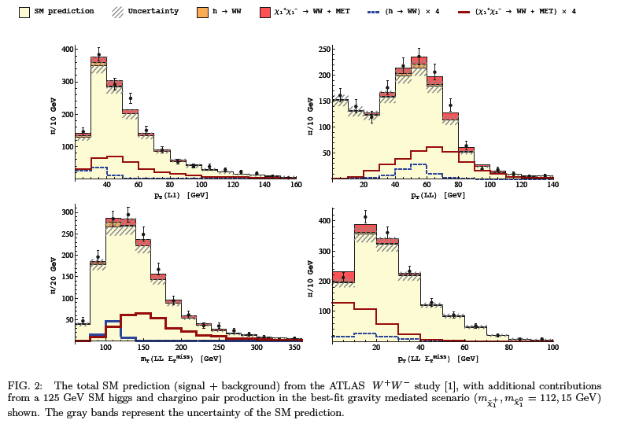
Excess in the W⁺W⁻ cross section?
http://arxiv.org/abs/1206.6888

Slide 12
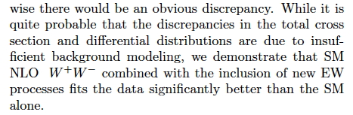
What does it mean?
I have no idea. First of all, it is a modest effect relative to the uncertainties.
Lots of reasons this could have nothing whatsoever to do with an additional physics process in the data.
But it does show that we have to be very careful about SUSY...it might appear in places that we are not expecting. We also have to be careful about our control samples.

Slide 13
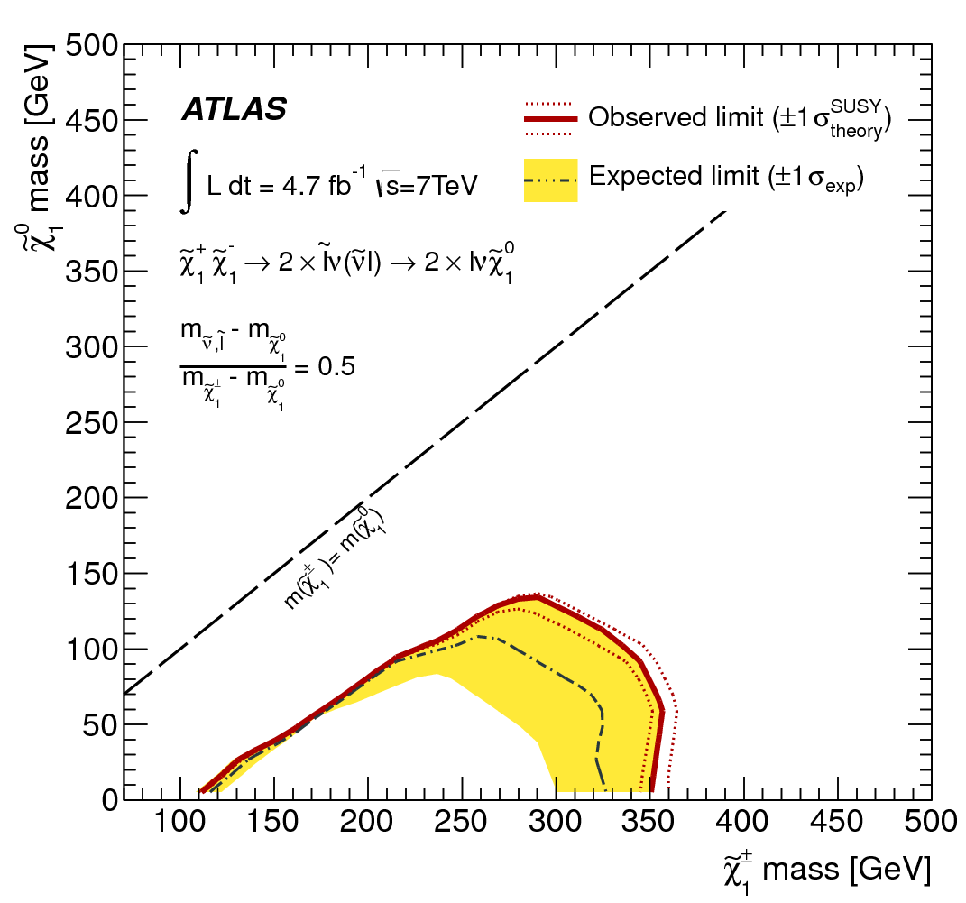
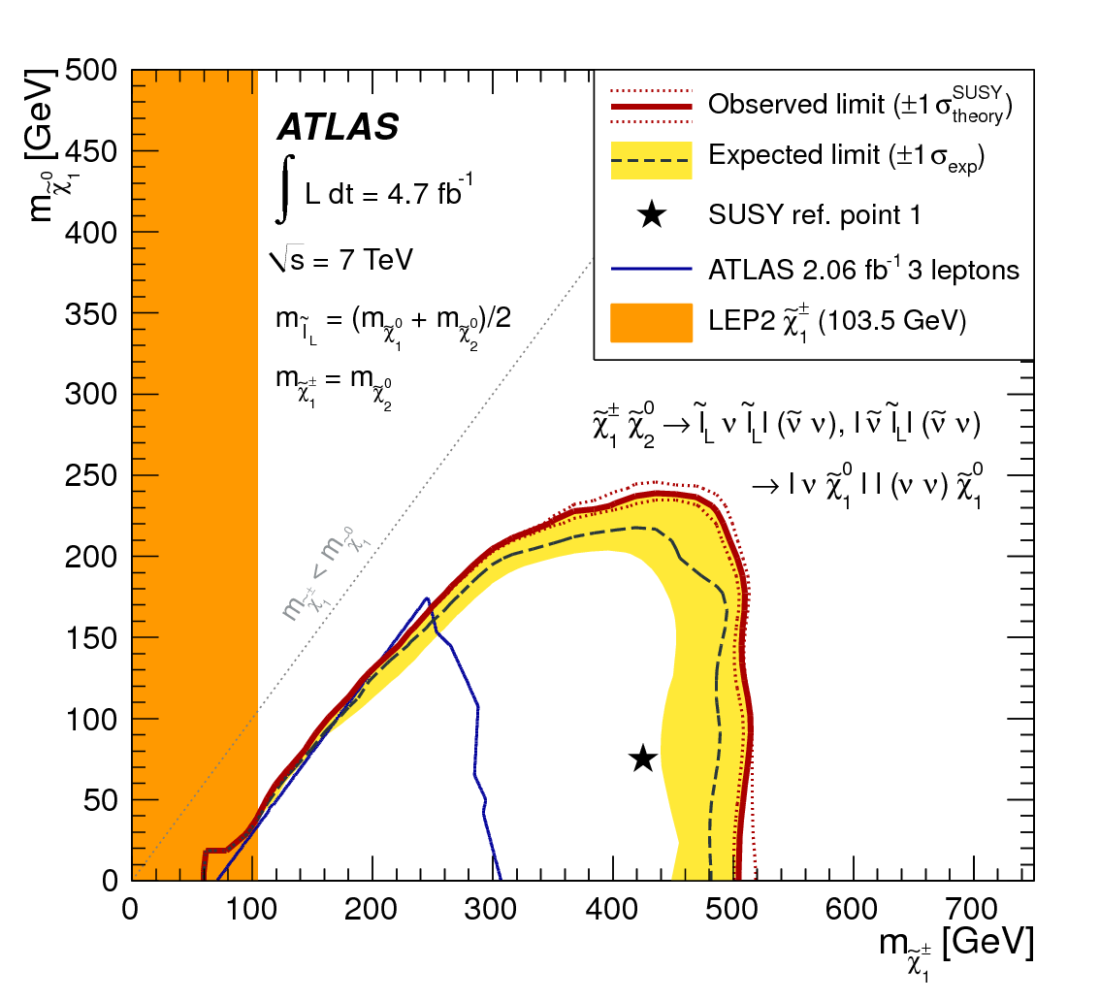
Direct gaugino searches (ATLAS, 7 TeV)
https://atlas.web.cern.ch/Atlas/GROUPS/PHYSICS/PAPERS/SUSY-2011-23/
https://atlas.web.cern.ch/Atlas/GROUPS/PHYSICS/PAPERS/SUSY-2012-13/
Combination of 2-lepton and 3-lepton searches for leptons produced in cascades starting from , , production.
Dilepton search
Trilepton search

Slide 14
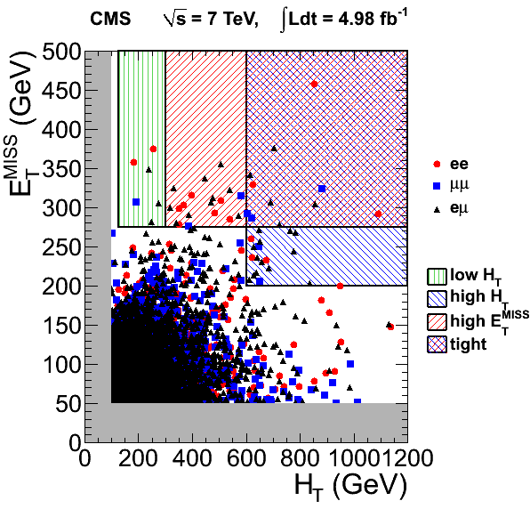
Opposite-sign dileptons + jets + MET
CMS SUS-11-011 http://arxiv.org/abs/arXiv:1206.3949
Event selection
2 opp-sign leptons
ee, μμ, eμ (control)
eτ, μτ (sep cuts)
≥2 jets, pT>30 GeV
pT(lep 1)>20 GeV
pT(lep 2)>10 GeV
HT>100 GeV, MET>50 GeV
Z veto region

Slide 15
The famous neutralino dilepton cascade
Opposite-sign, same flavor leptons
The dominant background (ttbar) produces different
flavor leptons as well → use eμ control sample!

Slide 16
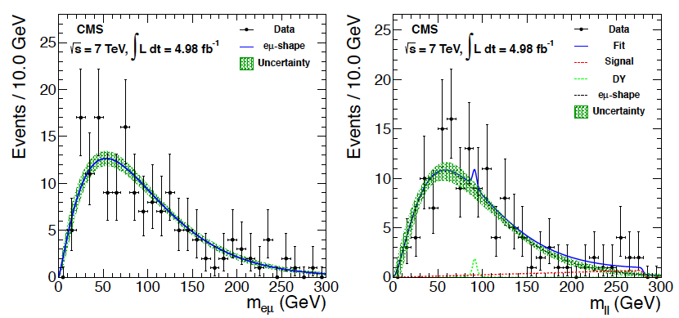
Opposite-sign dileptons: m(l⁺l⁻)
Fit signal and control regions jointly to shapes describing ttbar + DY + signal (smeared triangle).
signal region
eμ control region:
ttbar (+WW)
Signal contrib.
from fit (2.1 σ)
local signif.
Signal shape reflects kinematics of sequential two-body decay (m_{max}=280 GeV)

Slide 17
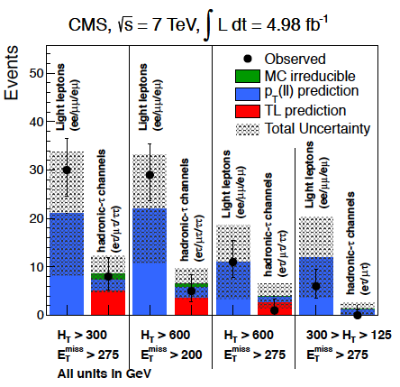
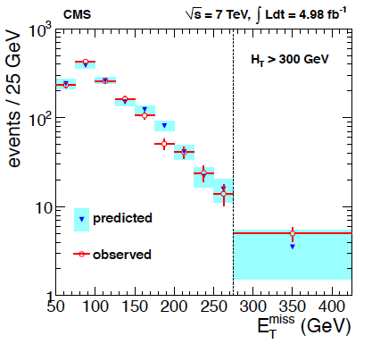
Opposite-sign dileptons: MET prediction
In SM events, can use lepton spectrum to predict the MET
spectrum! In general need suitable corrections for W polarization
in W+jets and ttbar, as well as resolution and threshold effects.

Slide 18
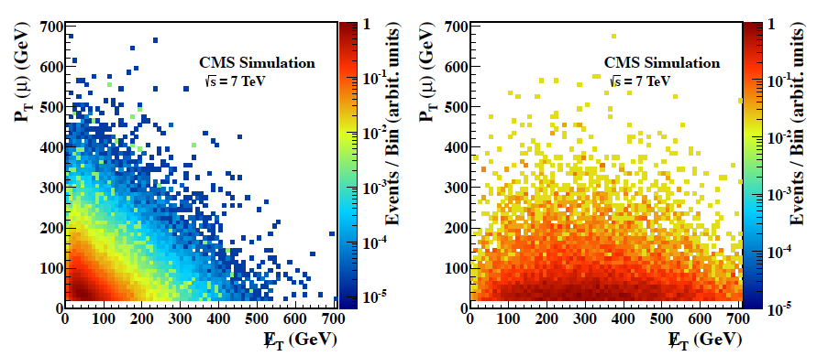
Using the lepton spectrum to predict MET in single-lepton events
CMS-PAS-SUS-12-010 http://cdsweb.cern.ch/record/1445275
In ttbar and W+jets events, the lepton & neutrino are produced together in W decay.
In many SUSY models the lepton and MET are decoupled. decoupled.

Slide 19
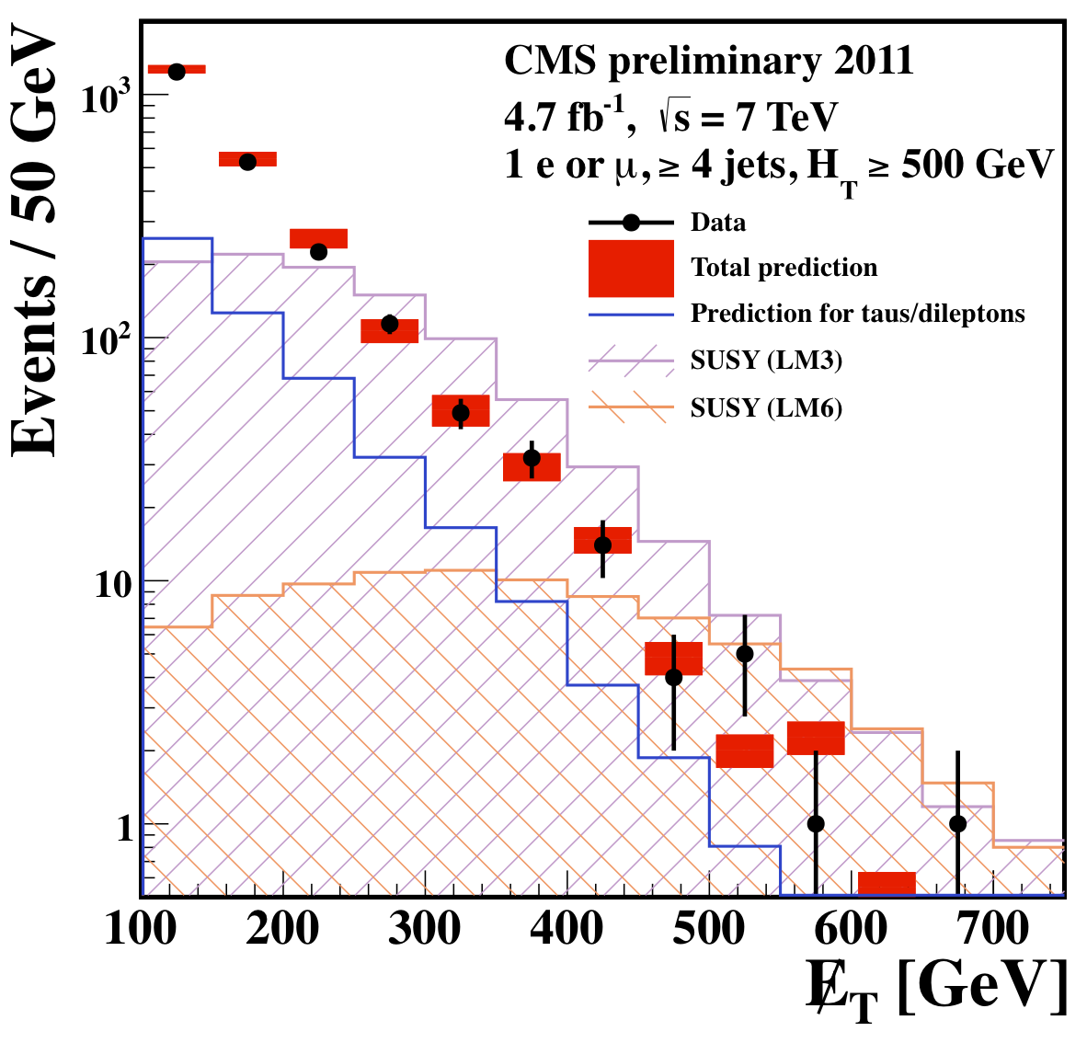
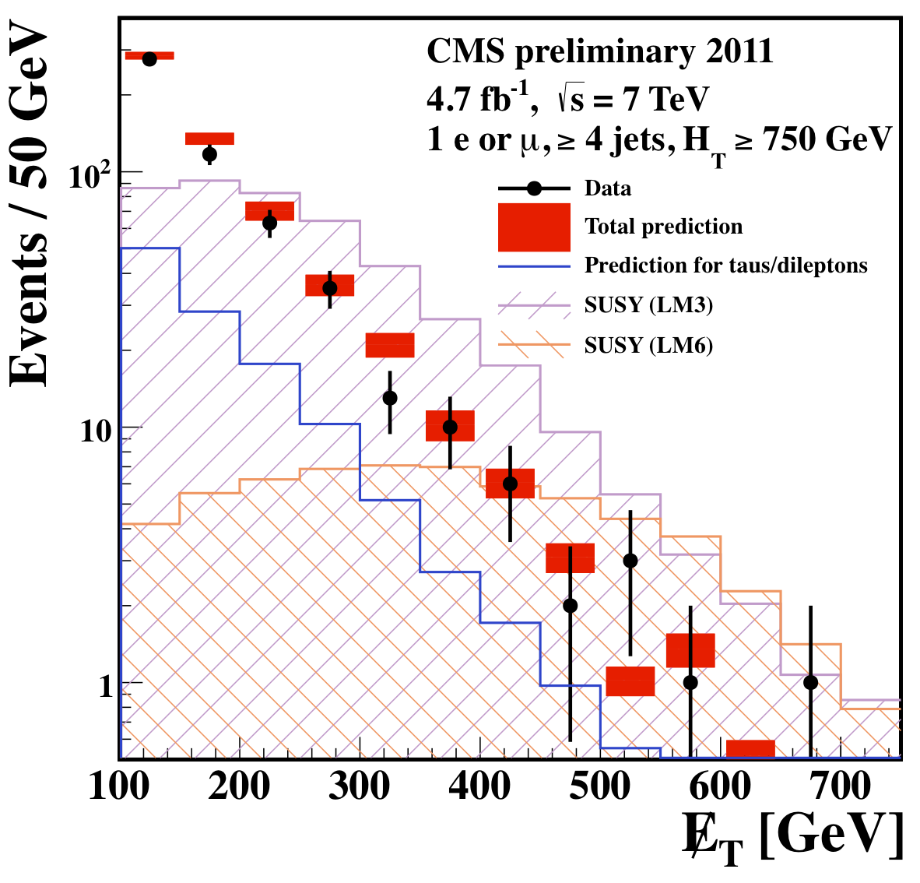
Using the lepton spectrum to predict MET in single-lepton events
CMS-PAS-SUS-12-010 http://cdsweb.cern.ch/record/1445275
The MET distribution for SM events is dominated by ttbar and W+jets.
The MET is dominated by the neutrino.
The neutrino spectrum can be predicted from the lepton spectrum, taking into account W polarization in both cases! MET resolution also included.

Slide 20
Search for long-lived, stopping particles
Imagine a particle that lives long enough that it does not decay during the beam crossing interval when it was produced, but stops in the detector!
It decays (asynchronously to beam X-ing.)
Such particles are predicted in several models.
Do we even trigger on events like this?
“If it didn’t trigger, it didn’t happen.”
  or it might as well not have happened...

Slide 21
Search for long-lived, stopping particles
Some references
M. J. Strassler and K. M. Zurek, “Echoes of a hidden valley at hadron colliders”, Phys. Lett. B 651 (2007) 374, arXiv:hep-ph/0604261.
N. Arkani-Hamed and S. Dimopoulos, “Supersymmetric unification without low energy supersymmetry and signatures for fine-tuning at the LHC”, JHEP 06 (2005) 073, arXiv:hep-th/0405159.
P. Gambino, G. F. Giudice, and P. Slavich, “Gluino decays in split supersymmetry”, Nucl. Phys. B 726 (2005) 35, arXiv:hep-ph/0506214.
R. Mackeprang and A. Rizzi, “Interactions of coloured heavy stable particles in matter”, Eur. Phys. J. C 50 (2007) 353, arXiv:hep-ph/0612161.

Slide 22
Example scenario: split SUSY
SUSY scalar particles (including
squarks) are at extremely high
mass scale
huge gap in Split SUSY
Compare with lifetime
of free neutron!
gluino
LHC energy scale
neutralino LSP

Slide 23
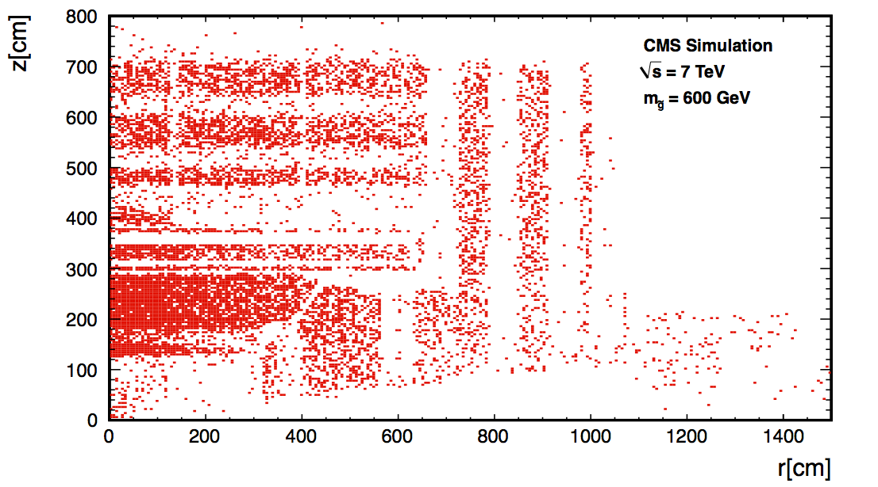
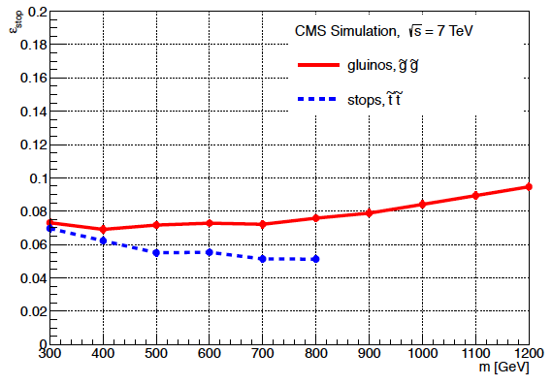
What happens to a long-lived gluino?
Hadronization turns gluino/stop into “R-hadron”
The R-hadron interacts with the material of the detector. Some fraction will stop, typically in the densest regons in the detector. Prob to stop ∼0.07.
Eventually the gluino decays.

Slide 24
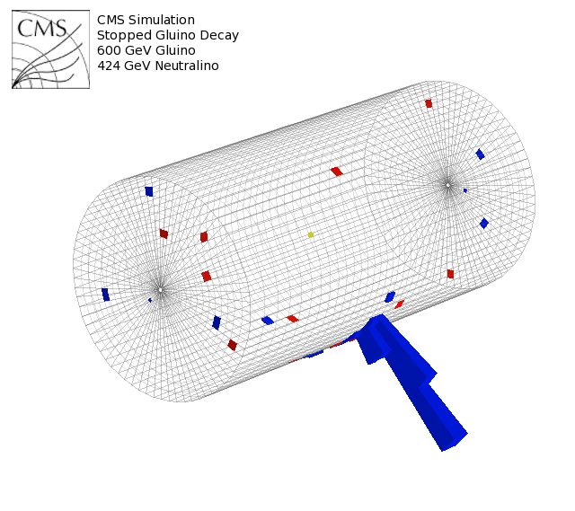
Gluino decay in hadronic calorimeter (MC)
Trigger = CALO cluster + no incoming p bunches + no muon segments
CMS simulation
Trigger: Calo jet ET>50 GeV + veto on signals from Beam Position and Timing Monitors (BPTX) 175 m on either side of CMS. Don’t want either proton bunch present (beam gas events can be produced with just one p bunch). Also veto on beam halo forward muon trigger.

Slide 25
Event selection for stopping particles
During 2011 run, number bunches/beam varied from 228 to 1380.
Select time intervals for analysis between bunch crossings.
Veto any event within two LHC clock cycles (BX= 25 ns) of either p bunch passing through CMS.
Get 85% of orbit time for 228 bunch fills; 16% of orbit for 1380 bunch fills for the search → 249 hours live time. LHC orbit period is 89 μs.
Cuts to reject beam halo muons, cosmics, HCAL noise. Final rate: (1.5 ± 2.5)×10⁻⁶ Hz.

Slide 26

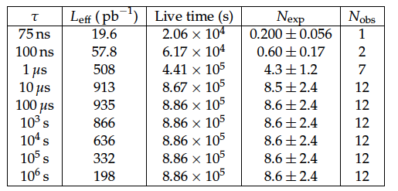
Stopped gluino search:
Background & observed yields
Estimate of background contributions over total live time.
Estimate of background contributions for live-time intervals chosen for each lifetime hypothesis.
For lifetimes
shorter than
one LHC revolution time,
search in an time window
of 1.3τ after beam xing.

Slide 27
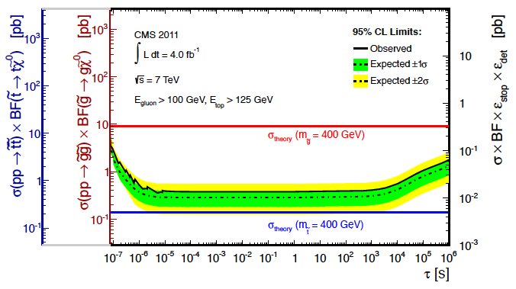
Cross section exclusion from stopped gluino search
Hypothetical lifetime

Slide 28
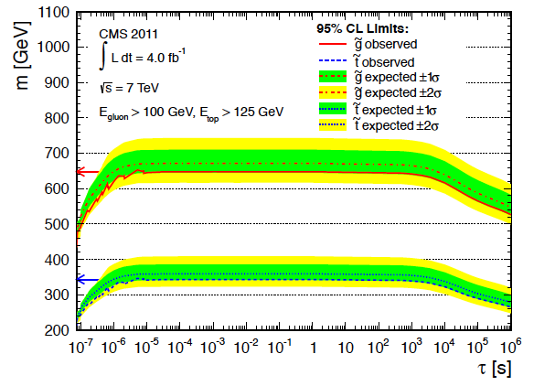
Mass limits on stopping and
Hypothetical lifetime

Slide 29
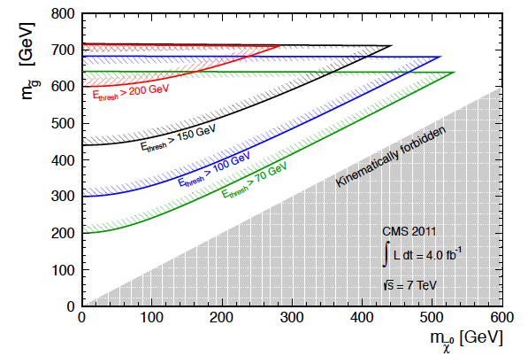
Mass exclusion from stopped gluino search

Slide 30
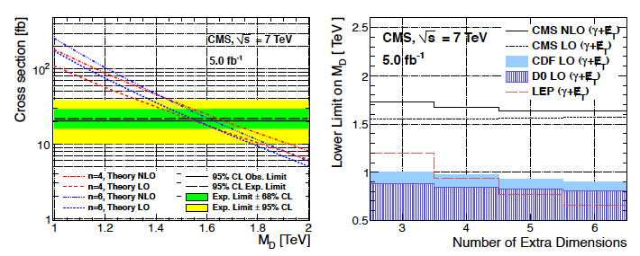
Monophoton search: interpretation in Large Extra Dimensions models
Try to explain difference between Planck and EW scales.
n extra compact spatial dimensions, characteristic scale R
Gravity propagates in the (4+n) dimensional bulk of space-time;
SM fields are confined to four dimensions. Graviton production
seen as missing momentum.

Slide 31
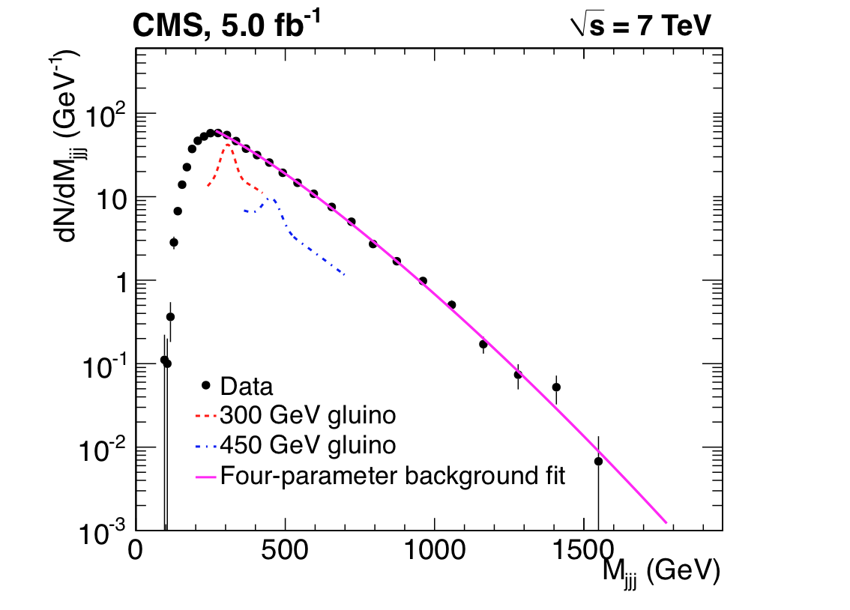
R-parity violating SUSY
CMS multilepton analysis: http://arxiv.org/abs/1204.5341
CMS three-jet search: https://twiki.cern.ch/twiki/bin/view/CMSPublic/PhysicsResultsEXO11060
What if SUSY violates R-parity?
Main issue: can have very little MET. Some existing SUSY searches with “strong” signatures can work with loose MET requirements (e.g., same-sign dileptons).
3 jet search
Excludes gluino masses
below ~460 GeV.

Slide 32
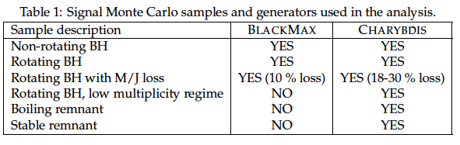
Search for “microscopic” black holes
CMS black hole search: http://arxiv.org/abs/1202.6396
Signature of low-scale quantum gravity.
But many different scenarios – small industry of simulations/models.
Physics of black hole formation and evaporation has several subtleties. (E.g., what fraction of the initial parton energy is trapped in the event horizon, rotating vs. non-rotating, etc.)

Slide 33
Search for microscopic black holes
Object selection is simple
  Leptons (e, mu): pT> 50 GeV
  Photons (e, mu): pT> 50 GeV
  Jets: pT>50 GeV
  Nonoverlapping in cone ΔR=0.3.
Compute total scalar sum of transverse momenta in the event.
Study S_{T} as a function of object multiplicity, which does not include MET.

Slide 34
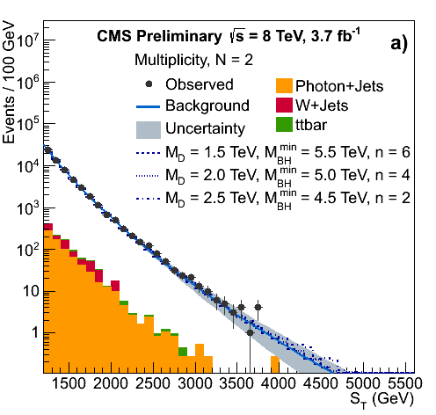
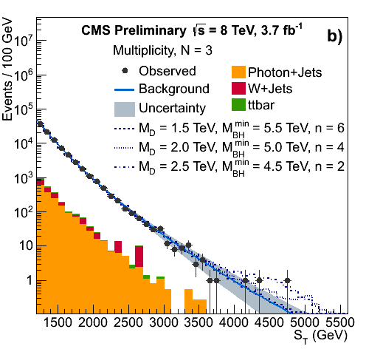
Black holes: background estimation
CMS black hole search: http://arxiv.org/abs/1202.6396
Background shape is obtained from fit to low-multiplicity (N) events and
restricting S_{T} to range 1200 < S_{T} < 2800 GeV.
Shapes in N=2 and N=3 samples are very similar.
Dedicated search for new physics in N=2 sample shows no signal.

Slide 35
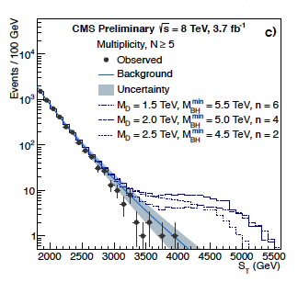
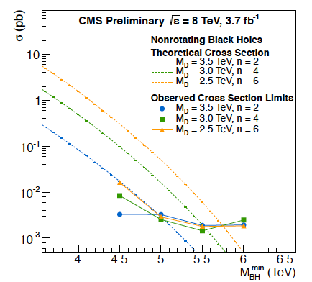
Search for microscopic black holes
Example of high-multiplicity sample
Cross sections vs. black hole mass
750 MC samples for the signal scenarios considered...
Excluding black hole masses below 4-6 TeV.

Slide 36
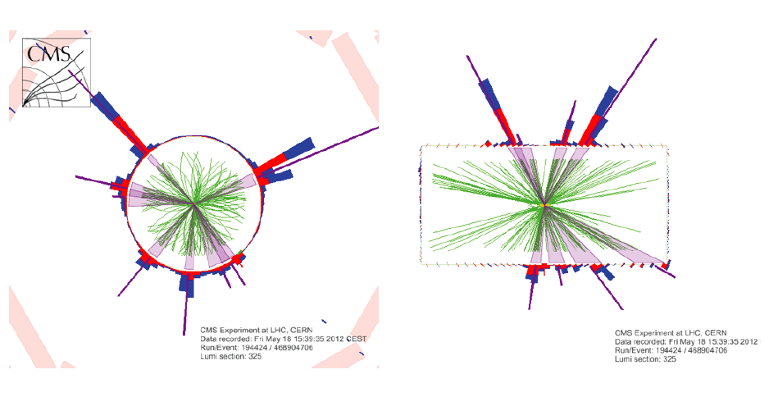
Black hole search: high ST event

Slide 37
Conclusions
This is a unique period in the history of particle physics.
We don’t know what we will discover – that is the fundamental nature of science.
There are no guarantees, but the potential for breakthroughs has never been greater.
Your work and leadership are critical to the future of high energy physics.
Many thanks to all the organizers, staff, postdocs, and students!

Slide 38
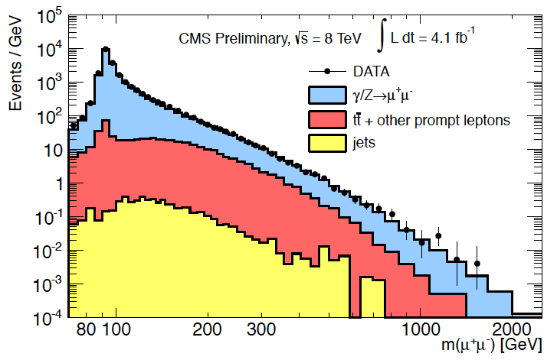
Search for Z’ → e⁺e⁻, μ⁺μ⁻

Slide 39
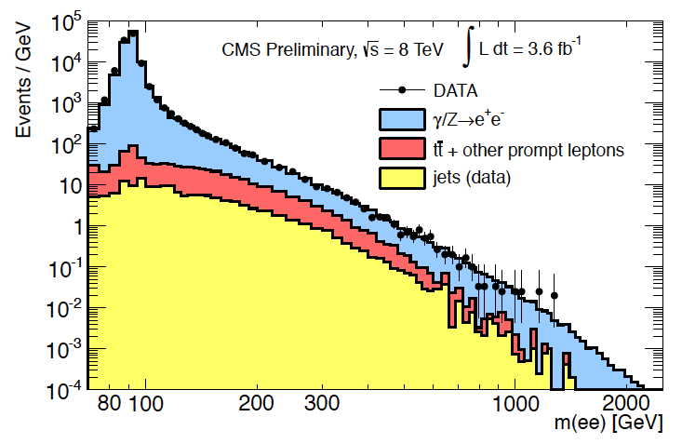
Search for Z’ → e⁺e⁻, μ⁺μ⁻

Slide 40
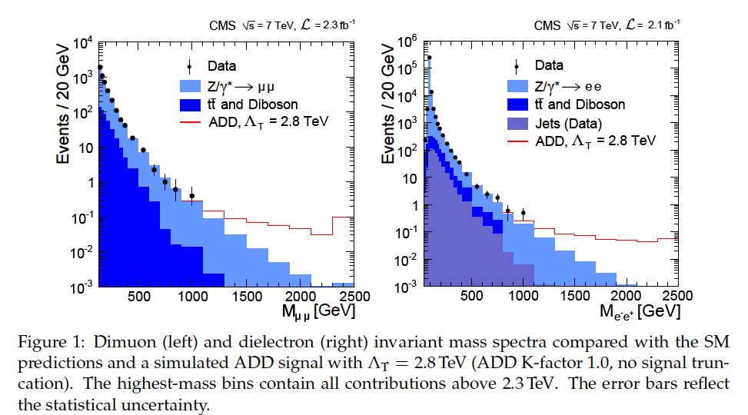
Data with simulated ADD signal

