Slide 1




Searches for New Physics at the Large Hadron Collider
Lecture 2: The Search for Supersymmetry
Scottish Universities Summer School in Physics, St. Andrews, 19 August – 1 September 2012
Jeffrey D. Richman
Department of Physics
University of California, Santa Barbara

Slide 2
Searching for SUSY
SUSY is not one thing: it is a very broad collection of models. Many different signatures and an extensive range of analysis approaches.
Most signatures are not “strong”. For the most part, no sharp peaks.
Nearly all analyses can be criticized. If you look carefully, you will find weak points.
Redundancy and multiple, cross-checking analyses using different methods are valuable (essential) if we are going to believe that an excess of events corresponds to new physics.

Slide 3
SUSY Outline
Inclusive SUSY searches based on topologies
  Methods for SUSY interpretation
Searches motivated by “naturalness” (3rd generation squarks and not too heavy gluinos)
Direct production of neutralinos & charginos
Hiding SUSY (“exotic models”)
  Long lived particles (e.g., long-lived gluinos in split SUSY)
  R-parity-violating SUSY
In Lecture 3
(See Lec 1 for monojet, monophoton discussion. )

Slide 4
ATLAS SUSY Results
There is a lot of territory here...
Mass scale (TeV)

Slide 5
ATLAS SUSY Results
Inclusive searches
3rd gen., gluon mediated
3rd gen., direct production
Electroweak SUSY direct production
Long-lived particles
R-parity violating SUSY
Other...monojets, etc.
Prev.
lecture
But it’s not as scary as it looks: a few basic ideas, many channels

Slide 6
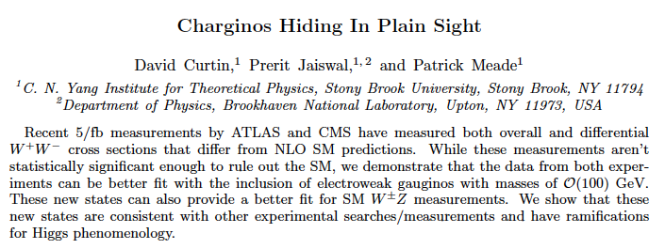
This year could be very interesting...or not!
http://arxiv.org/abs/1206.6888v1
Come back to this in next lecture.

Slide 7
SUSY particle production at √s=8 TeV
Courtesy T. Plehn (http://www.thphys.uni-heidelberg.de/~plehn/)

Slide 8
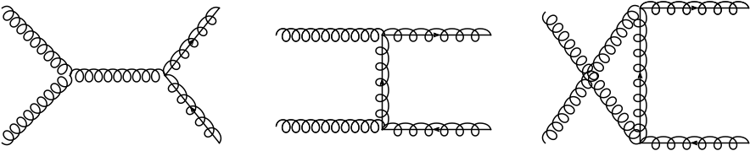
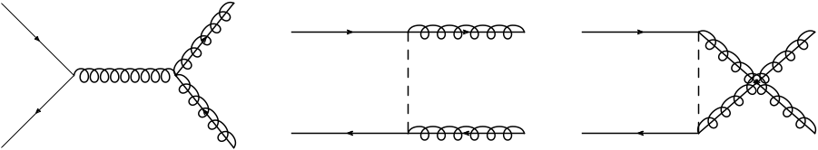
Gluino production in pp collisions
For production cross section calculations, the squark masses are often taken to be
arbitrarily large – the “decoupling limit”.

Slide 9
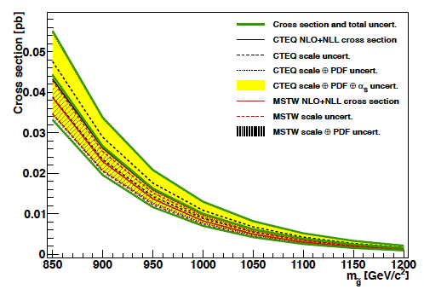
Gluino pair production (√s=7 TeV)
M. Kramer et al., http://arXiv/abs/1206.2892
Calculated assuming all squarks have high mass & decouple.

Slide 10
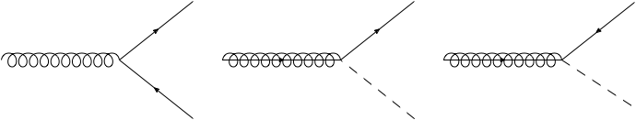
Gluinos: fundamental vertices with squarks
SUSY preserves the gauge symmetries, so the SUSY partners of the gluons must also transform according to the 8-dimensional representation of SU(3)_{C}.
Fundamental vertex for has same coupling strength as that for .
SUSY

Slide 11
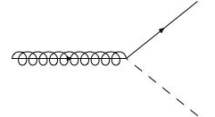
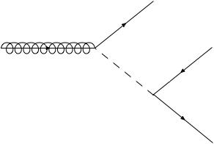
Gluino decays to lighter and heavier squarks
Two cases
2-body decay
3-body decay
(suppressed)
3-body decay is analogous to weak decay of low mass fermions, e.g., b → c l ν via a virtual W.

Slide 12
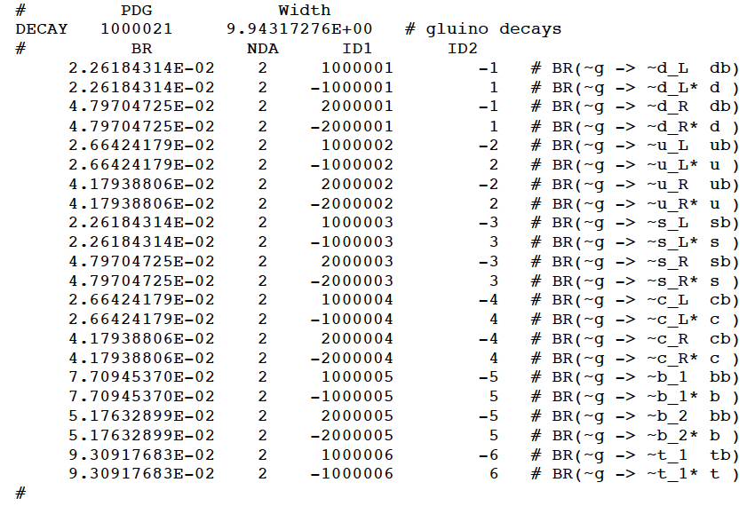
Decay table for gluinos in LM6
Number decay modes = 4x(5 flavors) + 2 = 22 That’s a lot!

Slide 13
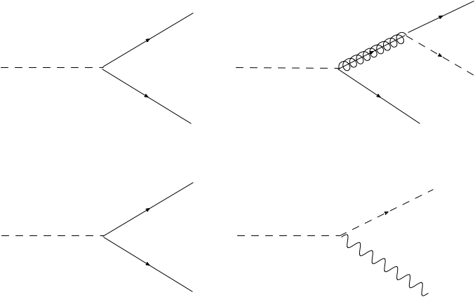
Squark decay
decay to/via neutralino
decay to/via gluino
decay to/via chargino
decay to/via W, Z, h

Slide 14
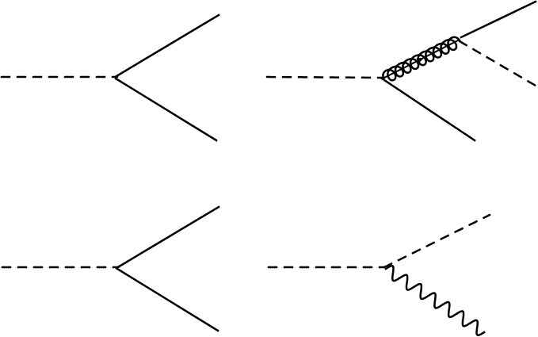

Slide 15
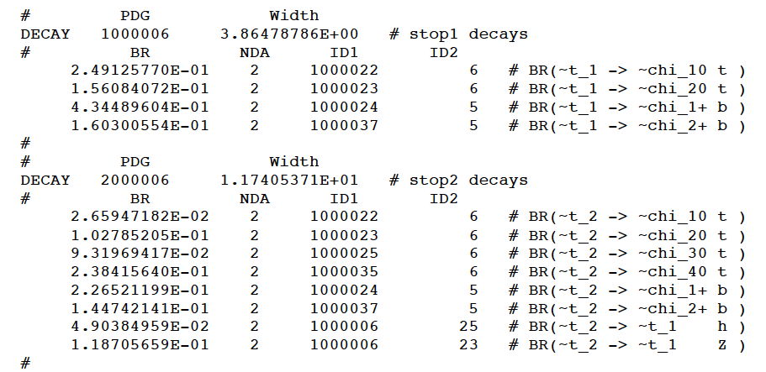
Decay tables for stop 1,2 in LM6

Slide 16
Starting from gluinos...
SUSY LM6
benchmark
Direct
production
via strong
processes
Nobody knows how many
squarks would be lighter than the gluino:
maybe 0, 1, 2, 3,???
e.g., split supersymmetry!
Direct
production
via electroweak
processes
neutralino
(LSP)

Slide 17
Things can start to get complicated
SUSY LM6
benchmark
Direct
production
via strong
processes
Direct
production
via electroweak
processes
neutralino
(LSP)
Things can get pretty complicated...and there are many scenarios!

Slide 18
Strategy for SUSY with complex decay patterns
Complex decay patterns, not dominated by any one (or even few) modes, can emerge in many models.
Inclusive search strategies, based on simple topological signatures are well suited to such cases.
Inclusive searches (can require b jets in all cases)
  Jets + MET (or similar variable)
  1 lepton + Jets + MET
  Dileptons + Jets + MET (same- or opp-sign dileptons)
  Single photon + jets + MET
  Two photons + jets + MET
Also on the menu: can add
b-jets, tau leptons to most items! Opp. sign dileptons: can add Z bosons.

Slide 19
CMS: Multijets + MHT search (7 TeV)
CMS, http://arxiv.org/pdf/1207.1898.pdf
Search variables:
Require ≥3 jets, pT>50 GeV, |η|<2.5
ttbar, W+jets suppression: veto events with isolated leptons with pT>10 GeV.
QCD suppression: veto events with Δφ(MET, Jet1)<0.5. Similar cuts for Jet2, Jet3.
Why not use MET?
Data-driven method
for QCD background
uses jet-smearing
method!

Slide 20
Background schematic for searches with MET
Key Background Processes
QCD multijet
production
W+jets
W→lep
Z/DY+ jets Z→νν
ttbar + jets
ttbar →1 lep
ttbar + jets
ttbar →2 lep
QCD: Fake MET from mismeasured jet is usually aligned with jet & dominated by single jet.
Also true for b→c l ν.
Key Search Channels
Jets + MET
(all-hadronic SUSY search)
Jets + 1 lepton
+ MET
Jets +Opp sign
dileptons + MET
Jets +Same sign
dileptons + MET

Slide 21
Background schematic for searches with MET
Key Background Processes
QCD multijet
production
W+jets
W→lep
Z/DY+ jets Z→νν
ttbar + jets
ttbar →1 lep
ttbar + jets
ttbar →2 lep
Real MET from W→ l ν, l = (e, μ),
W→τ ν; τ→(e, μ)
W→τ ν; τ→jets
...with leptons
below pT thresh.
escaping isol veto
not reconstructed
Key Search Channels
Jets + MET
(all-hadronic SUSY search)
Jets + 1 lepton
+ MET
Jets +Opp sign
dileptons + MET
Jets +Same sign
dileptons + MET

Slide 22
Background schematic for searches with MET
Key Background Processes
QCD multijet
production
W+jets
W→lep
Z/DY+ jets Z→νν
ttbar + jets
ttbar →1 lep
ttbar + jets
ttbar →2 lep
Real MET from νν →“Irreducible background”.
Measured using
Z→l⁺l⁻ or
gamma + jets
Key Search Channels
Jets + MET
(all-hadronic SUSY search)
Jets + 1 lepton
+ MET
Jets +Opp sign
dileptons + MET
Jets +Same sign
dileptons + MET

Slide 23

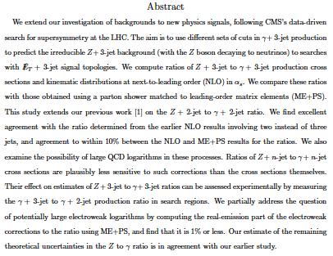
http://arxiv.org/pdf/1206.6064.pdf

Slide 24
Background schematic for searches with MET
Key Background Processes
QCD multijet
production
W+jets
W→lep
Z/DY+ jets Z→νν
ttbar + jets
ttbar →1 lep
ttbar + jets
ttbar →2 lep
Lost lepton (real MET from ν)
Real MET from W→ l ν, l = (e, μ),
W→τ ν; τ→(e, μ)
W→τ ν; τ→jets
Key Search Channels
Jets + MET
(all-hadronic SUSY search)
Jets + 1 lepton
+ MET
Jets +Opp sign
dileptons + MET
Jets +Same sign
dileptons + MET

Slide 25
Background schematic for searches with MET
Key Background Processes
QCD multijet
production
W+jets
W→lep
Z/DY+ jets Z→νν
ttbar + jets
ttbar →1 lep
ttbar + jets
ttbar →2 lep
Lots of MET, but hard to lose 2 leptons;
Also has fewer jets.
Key Search Channels
Jets + MET
(all-hadronic SUSY search)
Jets + 1 lepton
+ MET
Jets +Opp sign
dileptons + MET
Jets +Same sign
dileptons + MET

Slide 26
CMS inclusive jets + MHT search
http://arxiv.org/pdf/1207.1898.pdf
Distributions of HT and HTmiss for events passing the baseline selection
Backgrounds are from data-driven estimates, not MC.
SUSY LM5
benchmark
model
(overlaid)
Compare QCD behavior!
LM5: m0 = 230 GeV, m1/2 = 360 GeV, A0 = 0, tan b = 10, and sgn(m) > 0

Slide 27
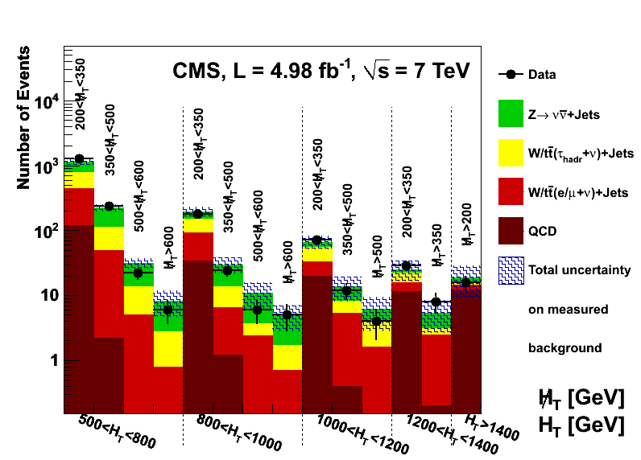
Yields vs. predictions by signal region
full MHT range
full MHT range

Slide 28
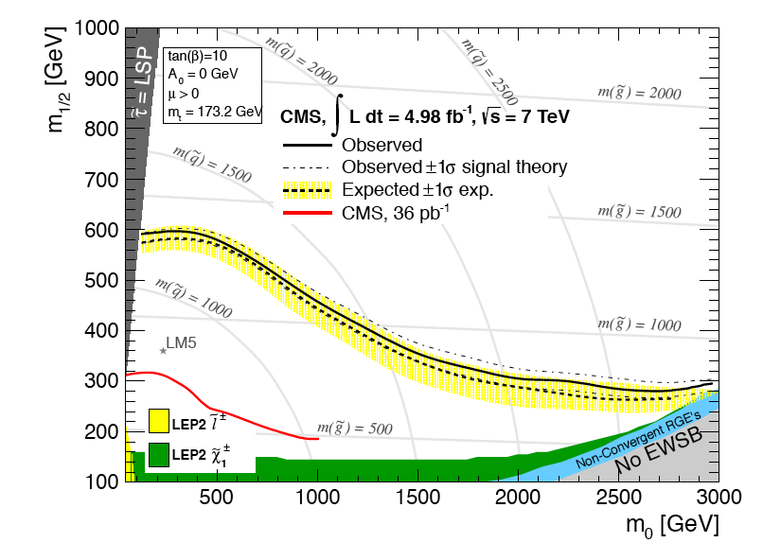
cMSSM exclusion region for jets + MHT search
For this cMSSM
param set, squark
masses below 1.2 TeV and gluino masses below 720 GeV are excluded.
But these conclusions
are not generic...
Must be extremely careful about drawing broad conclusions from cMSSM!
In the cMSSM/mSUGRA, the gluino mass can’t be too far above the squark masses.

Slide 29
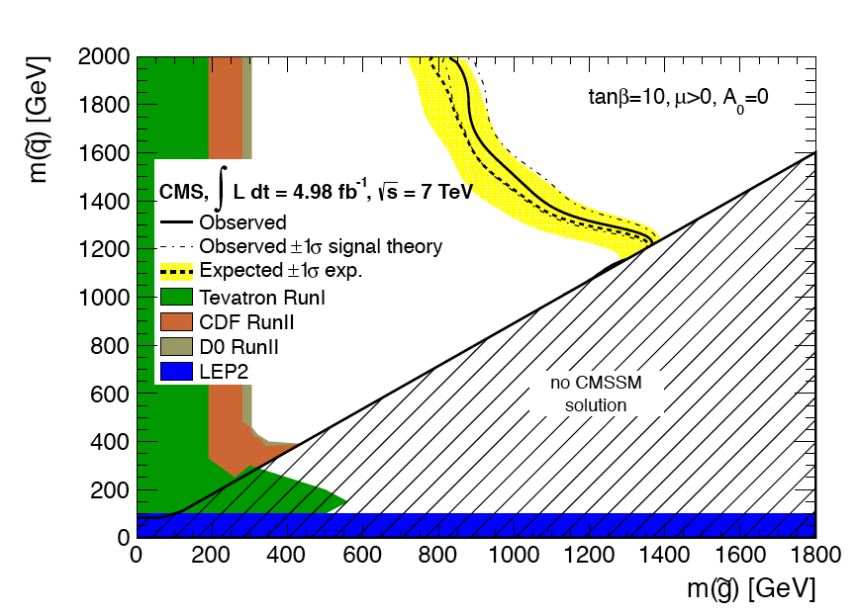
Constraints in the m( ) vs. m( ) plane

Slide 30
Limitations of cMSSM interpretation
People liked cMSSM because it reduced 105 parameters to just 5, defined at the GUT scale:
  common sfermion mass: m₀
  common gaugino mass: m_{1/2}
  common trilinear coupling A₀
  ratio of vac. expectation values for up-type & down-type fermions: tanβ
  sign of Higgsino mass parameter: μ
The interpretation of SUSY results in terms of cMSSM/mSUGRA parameter space is considered ~obsolete.
The cMSSM incorporates contraints at the GUT scale that are not well motivated. These can lead to spectra that are not sufficiently generic for searches.
great for making
pretty plots!

Slide 31
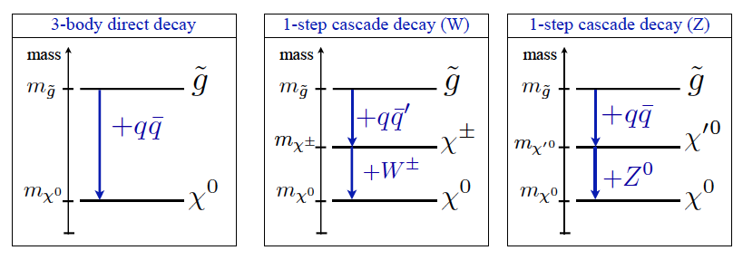
Simplified models: a new paradigm
http://arxiv.org/abs/1105.2838
To reduce the number of NP parameters, use very simple particle spectra. Masses specified at EW scale.
Each model based on an effective Lagrangian relevant for a particular process of interest.
Experimenters establish upper limits on the cross section for the simplified model, for given masses.

Slide 32
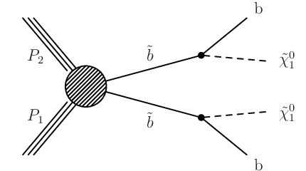
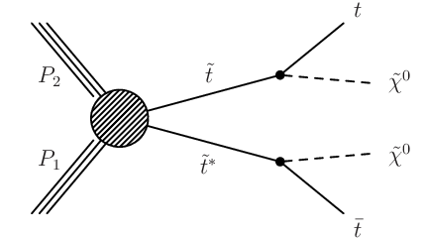
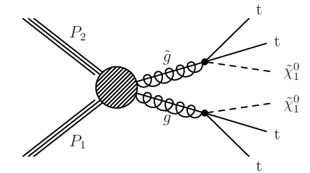
Simplified models: examples
T2bb
T2tt
T1bbbb
T1tttt
Tn=Topology n; n= even → squark production (gluino decoupled);
n=odd → gluino production (squark decoupled); see CMS PAS SUS-11-016.
http://cdsweb.cern.ch/record/1445580.

Slide 33
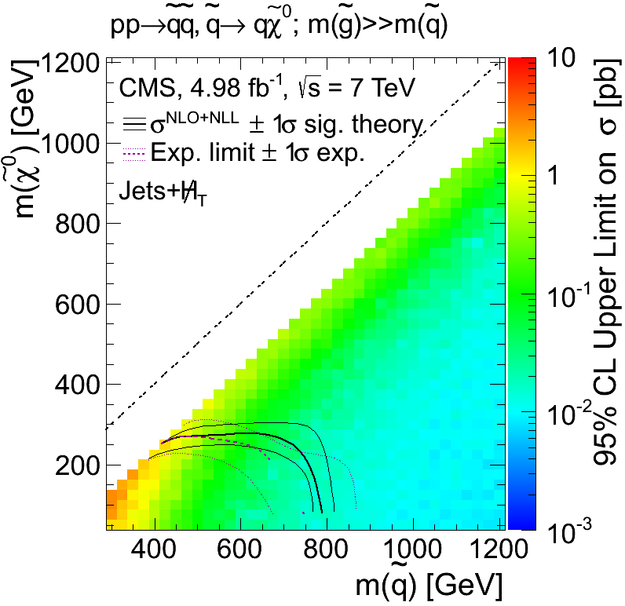
Simplified model interpretation:
CMS jets + MHT (7 TeV)
Gluino production with 3-body decay
Direct squark production with
2-body decay to LSP
Small mass splitting
Generic turn-over as
spectrum compresses!
(→softer jets, softer
MET spectrum)
→ less sensitivity.
ISR modeling crtical for this region
Expt limit
Paradigm shift: now quote the upper limit on the cross section for the given topology.

Slide 34
Inclusive SUSY searches with leptons
The decay of squarks can produce neutralinos, charginos, W and Z bosons. All of these can produce leptons.
Leptons are your friends.
Lepton isolation is a powerful tool for suppressing QCD background and for measuring how much remains.
ttbar is almost always a key background.
W, Z are more important for low numbers of jets.
b tagging suppresses W, Z.

Slide 35
Starting from gluinos...
SUSY LM6
benchmark
neutralino
(LSP)

Slide 36
Decays of ~t₂ → neutralinos, charginos, Z...
SUSY LM6
benchmark
neutralino
(LSP)

Slide 37
Decays of ~t₁ → neutralinos, charginos
SUSY LM6
benchmark
neutralino
(LSP)

Slide 38
Decays of : here come the leptons!
SUSY LM6
benchmark
neutralino
(LSP)

Slide 39
Decays of : more leptons!
SUSY LM6
benchmark
neutralino
(LSP)

Slide 40
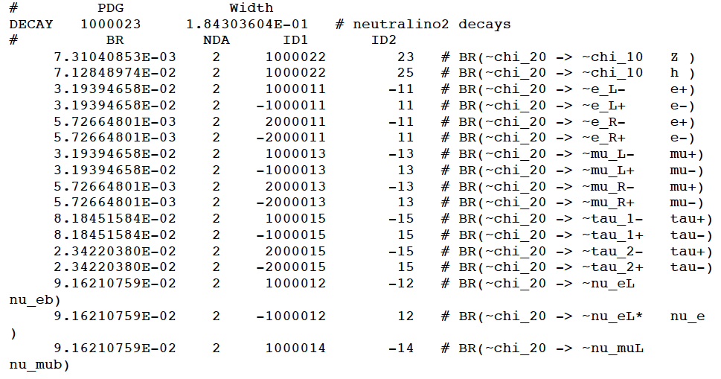
Decay table for in LM6
continued

Slide 41
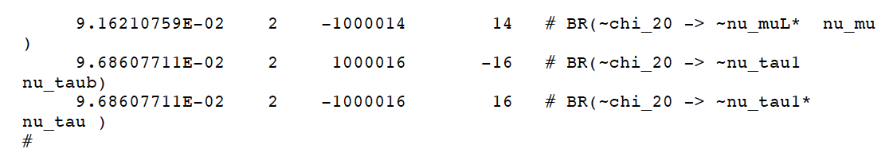
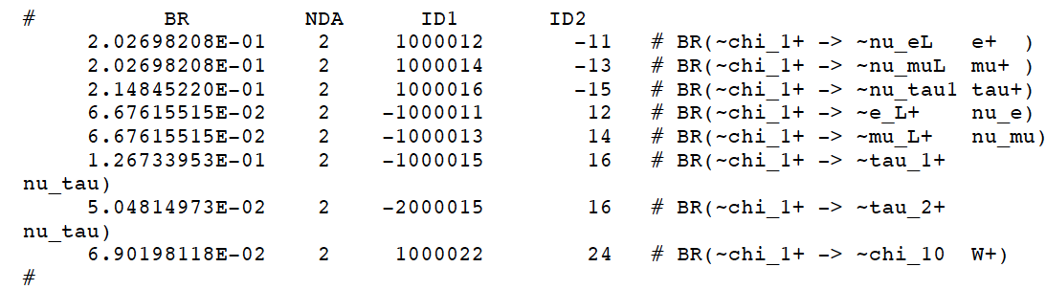
Decay table for in LM6
(continued)
Decay table for in LM6

Slide 42
ATLAS: Multijets + 1 lepton + MET (8 TeV)
ATLAS, http://atlas.web.cern.ch/Atlas/GROUPS/PHYSICS/CONFNOTES/ATLAS-CONF-2012-104/
Search variables:
Require ≥4 jets, pT>80 GeV, 1 isolated lepton pT>25 GeV
M_{T}(l, MET)>100 GeV: suppresses single-lepton SM
Veto event if has 2nd lepton pT>10 GeV
Suppresses ttbar dileptons. Separate 1 lep & 2 lep meas.
Perform fit to data in signal and control regions.
(many thanks to Jeannette Lorenz!)

Slide 43
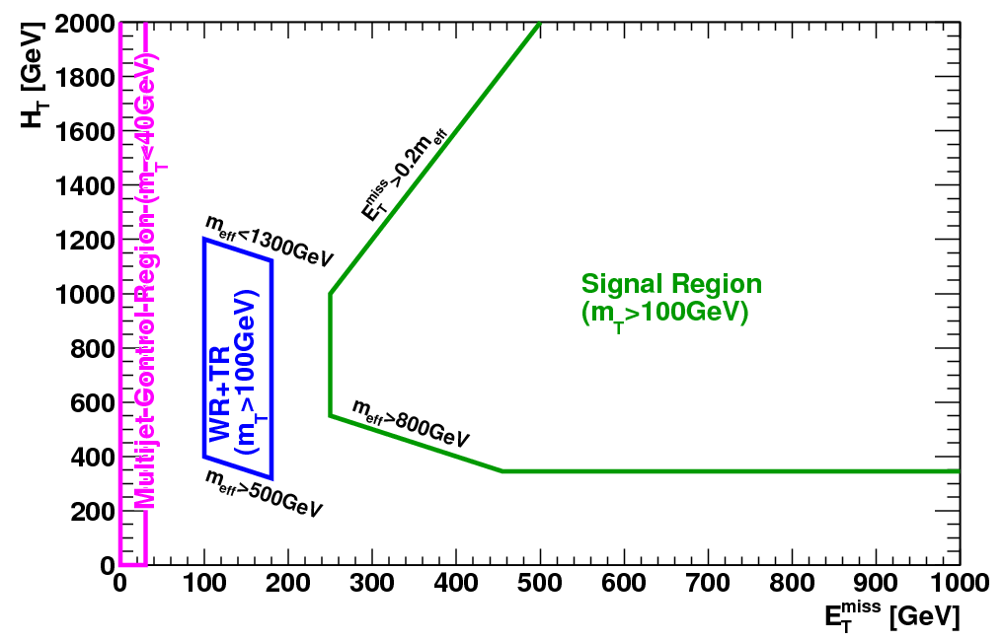
Signal and control regions for ATLAS analysis
Control region divided into 4 subsamples:
ttbar → e ν: electron + b-tag
ttbar → μ ν: muon + b-tag
(W→e ν) + jets: electron + anti-b-tag
(W→μ ν) + jets: muon + anti-b-tag
Signal region divided into
e and mu subsamples
Low ETmiss and HT suppress signal contamination.

Slide 44
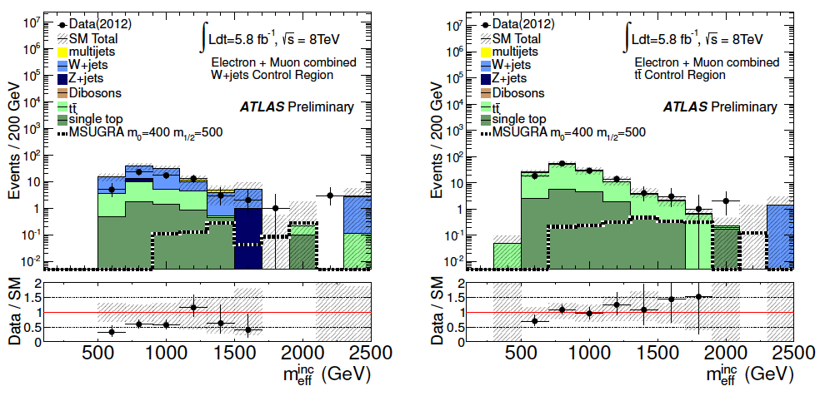
Data vs. MC comparison: e and mu
MC out-of-the-box predictions for backgrounds (not used for final result)
W + jets control region
(anti-b tagged)
ttbar control region
(anti-b tagged)
CONTROL
CONTROL
SUSY model
0.08 pb
SUSY model
0.08 pb

Slide 45
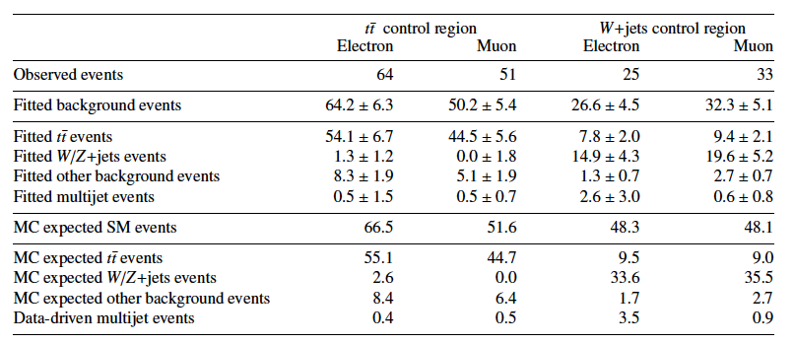
Yields and fits in the control regions
b tagging separates the
main backgrounds.
big
small
small
big
Perspective: how many ttbar and W+jets were produced?
Background | Cross section (pb) | Cross sec * BR | Events produced | Rejection
W→l nu + jets | 12,190 | 12,190 | 70.78 × 10⁶ | 2.8 ×10⁻⁷
ttbar | 238 | 238*(12/81)=35.3 | 0.20 × 10⁶ | 2 × 10⁻⁴
Huge suppression of W+jets → not surprising you can’t use MC value!

Slide 46
Yields and fits in the control regions
b tagging separates the
main backgrounds.
Total observed
Fitted ttbar
big
small
Fitted W/Z
small
big
QCD is small!
Wow!
Close
to fit
values!
Good
thing
fit is
done!
Perspective: how many ttbar and W+jets were produced?
Background | Cross section (pb) | Cross sec * BR | Events produced | Rejection
W→l nu + jets | 12,190 | 12,190 | 70.78 × 10⁶ | 2.8 ×10⁻⁷
ttbar | 238 | 238*(12/81)=35.3 | 0.20 × 10⁶ | 2 × 10⁻⁴
Huge suppression of W+jets → not surprising you can’t use MC value!

Slide 47
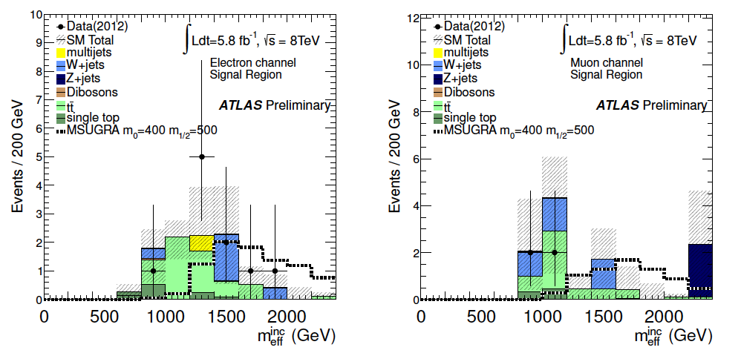
Apply fit params from control region to background MC for signal region
e signal region
(no b-tagging applied)
mu signal region
(no b-tagging applied)
SUSY benchmark
SUSY benchmark
 | electron | muon
Observed yield | 10 | 4
Predicted background | 9.0 ±2.8 | 7.7 ±3.2

Slide 48
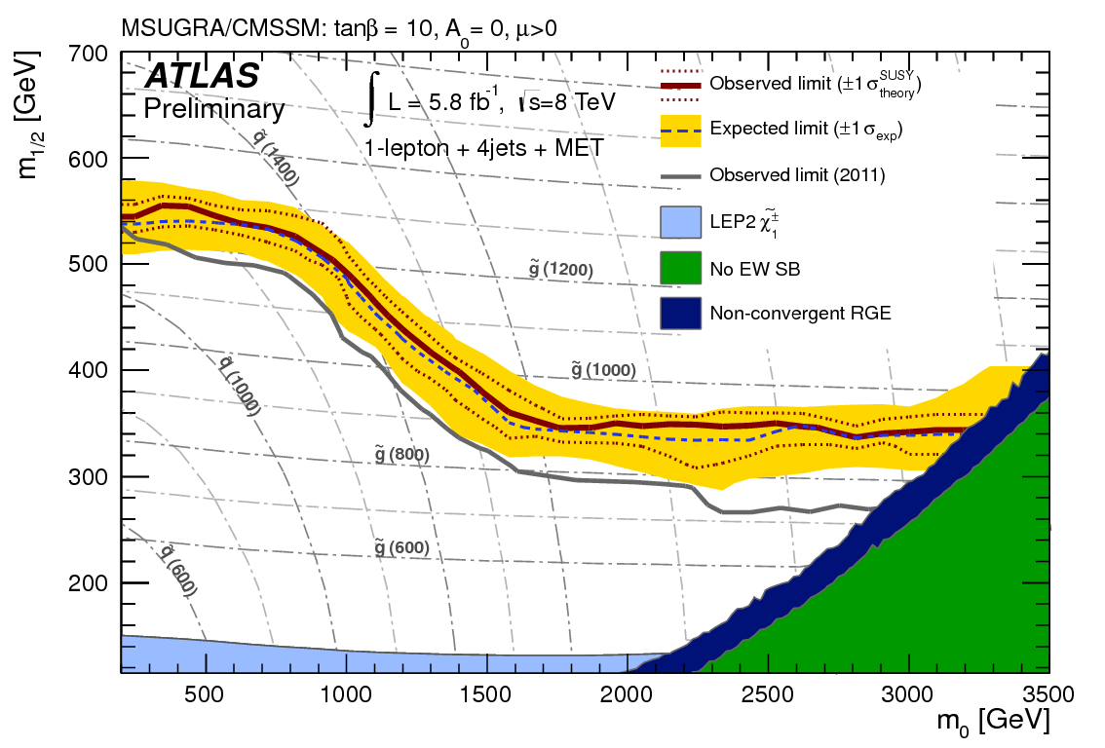
ATLAS cMSSM exclusion region (8 TeV)
Benchmark
(400, 500) GeV
Takes into account model-by-model signal contamination of control regions.

Slide 49
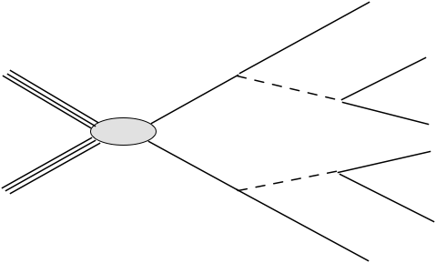
The famous neutralino dilepton cascade
Opposite-sign, same flavor leptons
The can be produced in any process, not just direct EW
production. Can produce sharp edge at upper limit of dilepton
mass spectrum corresponding to kinematic cutoff.

Slide 50
The famous SUSY trilepton signature
The can be produced in any process, not just direct EW
production.

Slide 51
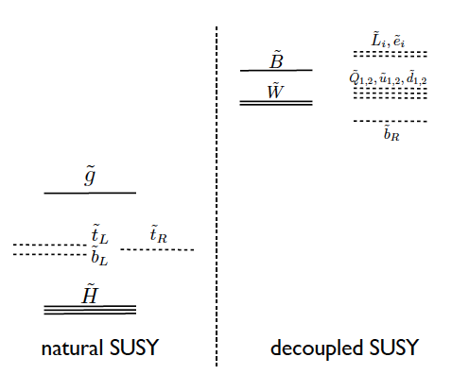
“Natural SUSY endures”: the current fashion
M. Papucci, J.T. Ruderman, and A. Weiler http://arxiv.org/abs/1110.6926

Slide 52
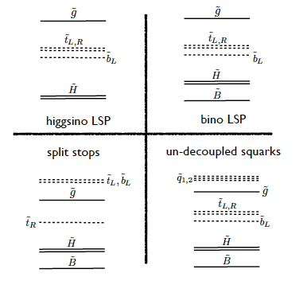
Some spectra compatible with “naturalness” considerations
not just one scenario...
M. Papucci, J.T.Ruderman,
and A. Weiler,
http://arxiv.org/abs/1110.6926
What sort of strategy
should we use for this?
Clearly, b-tagging will
play a big role. Have to
consider production
& decay.
See also D. Alves, M. Buckley, P.
Fox, J. Lykken, and C.-T. Yu
http://arxiv.org/abs/1205.5805

Slide 53
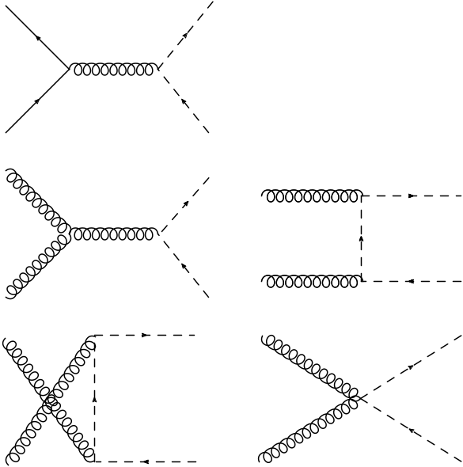
Production of scalar top (“stop”)
Very nice discussion in “Supersymmetric top and bottom squark production at
hadron colliders”, Beenakker et al. arXiv:1006.4771.
Even for m(~t)=m(t), the cross section is much lower than that for ttbar, as a consequence of spin-related effects.
If we find stop, and can determine its mass, then the small rate would be a probe of the spin.

Slide 54
Light stop decay
Not allowed,
assuming stop
is lightest squark
Not allowed
assuming stop
is lightest squark

Slide 55
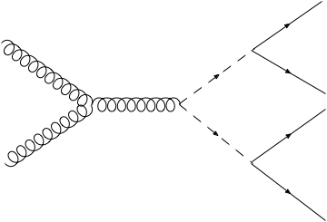
“Direct” pair production of light stops
Example: direct stop production with decay to neutralinos or charginos.
Sensitivity of the searches will depend strongly on the neutralino mass.
The channel with has sensitivity to lower stop mass.

Slide 56
Production cross section for low-mass stop
M. Kramer et al., arXiv:1206.2892
Even at the same mass, st-stbar production is suppressed relative to ttbar production.

Slide 57
Stop pair production: disappointingly small
M. Kramer et al., arXiv:1206.2892
For 5 fb⁻¹, get 1000 events for m(stop) = 400 GeV! Sounds easy...
But σ(ttbar) = 175 pb is about 900x larger!

Slide 58
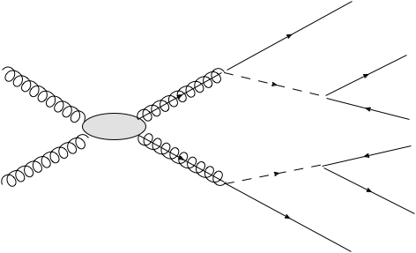
Gluino pair production and decay to light stop
Maybe the gluinos aren’t too heavy – very large production
cross section may make gluino pair production competitive.
The production of four top quarks and additional MET can lead to spectactular signatures.

Slide 59
Strategies/issues for light stop
With b-tagging, ttbar dominates the background.
Direct production:
  -ttbar + extra MET; correlations between t and tbar are affected (e.g., pT of top quarks can differ a lot).
  Need to exploit kinematic differences between stop signals and ttbar. (Helpful if there are lots of signal events are around.)
Gluino pair production: 4 top quarks + MET!
  many jets; 4 b jets
  can have multileptons, including same-sign leptons
  many useful features as long as cross section isn’t suppressed by too large gluino mass.

Slide 60
ttbar as a SUSY background
For a ttbar event to produce large MET (100-200 GeV) , need at least one W→ l ν, l = e, μ, τ).
→ reduces Njets.
ISR
ISR
Searches for SUSY in hadronic channels benefit from lepton vetoes.
τ-leptons are a problem!

Slide 61
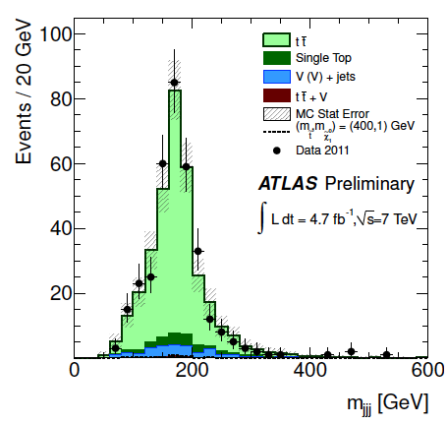
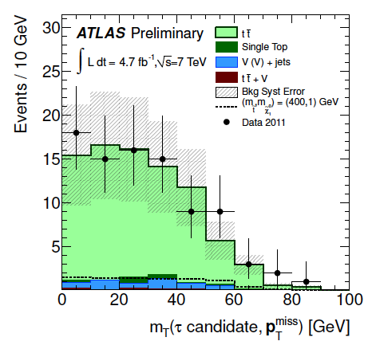
Direct stop production: 0 leptons
ATLAS collaboration, arXiv:1208.1447
1 lep control
region
Require ≥6 jets, pT(leading)>130 GeV, pT>30 GeV for 5 other jets.
80<M(jjj)>270 GeV for consistency with top
  both triplets
Suppression of ttbar; W→τν
  if tau-like jet has MT(jet, MET)<100 GeV reject event.
Require either one tight b jet or two loose b jets
MET must not be ~collinear with any jet
mT: tau-like jets

Slide 62
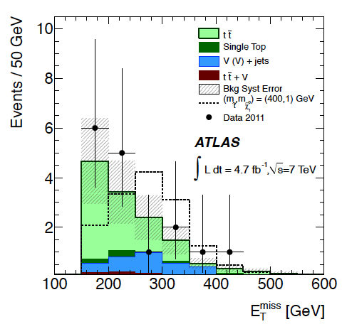
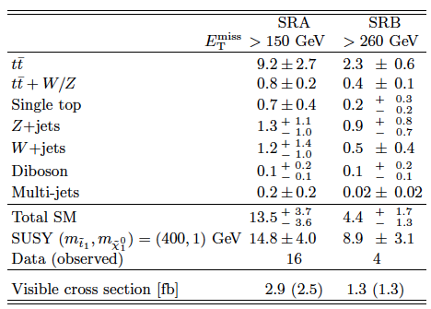
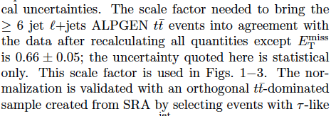
Search for direct stop production: 0 lepton
ATLAS collaboration, arXiv:1208.1447
SRA
SRA

Slide 63
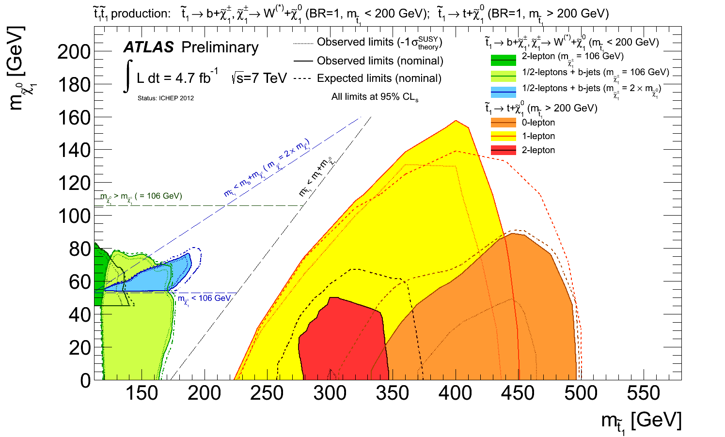
ATLAS searches for direct stop production
(analysis shown)
Stop excluded up to ~500 GeV, but strong dependence on

Slide 64
Searches with like-sign dileptons and b-jets
Like-sign dileptons are a classic SUSY
signature. With multiple b-jets the
signature becomes quite strong.

Slide 65
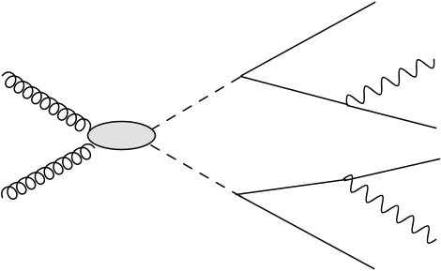
Like-sign dileptons from b-squark pairs
Can also get like-sign dileptons and multileptons
from b-quark pair production. Also have b-jets
here.

Slide 66
Same-sign dileptons: experimental issues
ttbar dilepton background: normally opposite-sign isolated leptons;
highly suppressed by
like-sign selection.
primary lepton
primary lepton

Slide 67
Same-sign dileptons: experimental issues
secondary lepton,
accidentally isolated
Will be same-sign with respect to primary lepton from other top decay.
primary lepton
The number of such isolated leptons from b decay is small,
but it must be determined very carefully from data (“fake rate”
for secondary lepton to look like
a primary lepton).

Slide 68
Like-sign dileptons + b jets
CMS–SUS-12-017 http://cdsweb.cern.ch/record/1459811
Backgrounds
primary-secondary pairs
lepton charge mis-ID (e bremstrahlung)
rare SM processes: ttbar+W, ttbar+Z (~200 fb each)
Selection 2 same-sign leptons (pT>20 GeV), ≥2 b jets (pT>40)

Slide 69
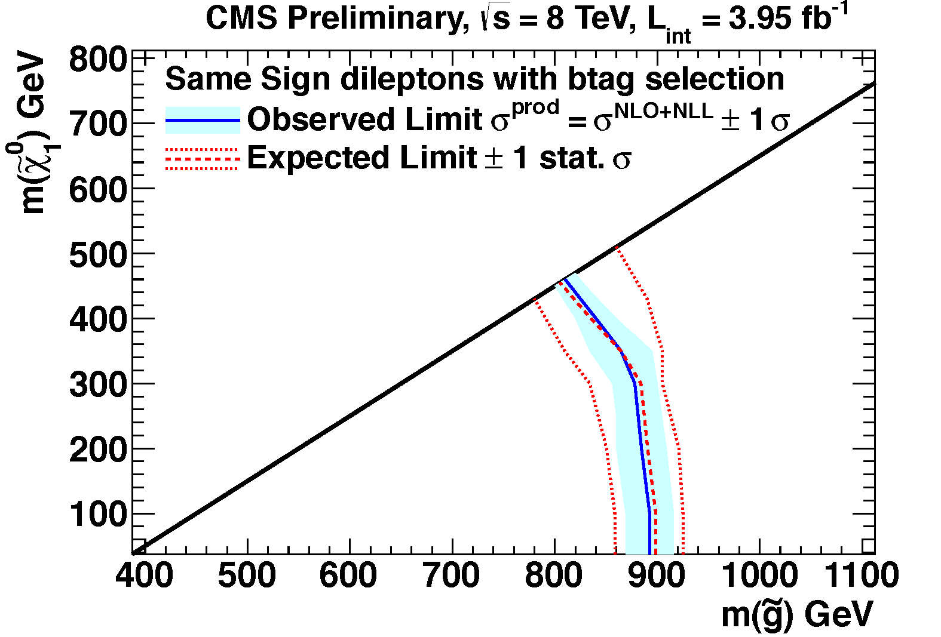
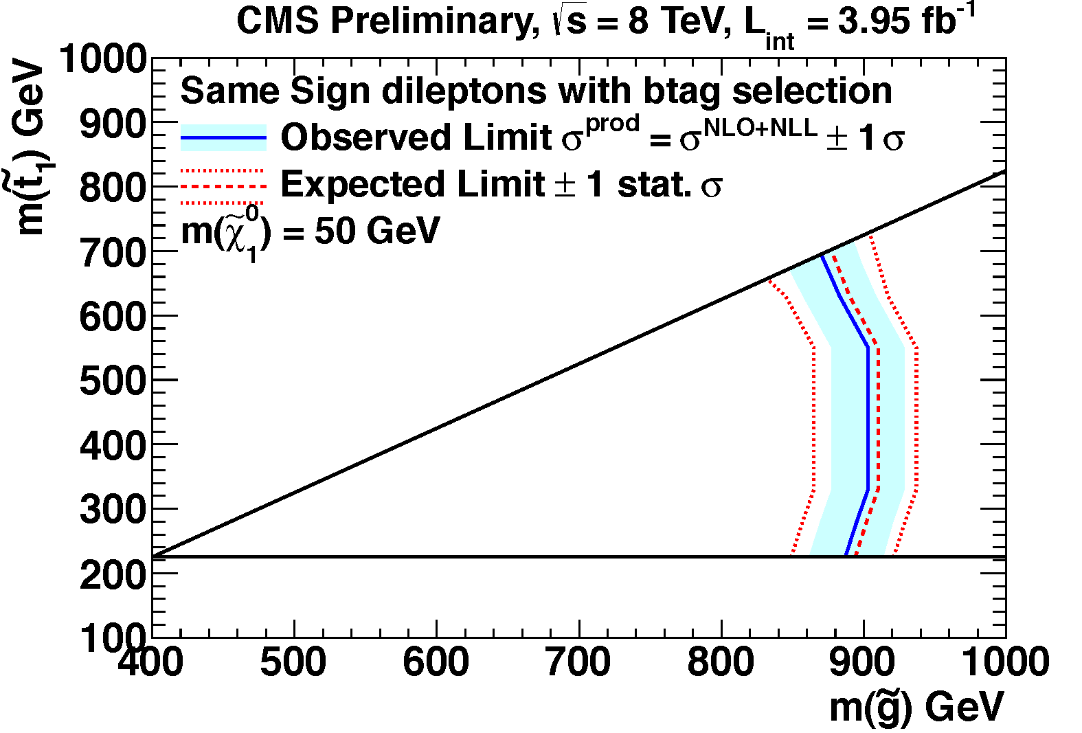
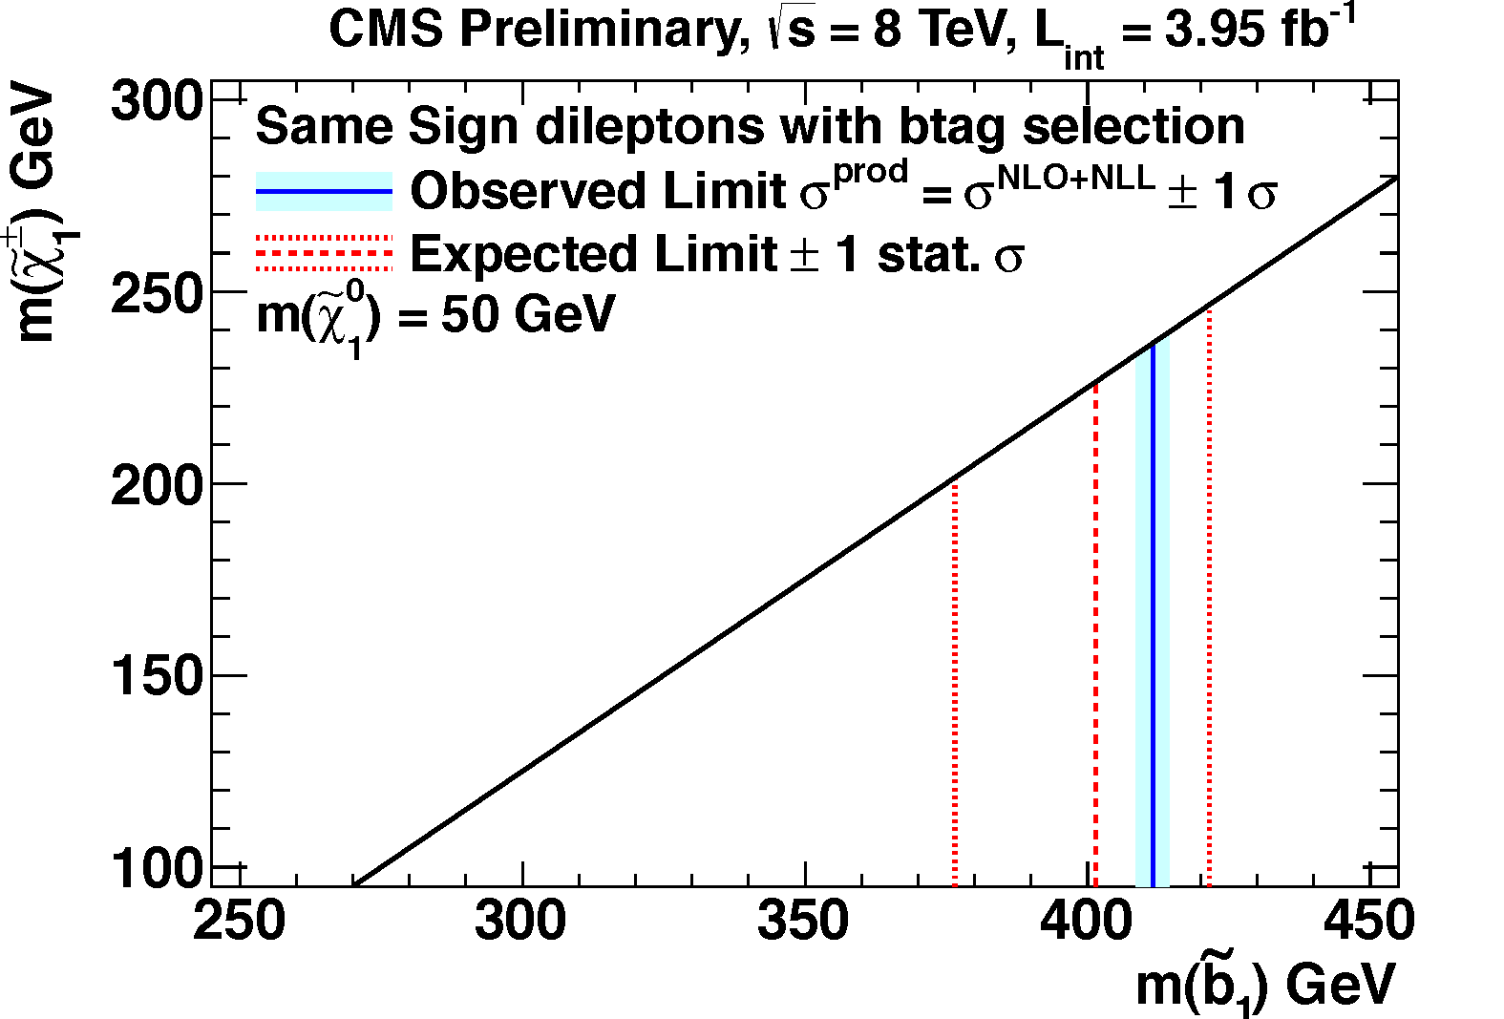
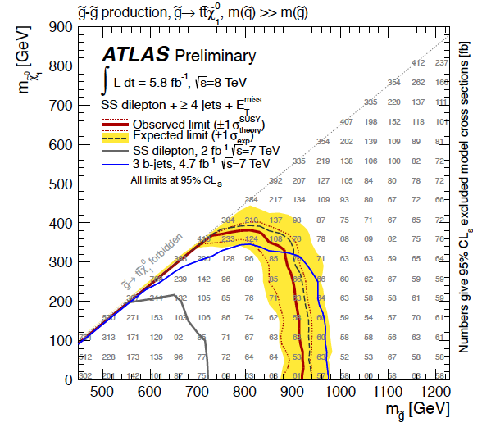
Like-sign dileptons + b-jets results
gluino pairs,
virtual stops
gluino pairs,
real stops
ATLAS-CONF-2012-105
sbottom pair
production

Slide 70
Limits on gluino pair production to 4 b quarks

Slide 71
Conclusions
SUSY searches are evolving from inclusive measurements to more focussed searches, especially for light stop/sbottom.
The simplified-model approach is replacing CMSSM for interpretations.
“Naturalness”-motivated searches are just beginning. The 2012 data sample will be extremely important for natural SUSY models.
Tomorrow: Electroweak production and “exotica”.

Slide 72
Backups

Slide 73
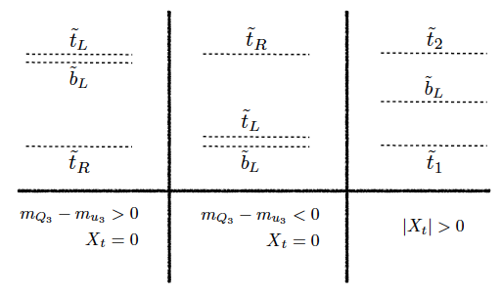
Some spectra compatible with “naturalness” considerations
M. Papucci, J.T. Ruderman, and A. Weiler, http://arxiv.org/abs/1110.6926
What sort of strategy should we use for this?
Clearly, b-tagging will play a big role. Have to consider
production & decay.

Slide 75
Limits on stop production - CMS

Slide 76
