Slide 1

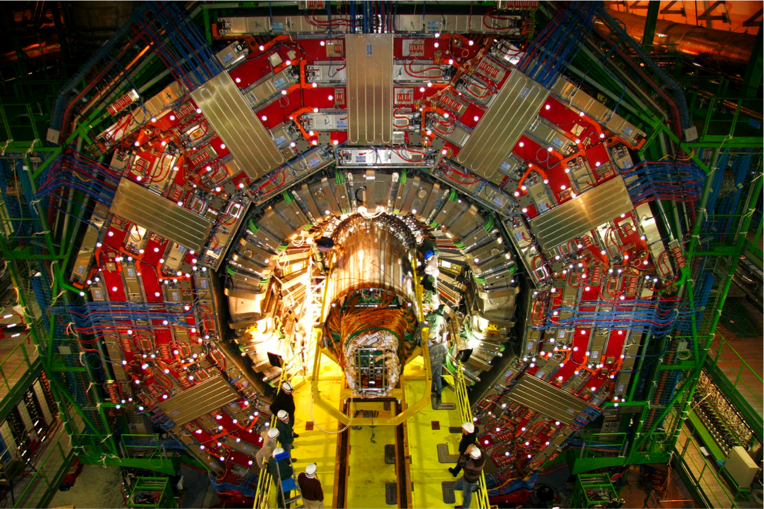
Searches for Supersymmetry in the
CMS Experiment
Jeffrey D. Richman (UC Santa Barbara)
Representing the CMS Collaboration
21st International Conference on Supersymmetry and Unification of Fundamental Interactions
International Center for Theoretical Physics, Trieste, August 26–31, 2013

Slide 2
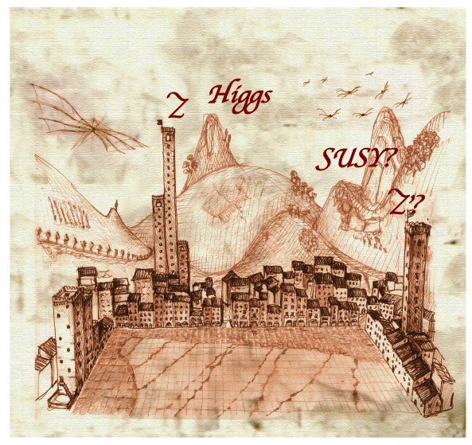
Outline
Big themes and challenges for SUSY searches
Inclusive (generic) searches
Naturalness-inspired searches:
Search for EWKinos & sleptons
SUSY decays with Higgs
Multi-lepton & R-parity violating signatures
Conclusions
Drawing courtesy Sergio Cittolin
CMS PUBLIC SUSY RESULTS
https://twiki.cern.ch/twiki/bin/view/CMSPublic/PhysicsResultsSUS
New results in all of these areas.
Most use 19.5 fb⁻¹ (√s =8 TeV).
2

Slide 3
CMS SUSY talks in the parallel sessions (I)
1. Search for SUSY in hadronic final states at CMS (Mon.)
Joshua THOMPSON
2. Search for SUSY in the single and di-lepton final state at CMS (Mon.)
Marco-Andrea BUCHMANN
3. Search for SUSY in multilepton final states at CMS (Mon.)
Andrea GOZZELINO
4. Search for SUSY in final states with photons at CMS (Tues.)
David MORSE
5. Interpretation of CMS SUSY results and outlook to 14 TeV data taking (Tues.)
Frank GOLF
6. Dark matter searches in monojet and monophoton events at CMS
(Tues.)
Tai SAKUMA
3

Slide 4
CMS SUSY talks in the parallel sessions (II)
7. Search for direct stop and sbottom production at CMS (Thurs.)
Mariarosaria D’ALFONSO
8. Search for EWK production of gauginos and sleptons at CMS (Thurs.)
Ben HOOBERMAN
9. Interpretations of CMS SUSY searches in the context of R-parity violation (Fri.)
Matthew WALKER
OTHER CMS PLENARY SESSION TALKS
Recent results on Higgs physics from CMS (Tues.)
Sridhara DASU
Recent results from exotic searches from CMS (Fri.)
Sunil SOMALWAR
My talk: just a small sampling of the many CMS SUSY results.
4

Slide 5
CMS SUSY overview: a broad program
Gluino production
Squark production
Stop production
Sbottom production
EWK Gaugino production
Slepton production
Mass scale (GeV)
5

Slide 6
Big themes: production and decays
Strong production
Stop pair
production
Electroweak
production
LHC SUSY Cross Section Working Group
https://twiki.cern.ch/twiki/bin/view/LHCPhysics/SUSYCrossSections
6

Slide 7
Big themes: production and decays
Strong production
Stop pair
production
Electroweak
production
Exploring 𝜎 = ~1 fb → ~1 pb
LHC SUSY Cross Section Working Group
https://twiki.cern.ch/twiki/bin/view/LHCPhysics/SUSYCrossSections
7

Slide 8
Big themes: background measurement
Diboson processes
(W,Z) + jets
SUSY down here somewhere?
8

Slide 9
Big themes: background measurement
Inclusive cross sections are well measured, but details of kinematic distributions are key for SUSY searches.
SUSY down here somewhere?
9

Slide 10
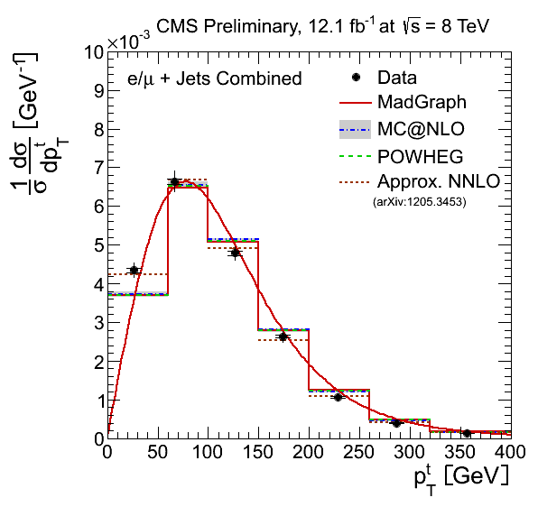
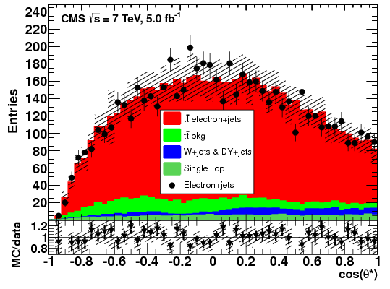
Big themes: key SUSY background
Heaviest SM particle
Jets, b-jets, leptons, missing transverse momentum (MET)
Now have many detailed studies of kinematic distributions.
https://twiki.cern.ch/twiki/bin/view/CMSPublic/PhysicsResultsTOPSummaryPlots
CMS TOP-11-020
CMS
TOP-12-027
Electron
helicity angle
→W polarization
top pT spectrum
https://twiki.cern.ch/twiki/bin/view/CMSPublic/PhysicsResultsTOP12027
http://arxiv.org/abs/1308.3879

Slide 11
Big themes: tails of SM kinematic distributions
SUSY processes usually do not have narrow features in observed distributions.
Search is performed in the extreme tails of SM processes. Narrow kinematic region of phase space; possible rare detector effects also.
https://twiki.cern.ch/twiki/bin/view/CMSPublic/PhysicsResultsSUS13011
SUS-13-011
Direct
As far as possible, use data-driven methods based on control samples → use multiple, complementary approaches. MC/theory plays key role in validating our understanding of these control samples.
Multiple methods: critical for discovery scenarios!
11

Slide 12
The pentaquark phenomenon, 2002-2005
Slide courtesy of R. Schumacher
From Particles and Nuclei International Conference, Santa Fe, 2005
LEPS-d2
CLAS-d2
Photoproduction on Deuteron Θ⁺
Photoproduction on Proton pK_{s}⁰
Photoproduction on Proton nK⁺K⁻π⁺
Exclusive K + (N) → pK_{s}⁰
Inclusive lepton + D, A → p K_{s}⁰
p + A → pK_{s}⁰ + X
p + p → pK_{s}⁰ + Σ⁺
Other Θ⁺ Upper Limits
p + p (or A) → Ξ ⁻ ⁻ + X
Inclusive Θ ⁺ ⁺ → p K⁺
Inclusive Θ⁰c → D^{(*) −} p
 | 9 10 | 11 12 | 1 2 | 3 4 | 5 6 | 7 8 | 9 10 | 11 12 | 1 2 | 3 4 | 5 6 | 7 8 | 9 10 | 11 12 | 1 2 | 3 4 | 5 6 | 7 8 | 9 10 | 11 12
LEPS-C
CLAS-d1
LEPS-d
SAPHIR
CLAS g11
CLAS-p
DIANA
ZEUS
νBC
BELLE
Hermes
SPHINX
BaBar
SVD2
JINR
HyperCP
SVD2
COSY-TOF
HERA-B
Pentaquark
observations
BES J,Ψ
CDF
FOCUS
WA89
ALEPH, Z
NA49/CERN
WA89
HERA-B
ZEUS
E690
ALEPH
ZEUS
STAR/RHIC
H1/HERA
ZEUS
Pentaquark
non-observations
ALEPH
FOCUS
2002 2003 2004 2005
Let’s not do this! (I don’t think we will.)
12

Slide 13
Big themes: many (& complex) signatures
gluino
Direct
production
via strong
processes
SUSY LM6
benchmark
Higgs
sector
squarks
gauginos/higginos
Direct
production
via electroweak
processes
sleptons
neutralino
(LSP)
13

Slide 14
SUSY cascade starting from gluino decay
SUSY LM6
benchmark
neutralino
(LSP)
14

Slide 15
Decays of ~t₁ → neutralinos, charginos
SUSY LM6
benchmark
neutralino
(LSP)
15

Slide 16
Decays of : here come the leptons!
SUSY LM6
benchmark
neutralino
(LSP)
16

Slide 17
Decays of : more leptons!
SUSY LM6
benchmark
Even more possibilities
...and in GMSB, the lightest neutralino can decay into a gravitino → MET
... and in R-parity violating SUSY, the neutralino can decay into SM
particles →no MET
neutralino
(LSP)
17

Slide 18
Decays of : more leptons!
SUSY LM6
benchmark
New program of searches for SUSY decays with Higgs.
H
neutralino
(LSP)
18

Slide 19
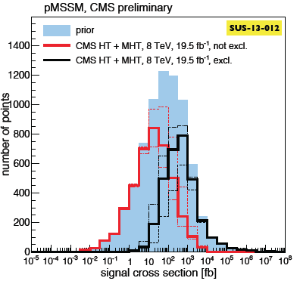
Big themes: Interpretation(s)
Frank Golf
parallel talk
Early LHC running: heavy use of cMSSM to connect with results from Tevatron. (Not sufficiently general.)
Today: Extensive use of simplified models. Reasonably well suited to natural SUSY spectra. Big assumption: BF=100%.
Alternatives: pMSSM and efficiency models.
SMS:
SUS-13-012 (Jets+MHT)
pMSSM interpretation of
SUS-13-012
Efficiency model for
SUS-13-013
Expected limit
w/experimental
uncertainty
Prior
Not
excluded
Excluded
Observed limit
w/theoretical
uncertainty
E_{T}^{miss}(gen)
https://twiki.cern.ch/twiki/bin/view/CMSPublic/PhysicsResultsSUS13012
https://twiki.cern.ch/twiki/bin/view/CMSPublic/PhysicsResultsSUS13013
19

Slide 20
Outline
Big themes and challenges for SUSY searches
Inclusive (generic) searches
Naturalness-inspired searches:
Search for EWKinos & sleptons
SUSY decays with Higgs
Multi-lepton & R-parity violating signatures
Conclusions
Drawing courtesy Sergio Cittolin
CMS PUBLIC SUSY RESULTS
https://twiki.cern.ch/twiki/bin/view/CMSPublic/PhysicsResultsSUS
New results in all of these areas.
Analyses use 19.5 fb⁻¹ (√s =8 TeV).
20

Slide 21
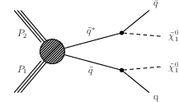
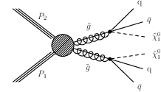
Generic searches for jets + MET
1 Jet + MET Dark matter search | 2 Jets + MET | Multi. Jets + MET
SM: Z(νν) + 1 jet | SM: QCD dijets + fake MET from mismeasurementof jets; W + jets,... | SM: many sources! Both real & fake MET.
EWK production + ISR
Strong production
Strong production
ISR jet or
photon
For dark matter results, see Sunil Somalwar plenary & Tai Sakuma parallel talk.
21

Slide 22
All-hadronic SUSY search using 𝛼_{T}
SUS-12-028
http://arxiv.org/abs/1303.2985
J. Thompson
& F. Golf
parallel talks
Randall and Tucker-Smith
http://arxiv.org/pdf/0806.1049
QCD
SUSY
dijets +
MET
Generalized to multijet events in CMS (form 2 pseudo-jets).
2 ≤ Njets ≤ 3
8 degenerate-
mass squarks
QCD multjet
1 squark (but
~b search more
sensitive!)
https://twiki.cern.ch/twiki/bin/view/CMSPublic/PhysicsResultsSUS12017
22

Slide 23
Generic hadronic SUSY search using MHT
SUS-13-012
https://twiki.cern.ch/twiki/bin/view/CMSPublic/PhysicsResultsSUS13012
J. Thompson parallel talk
Signature: Jets + MHT; events with leptons are vetoed
  Jets: ≥3 jets with p_{T} > 50 GeV, no b-tagging.
  Veto event if MHT vector is ≈aligned with any of 3 leading jets.
Bin data in
  HT
  missing HT (MHT)
  Jet multiplicity (3—5, 6—7, ≥8 jets)
Background estimation: largely data driven.
ttbar with W→l 𝜈
W → l 𝜈 + jets
ttbar with W→𝜏 (→h) 𝜈
W → 𝜏 (→h) 𝜈 + jets
Control sample: Single-lepton + jets + MHT
Z→𝜈𝜈 + jets
QCD multijet events
MHT ~ aligned with high pT jet.
Control samples:
𝛾 + jets,
Z(𝜇𝜇)+jets
Control sample:
Multijets with re-balance and
smear procedure
23

Slide 24
Distribution in bins of N(jets), H_{T} , and H_{T}
CMS PAS SUS-13-012
H_{T} : 0.8-1.0 TeV
H_{T} : 1.0-1.2 TeV
MHT
MHT
24

Slide 25
Statistical interlude
Consider the bin with
  N(observed) = 9 events
  N(background) = 0.8 ± 1.7 events
First, let’s ignore the uncertainty on the background. What is the probability for a Poisson with μ=0.8 to fluctuate to at least 9 events?
  Prob( n≥9 | μ =0.8 ) = 1.8 × 10⁻⁷
Have we discovered new physics?
NO! The uncertainty is crucial!
  Prob( n≥9 | μ = 0.8 ± 1.7) ≈ 0.15
This example highlights the importance of quantifying the uncertainties on the SM backgrounds.
See CMS PAS SUS-13-012,
Table 1, p. 10
Njets: 6-7
HT: 500-800 GeV
MHT>450 GeV
25

Slide 26
Search for generic jets and MET: results
Simplified model exclusion plots
  Compute excluded cross section for each model in param space
  Compare to reference cross section to see if model excluded
    Assume 100% branching fraction for stated process!
CMS PAS SUS-13-012
Gluino pair
production
Signal efficiency
increases away
from diagonal
→ excluded 𝜎 falls
Squark pair
production;
see F. Golf talk
(L + R)
As before, weak limit with reduced number of squarks!
26

Slide 27
Search for generic jets and MET: results
Simplified model exclusion plots
  Compute excluded cross section for each model in param space
  Compare to reference cross section to see if model excluded
    Assume 100% branching fraction for stated process!
CMS PAS SUS-13-012
Gluino pair production
Squark pair
production
Expected limit
w/experimental
uncertainty
(L + R)
Observed limit
w/theoretical
uncertainty
Th’y cross section fall-off
As before, weak limit with reduced number of squarks!
27

Slide 28
Outline
Big themes and challenges for SUSY searches
Inclusive (generic) searches
Naturalness-inspired searches:
Search for EWKinos & sleptons
SUSY decays with Higgs
Multi-lepton and R-parity violating signatures
Conclusions
Drawing courtesy Sergio Cittolin
CMS PUBLIC SUSY RESULTS
https://twiki.cern.ch/twiki/bin/view/CMSPublic/PhysicsResultsSUS
New results in all of these areas.
Analyses use 19.5 fb⁻¹ (√s =8 TeV).
28

Slide 29
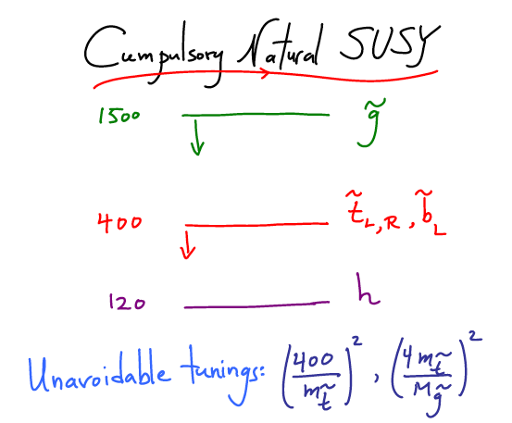
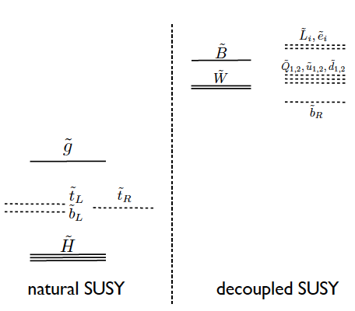
The focus on natural SUSY signatures
With the discovery of the/a Higgs boson, the problem of the stability of m(H) against radiative corrections has become urgent.
Many searches designed for signatures motivated by a “natural SUSY” solution to the gauge hierarchy problem.
N. Arkani-Hamed, http://indico.cern.ch/getFile.py/access?contribId=7&sessionId=2&resId=0&materialId=slides&confId=157244
M. Papucci, J.T. Ruderman, and A. Weiler,
Natural SUSY Endures,
http://arxiv.org/abs/1110.6926
29

Slide 30
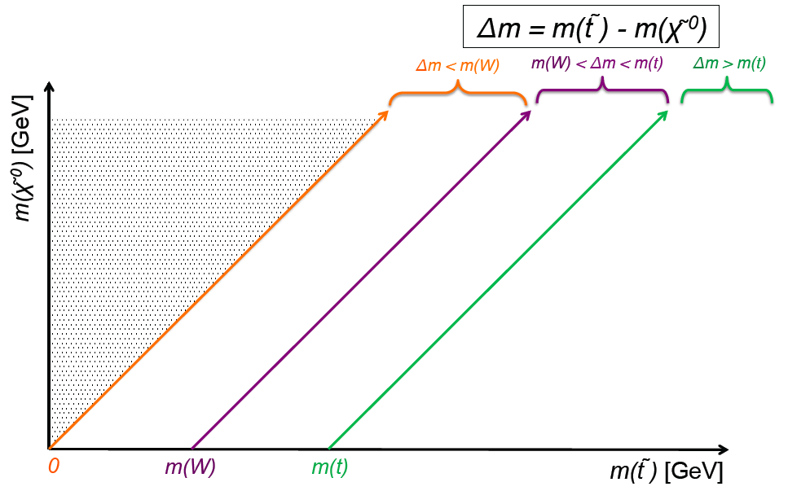
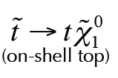


Search for direct stop production:
SUS-13-011
Parallel talks: Mariarosaria D’Alfonso, Frank Golf
http://arxiv.org/abs/1308.1586
https://twiki.cern.ch/twiki/bin/view/CMSPublic/PhysicsResultsSUS13011
4-body
3-body
2-body
violates assumed
spectrum
(off-shell W)
has extra mass parameter
30

Slide 31
Search for direct stop production:
SUS-13-011
Parallel talks: Mariarosaria D’Alfonso, Frank Golf
http://arxiv.org/abs/1308.1586
https://twiki.cern.ch/twiki/bin/view/CMSPublic/PhysicsResultsSUS13011
4-body
3-body
2-body
violates assumed
spectrum
(off-shell W)
has extra mass parameter
31

Slide 32
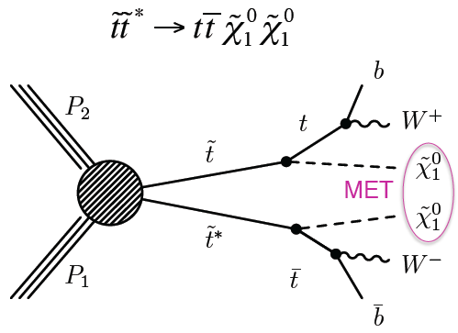
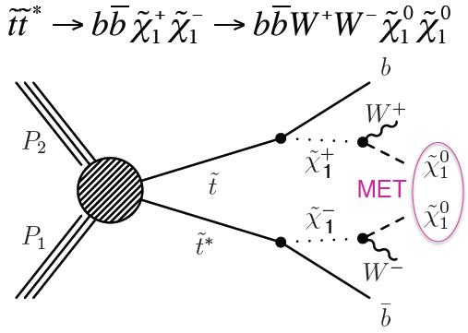
Search for direct stop production:
SUS-13-011
Parallel talk: Mariarosaria D’Alfonso
http://arxiv.org/abs/1308.1586
https://twiki.cern.ch/twiki/bin/view/CMSPublic/PhysicsResultsSUS13011
violates assumed
spectrum
(off-shell W)
Same final state but different
kinematics!
32

Slide 33
Search for direct stop production:
SUS-13-011
Parallel talk: Mariarosaria D’Alfonso
http://arxiv.org/abs/1308.1586
https://twiki.cern.ch/twiki/bin/view/CMSPublic/PhysicsResultsSUS13011
MT > 120 GeV
MET > 100 GeV
(off-shell W)
Use BDTs
for separate
modes & regions.
MT > 120 GeV
MET > 100 GeV
33

Slide 34
Search for direct stop: initial state radiation
SUS-13-011
The effects of initial-state radiation are important for the signal efficiency in the region where MET is small.
Does the simulation get this right (MADGRAPH) ?
Study in Z+jets and ttbar.
Z + jets
p_{T}(jets)
ttbar(l⁺l⁻) + jets
34

Slide 35
Search for direct stop: initial state radiation
SUS-13-011
The effects of initial-state radiation are important for the signal efficiency in the region where MET is small.
Does the simulation get this right (MADGRAPH) ?
Study in Z+jets and ttbar.
MC predicts up to 20% too much ISR at high pT
DATA/MC
Z + jets
p_{T}(jets)
ttbar(l⁺l⁻) + jets
35

Slide 36
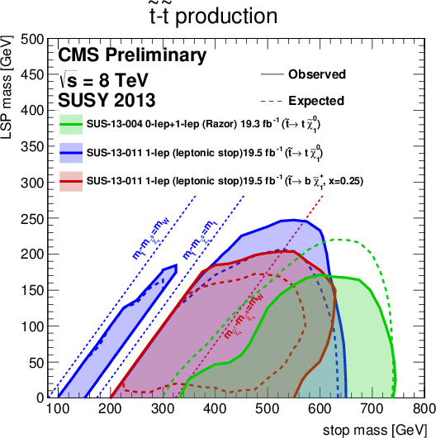
Search for : results
SUS-13-011
SUS-13-004
For each
decay
channel,
100% BF
is assumed!
1-lepton
analysis
~t→t ~X₁⁰
1-lepton
analysis
~t→b~X₁⁺
Razor analysis
0 lep + 1 lep
36

Slide 37
Search for direct stop: dependence on BF
37

Slide 38
Search for b-jets, same-sign dileptons, MET
SUS-13-013
https://twiki.cern.ch/twiki/bin/view/CMSPublic/PhysicsResultsSUS13013
Parallel talk: Marco-Andrea Buchmann
SM background
SM same-sign
dilepton
background
54 signal bins!
N(b) = 0, 1, 2; N(J) =2-3, ≥4, MET bins (50-120,>120 GeV), HT bins (200-400, >400 GeV).
Sensitivity to direct sbottom, gluino pairs, RPV SUSY, same-sign top, etc.
Leading
lepton pT
38

Slide 39
Same-sign dileptons: search for
SUS-13-013
Test how the exclusion region depends on
Low pT lepton
selection
High pT lepton
selection
High pT lepton
selection
39

Slide 40

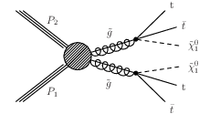
Examples for ,
b-Jets + MET (all hadronic search) | b-Jets + 1 lepton + MET | b-Jets + 2 same-sign leptons + MET
Require ≥3 b jets, no isol leptons, large MET. | Require 1 lepton, large MET, large N(jets), b jets. | Classic SUSY signature. Key issue is “fake” leptons.
Off-shell ~t, but also have on-shell interpretation.
For many SUSY searches, ttbar is the dominant background.
Lots of real MET from W decays
b-tagging suppresses Z + jets, W + jets.
40

Slide 41
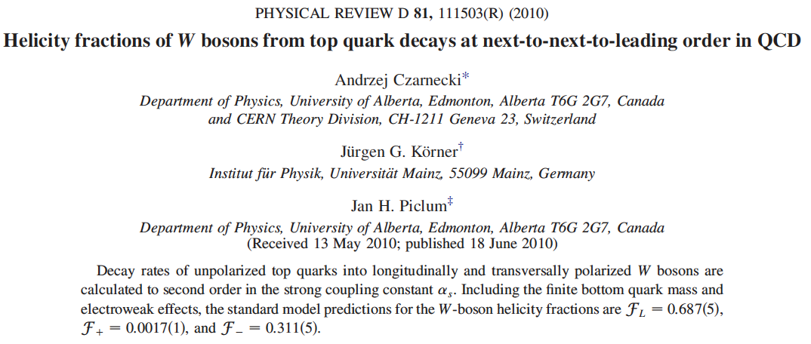
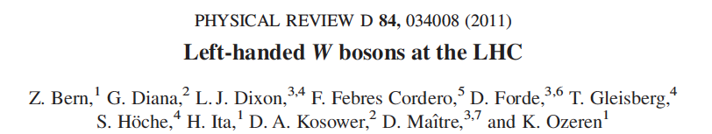
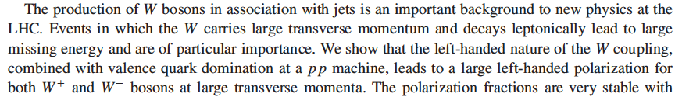
SUSY search for b-jets, 1 lepton, and MET
CMS PAS SUS-13-007
https://twiki.cern.ch/twiki/bin/view/CMSPublic/PhysicsResultsSUS13007
Parallel talk: Marco-Andrea Buchmann
Lepton spectrum method: for leptons produced in W decay,
the lepton spectrum can be used to measure the 𝜈 spectrum.
Makes use of W helicity fractions in t→bW
...and W helicity fractions in W+jets
41

Slide 42
SUSY search for b-jets, 1 lepton, and MET
CMS PAS SUS-13-007
https://twiki.cern.ch/twiki/bin/view/CMSPublic/PhysicsResultsSUS13007
Parallel talk: Marco-Andrea Buchmann
Δ𝜑(lepton, W) method: strong suppression of 1-lepton background (similar to MT). Also use ST = pT(lep) + MET.
Signal region
Optimized for gluino pair production: N(J)≥6 and N(b)≥2.
42

Slide 43
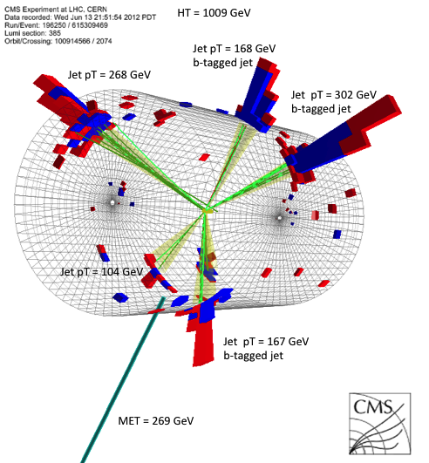
Search for b-jets & MET: ,
SUS-12-024
http://arxiv.org/abs/1305.2390
J. Thompson parallel talk
https://twiki.cern.ch/twiki/bin/view/CMSPublic/PhysicsResultsSUS12024
Acceptance x
Efficiency
Excluded
cross section
43

Slide 44

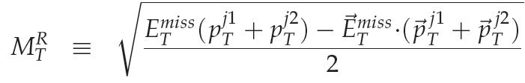
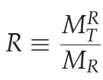
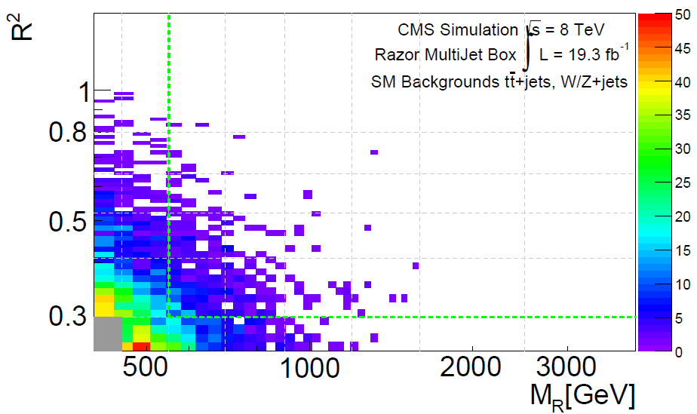
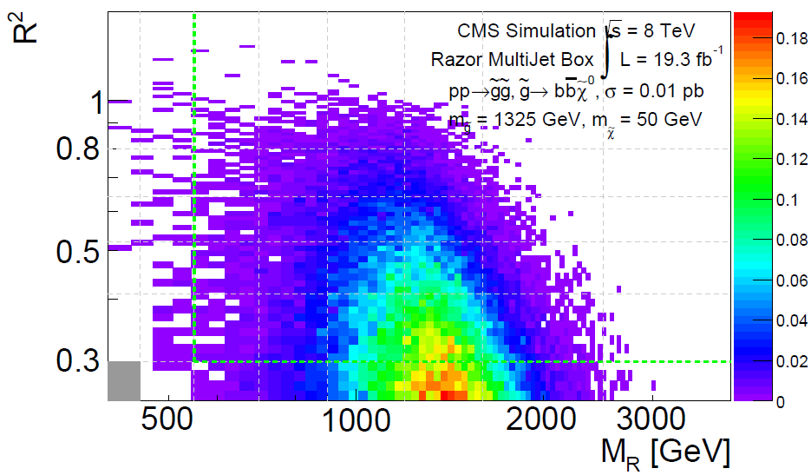
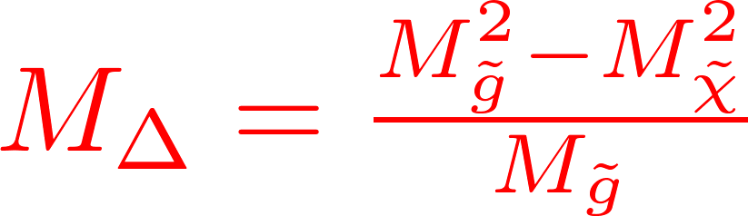
Search for b-jets and MET with razor variables
SUS-13-004
https://twiki.cern.ch/twiki/bin/view/CMSPublic/PhysicsResultsSUS13004
“Razor” kinematic variables
Variables defined in terms of a dijet topology. For higher multiplicity, cluster jets into 2 pseudojets.
C. Rogan, arXiv:1006.2727
Signal has tail at high R²
SM Background
m_{gluino} = 1325 GeV
m_{LSP}=50 GeV
44

Slide 45
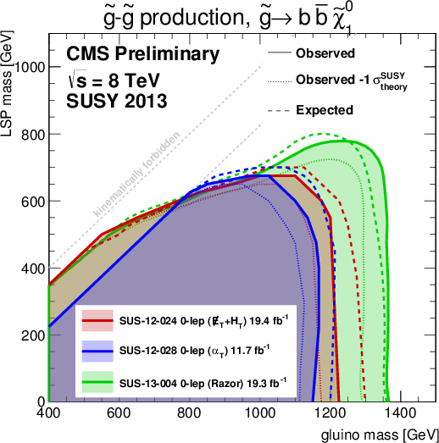
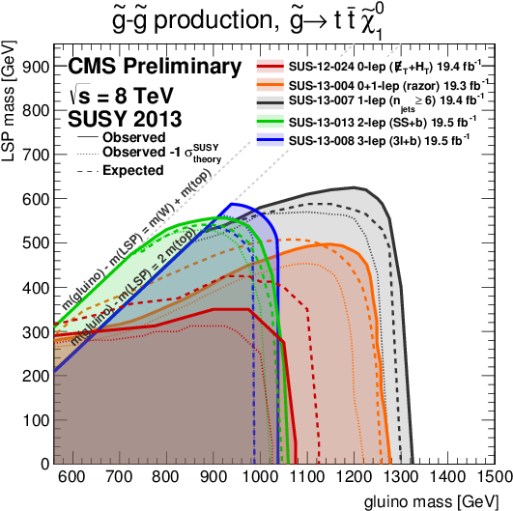
Searches for gluino pair production (→b-jets)
4b + MET final state:
hadronic searches most sensitive.
4t + MET final state:
single lepton search most sensitive.
Razor
3-lepton+b
2 SS-
lepton+b
1-lepton
+b
𝛼_{T}
Razor
b-jets
+MET
0-lepton
+b
No exclusion for M(LSP) ≳ 750 GeV.
Strongest limit: m(~g) ≳ 1375 GeV.
No exclusion for M(LSP) ≳ 600 GeV.
Strongest limit: m(~g) ≳ 1320 GeV.
45

Slide 46
Outline
Big themes and challenges for SUSY searches
Inclusive (generic) searches
Naturalness-inspired searches:
Search for EWKinos & sleptons
SUSY decays with Higgs
Multi-lepton and R-parity violating signatures
Conclusions
Drawing courtesy Sergio Cittolin
CMS PUBLIC SUSY RESULTS
https://twiki.cern.ch/twiki/bin/view/CMSPublic/PhysicsResultsSUS
New results in all of these areas.
Analyses use 19.5 fb⁻¹ (√s =8 TeV).
46

Slide 47
Electroweak production: and
SUS-13-006
https://twiki.cern.ch/twiki/bin/view/CMSPublic/PhysicsResultsSUS13006
Parallel talk: Ben Hooberman
3 lep & SS dileptons
3 lepton & Z + dijet
3 lep, 4 lep, Z dijet
Opposite-sign dileptons (off Z)
47

Slide 48
Results: Electroweak production of
SUS-13-006
https://twiki.cern.ch/twiki/bin/view/CMSPublic/PhysicsResultsSUS13006
Parallel talk: Ben Hooberman
GMSB Z-enriched higgsino scenario
Chargino-Neutralino
production/decay scenarios
combine
𝜇 < 330 GeV
excluded
at 95% CL
48

Slide 49
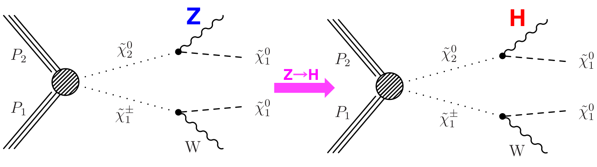
EWK production of : Higgs final states
SUS-13-017
https://twiki.cern.ch/twiki/bin/view/CMSPublic/PhysicsResultsSUS13017
Parallel talk: Ben Hooberman
Natural SUSY models suggest higgsinos are light.
Search for WH +MET in three channels (1 lepton, SS dilepton, multilepton)
→Single lepton analysis
→SS lepton analysis
→Multilepton analysis
49

Slide 50
EWK production of : Higgs final states
SUS-13-017
https://twiki.cern.ch/twiki/bin/view/CMSPublic/PhysicsResultsSUS13017
Parallel talk: Ben Hooberman
1-lepton channel W(l nu) + H(bb) + MET | Same-sign dileptons W(l n) + H(WW) + MET | Multilepton channels W(l nu) + H(WW, ZZ, 𝜏𝜏)+MET
1 lepton, exactly 2 jets, both b jets, kinematic cuts, MET, SIGNAL: m(bb) | 2 same-sign leptons, 2-3 jets, no b-jets, kin. cuts, SIGNAL m(l, J1, J2) <120 | Mainly: 3 leptons, low HT, and no b-tagged jets.
1 lep, MET > 150 GeV
Combine all
three search
channels.
Signal
bin
theory
observed limit
2 lepton
ttbar
Limit is very close to the theoretical
cross section. Exclusion below 204 GeV.
50

Slide 51
Search for and in H→𝛾𝛾 final states
SUS-13-014
https://twiki.cern.ch/twiki/bin/view/CMSPublic/PhysicsResultsSUS13014
Parallel talk: David Morse
Up until now, CMS searches for GMSB photon signatures have been searches for inclusive Jets + MET + 1-2 photons.
Now look for naturalness motivated signature in GMSB
Strong +EWK production
JET
JET
JET
JET
𝜎×B(H→𝛾𝛾) can lead to significant number produced events!
QCD background: 𝛾𝛾 + bb & 1𝛾 + bb + jet faking 𝛾.
51

Slide 52
Search for and in H→𝛾𝛾 final states
SUS-13-014
https://twiki.cern.ch/twiki/bin/view/CMSPublic/PhysicsResultsSUS13014
Parallel talk: David Morse
Selection: 2 photons (isolated, ET>40, 25 GeV), ≥2 b-jets (pT>30 GeV).
Use H→𝛾𝛾 mass sidebands to predict background MET distrib.
Normalize to number of events obtained from fit to M(𝛾𝛾).
3 samples: 2 b-jets with M(bb)~M(H); ≥3 b-jets; other.
Data in Higgs mass window
Background
Excluded
region
MC signals peak at high MET
52

Slide 53
Outline
Big themes and challenges for SUSY searches
Inclusive (generic) searches
Naturalness-inspired searches:
Search for EWKinos & sleptons
SUSY decays with Higgs
Multi-leptons and R-parity violating signatures
Conclusions
Drawing courtesy Sergio Cittolin
CMS PUBLIC SUSY RESULTS
https://twiki.cern.ch/twiki/bin/view/CMSPublic/PhysicsResultsSUS
New results in all of these areas.
Analyses use 19.5 fb⁻¹ (√s =8 TeV).
53

Slide 54
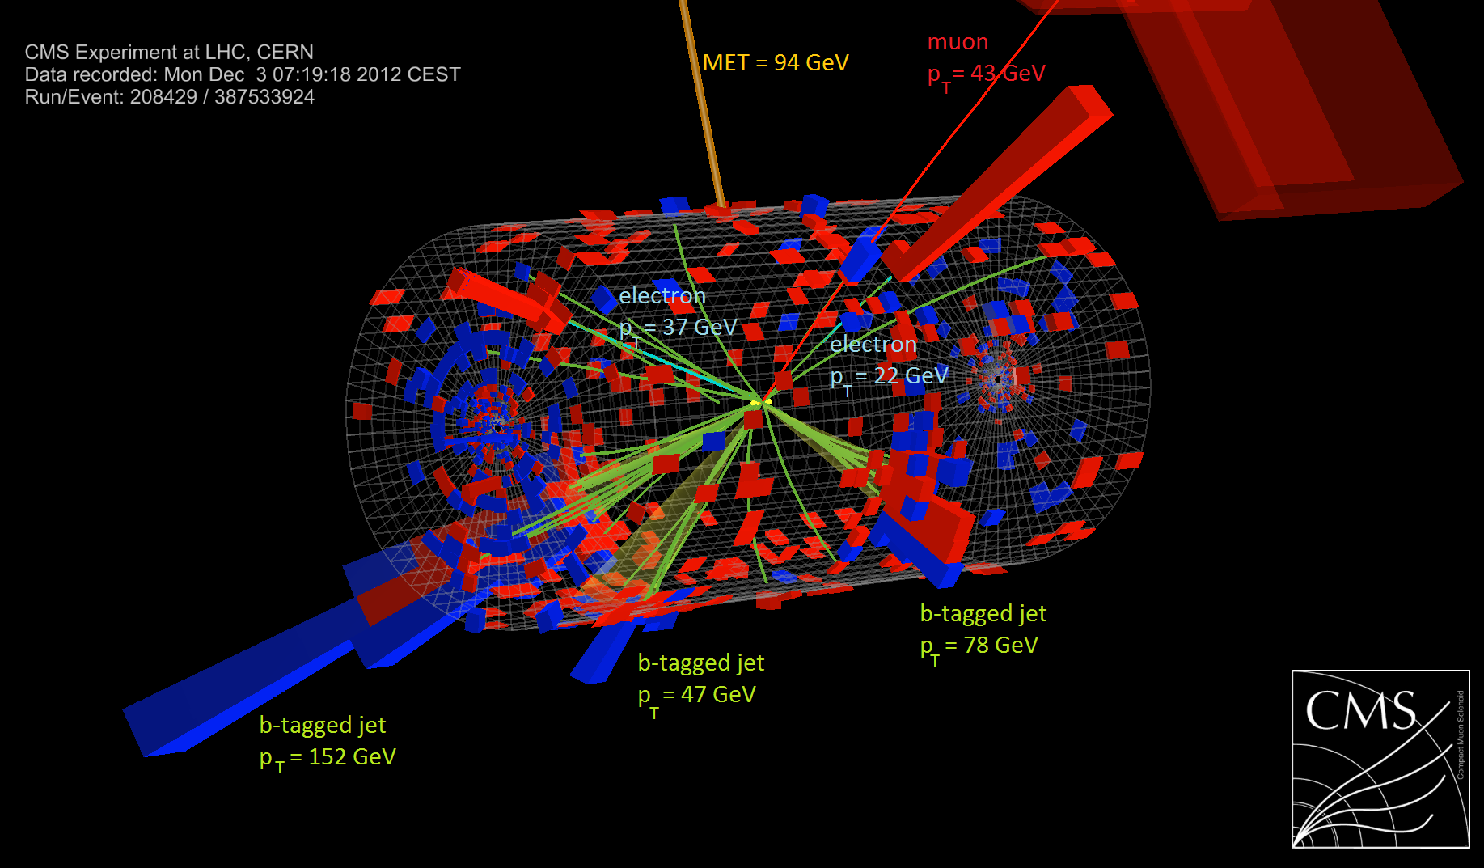
Multi-lepton and R-parity violating processes
SUS-13-002, 13-008
Andrea Gozzelino (multilepton)
SUS-13-003, 13-010, 13-013, EXO-12-049
Matthew Walker (R-parity violating)

Slide 55
Multi-lepton and R-parity violating processes
SUS-13-002, 13-008
Andrea Gozzelino (multilepton)
SUS-13-003, 13-010, 13-013, EXO-12-049
Matthew Walker (R-parity violating)
Common theme: powerful signatures that strongly suppress ttbar and other SM backgrounds. Typically have loose/no MET cuts!
→ Access to compressed spectra and R-PV SUSY.
55

Slide 56
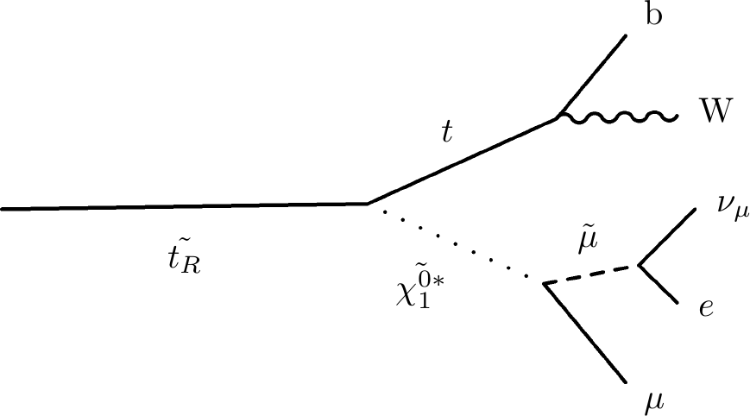
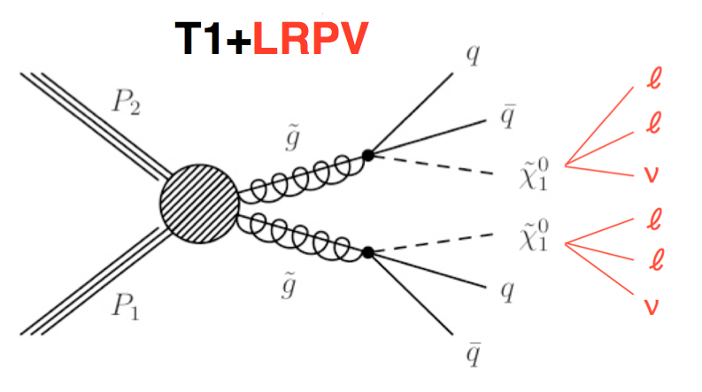
Multilepton searches with R-PV interpretations
Matthew Walker (R-parity violating)
Same-sign dileptons + b-tags (SUS-13-013) | ≥3 leptons + b-tags (SUS-13-003) | 4 leptons (SUS-13-010)
gluino RPV decay
direct stop with
RPV decay
neutralino RPV decay
Results from
4𝜇 & 4e similar
Exclude masses
up to ~900 GeV
Exclude stop
masses
up to ~1 TeV
56

Slide 57
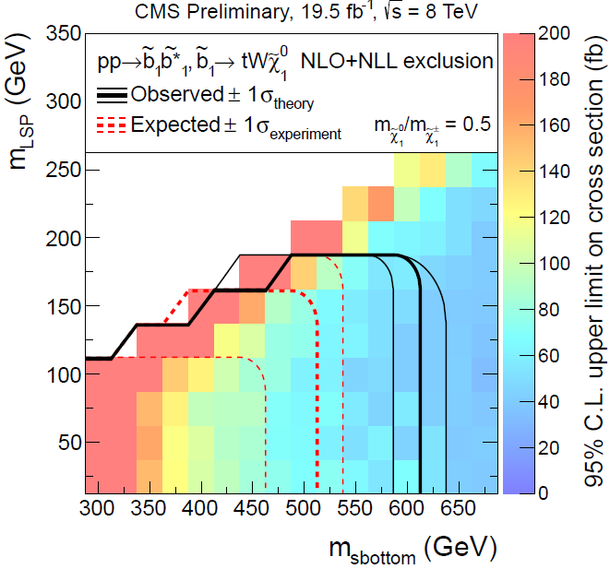
Multilepton searches: general
SUS-13-002
SUS-13-008
Andrea Gozzelino talk
Search for anomalous lepton production
≥3 leptons (e, 𝜇, 𝜏)
Binning in
  N(lep), N(𝜏), N(b-jet)=0, ≥1, MET, HT, OSSF pairs,
  on Z/off Z
Search for events with
≥3 leptons, ≥2 jet, ≥1 b-jet.
3(e, 𝜇)
Binning in
N(lep), N(jets), N(b-jets), MET, HT, on Z/off Z
Sbottom pair production
GMSB natural higgsino NLSP scenario
57

Slide 58
Conclusions
Over the first 3 years of LHC running, we have developed a broad SUSY program, with an extensive set of searches.
There is no evidence for a signal in any search.
The overall behavior of SM backgrounds in the data sample appears to be well understood.
Searches for gluinos and squarks are highly developed.
There is significant progress in developing searches for EWKinos.
Compressed spectra represent a challenge.
Interpretation is complex; much ongoing work.
We expect very substantial gains in the discovery reach for the upcoming run.
58

Slide 59
Backup slides

Slide 60
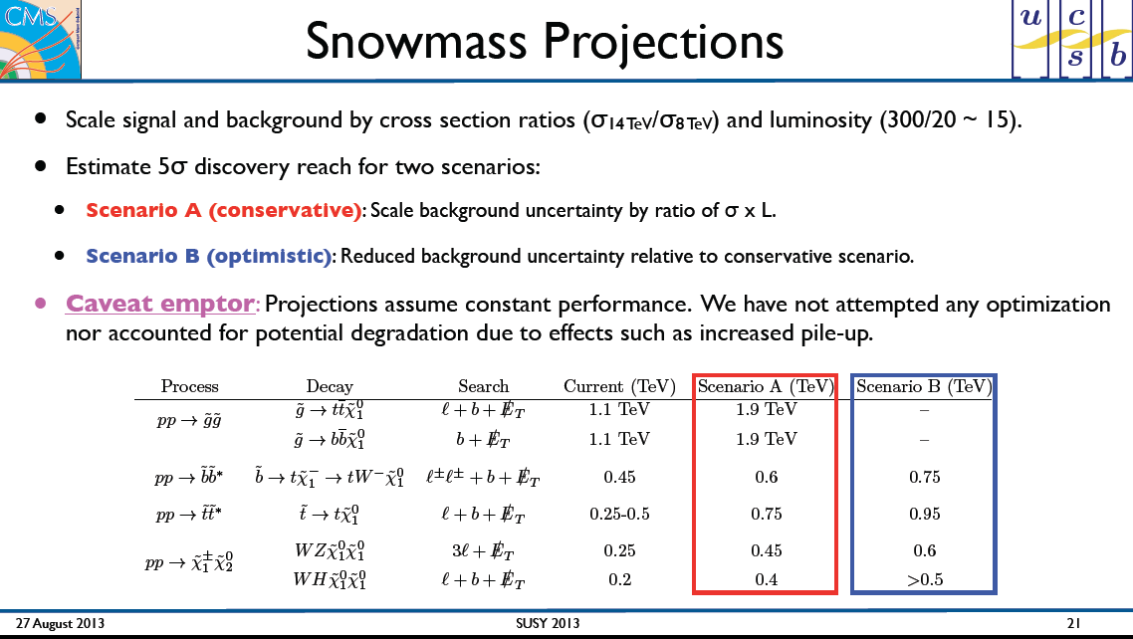
from Frank Golf talk

Slide 61
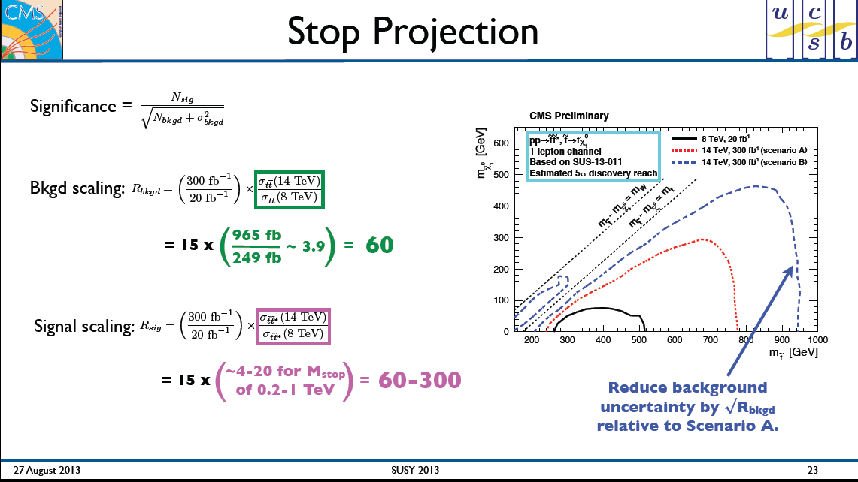
from Frank Golf talk
5σ discovery curves

Slide 62
Electroweak production:
SUS-13-006
https://twiki.cern.ch/twiki/bin/view/CMSPublic/PhysicsResultsSUS13006
WZ+MET: search complementarity
Slepton exclusion region

