Slide 1




From the Big Bang to the Higgs Boson in Less Than an Hour
UCSB Summer Research Mentorship Program
Groundbreaking Research/Innovative Technology Talk
July 1, 2013
Jeffrey D. Richman
Department of Physics
University of California, Santa Barbara

Slide 2
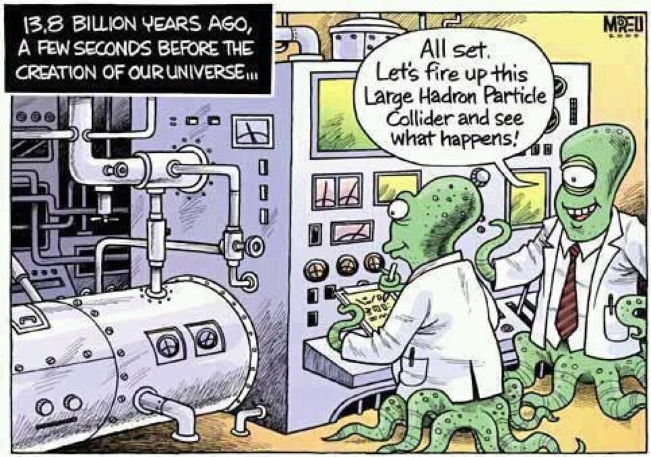

Slide 3
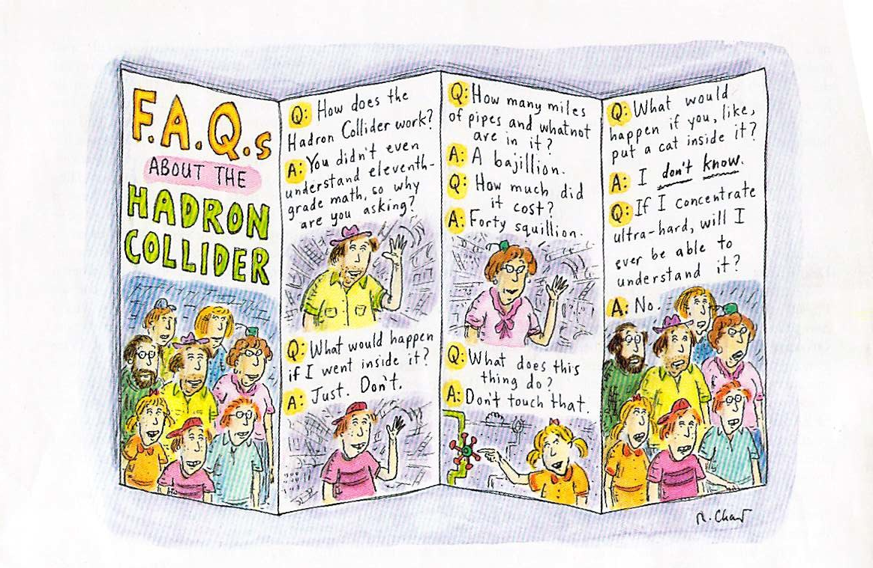

Slide 4
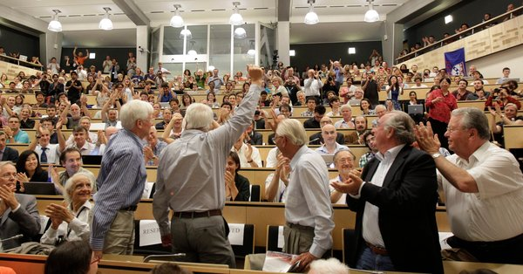
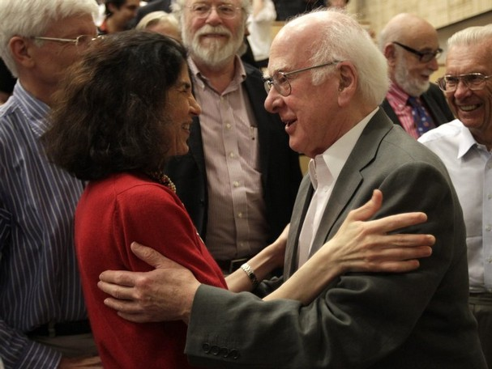
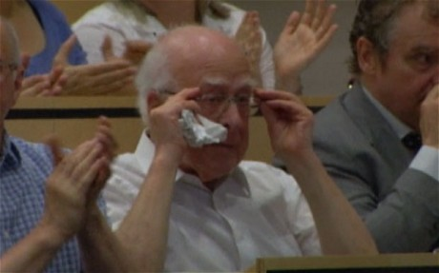
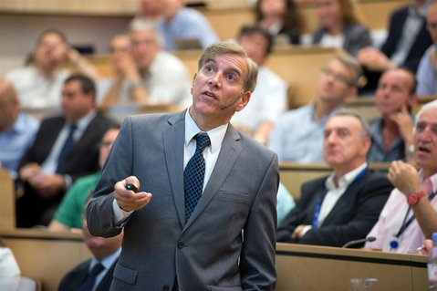
European Organization for Nuclear Research Geneva, Switzerland, July 4, 2012
Fabiola Gianotti, ATLAS
Peter Higgs
CERN main auditorium
photo courtesy CERN
Peter Higgs
Joe Incandela. CMS, UCSB

Slide 5

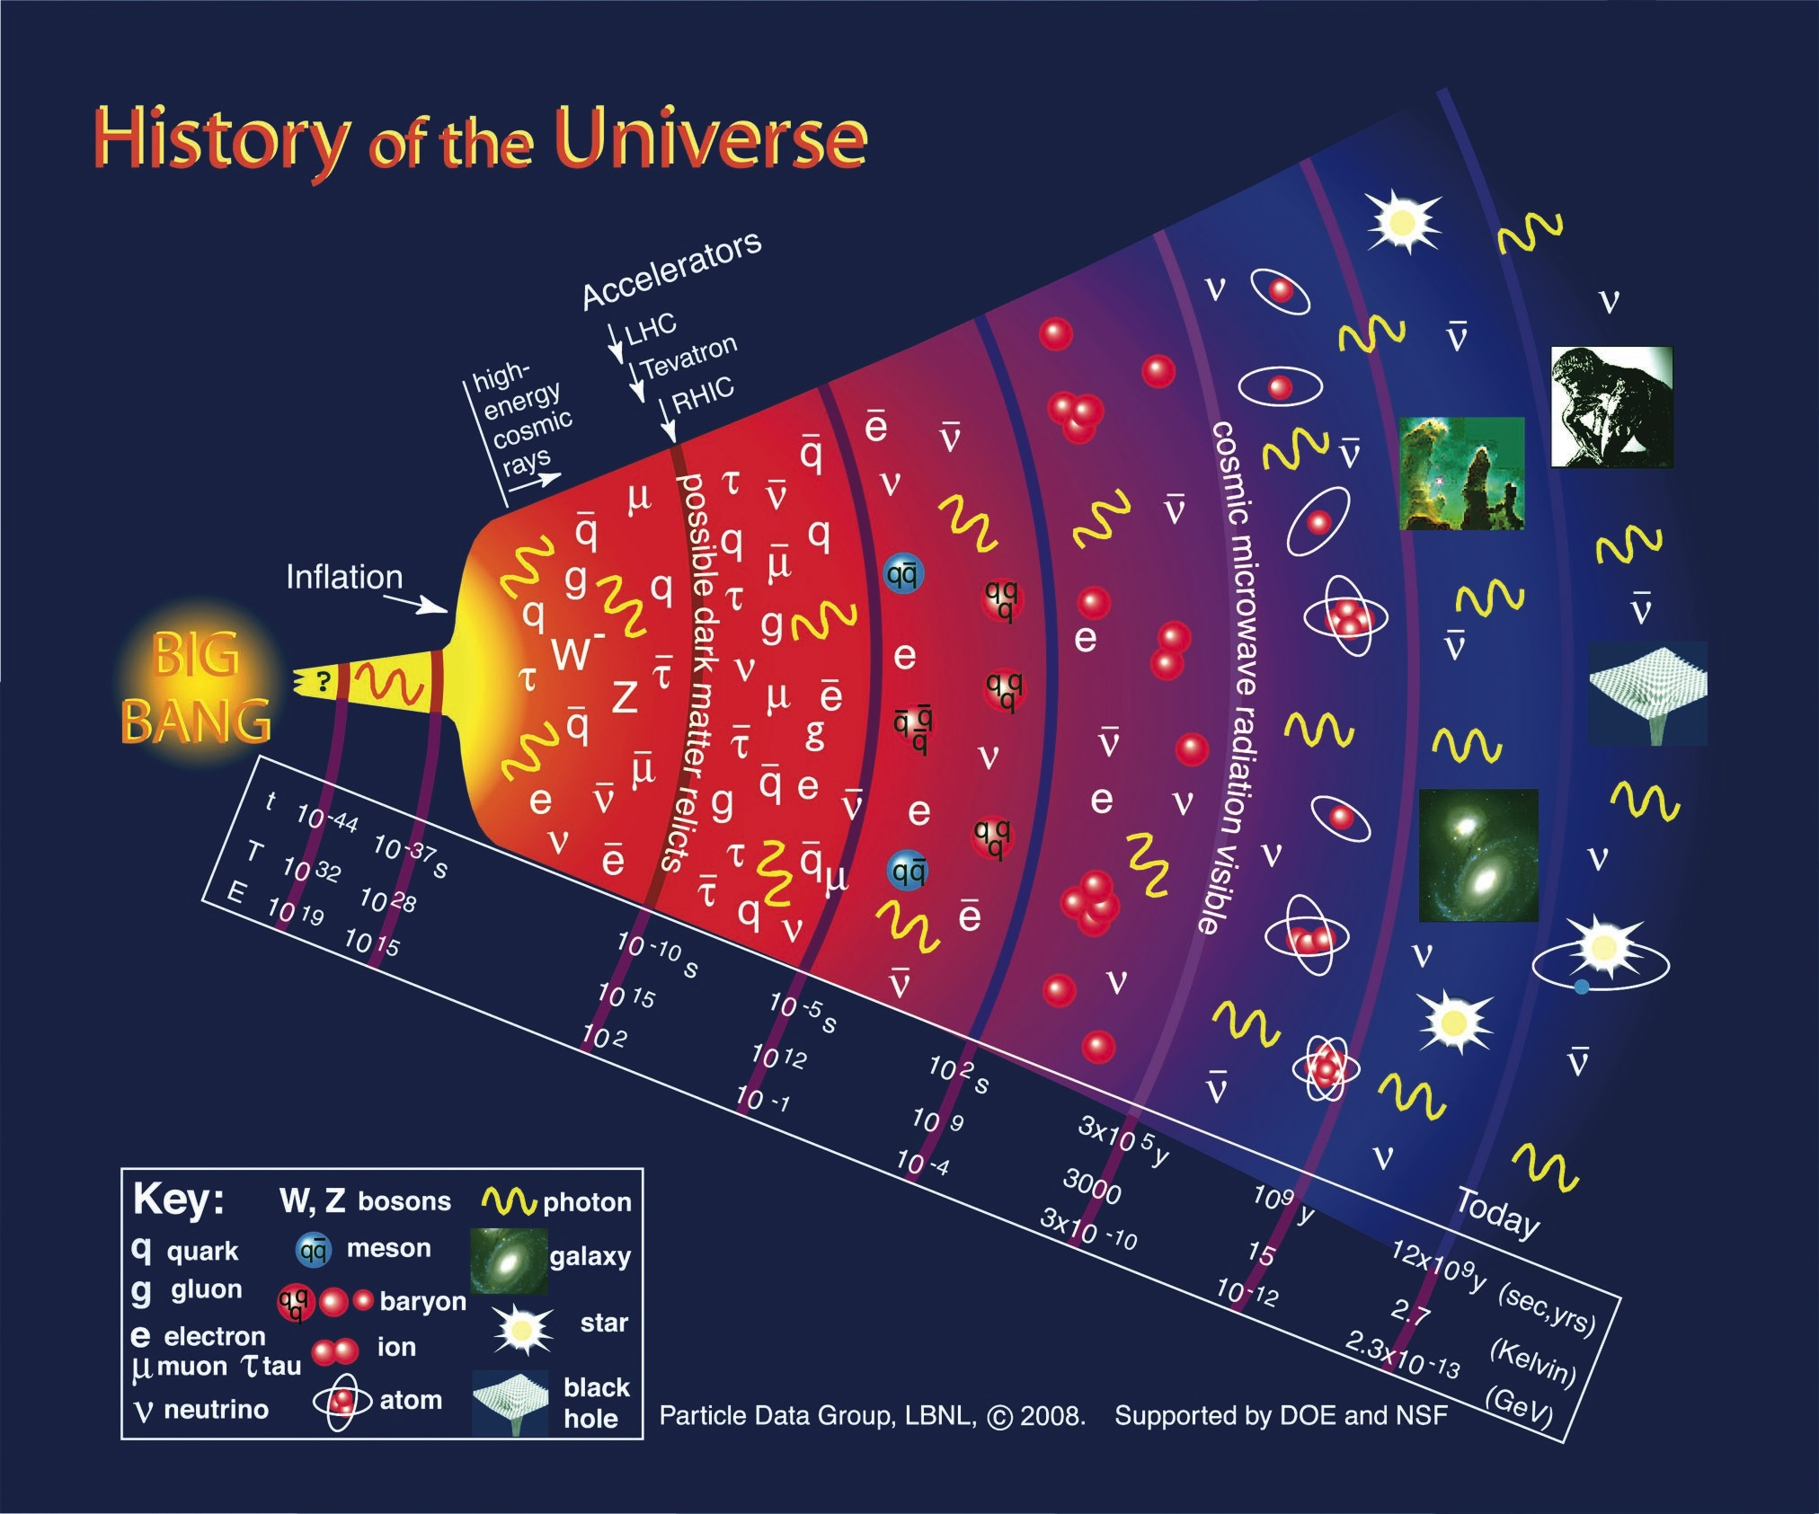

Plan of my talk
The universe, particles,
and fields
2. Accelerator and Detectors
3. What happens when
protons collide?
4. Discovery of a new particle

Slide 6
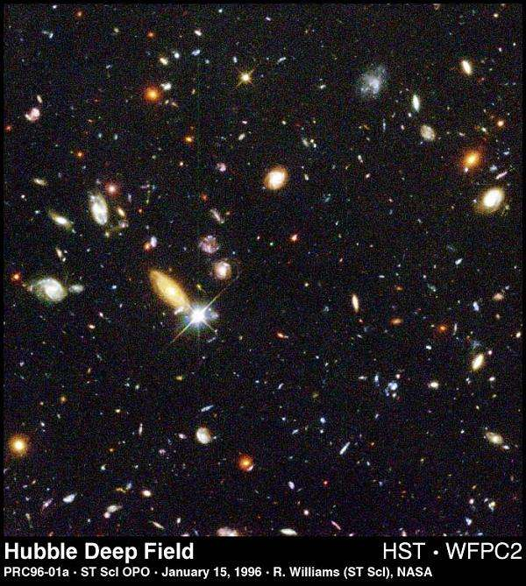

Slide 7
Notes:
nuclei: 100s nucleons 10^-4 seconds

Slide 8
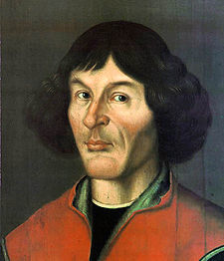
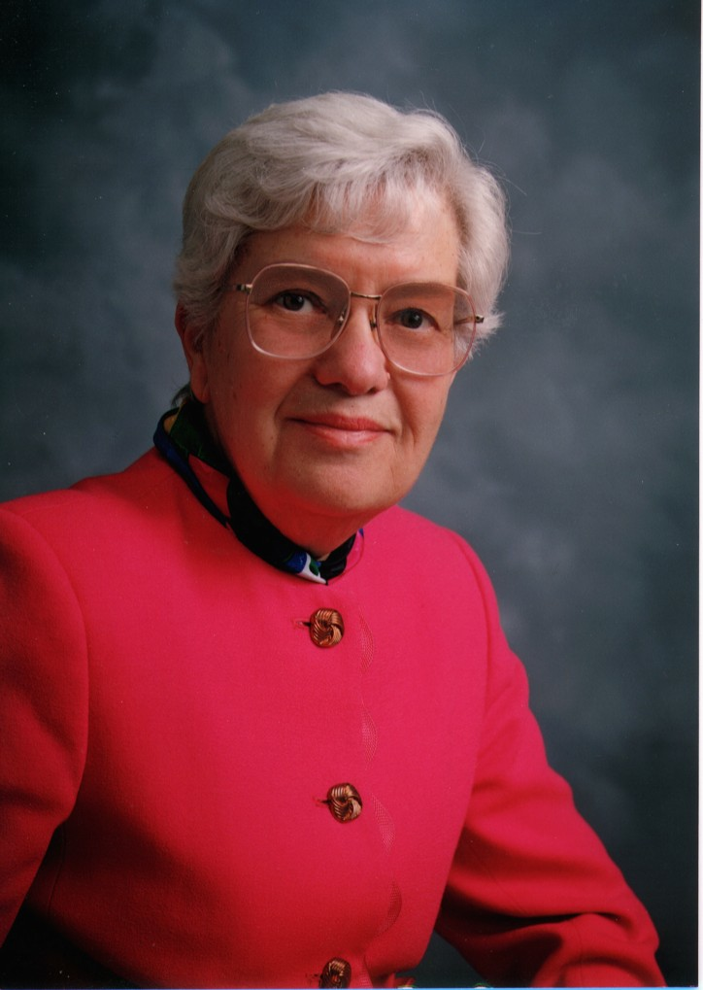
The dark matter revolution/mystery
Atoms:
4.6%
Dark
matter:
23%
Dark
energy:
72%
Nicolaus Copernicus
(1473-1543):
heliocentric model
Vera Rubin (1928-):
dark matter in galaxies
WMAP
We aren’t at the center of the solar system (or anything else),
and we aren’t made up of the dominant form of matter...

Slide 9
Who ordered that?
Quarks
Leptons
up
charm
top
electron
muon
tau
down
strange
bottom
electron
neutrino
muon
neutrino
tau
neutrino
Gauge bosons (force field quanta)
Higgs boson
and vacuum expectation value
Strong force
EM force
Weak force
gluon (8)
photon
Z boson
W bosons
Higgs boson
Notes:
Discuss charges
Discuss 3 generations

Slide 10
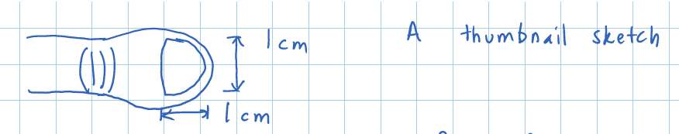
Particles all around: neutrinos and you
How many neutrinos pass through
your thumbnail every second?
(a) 0.1 (b) 1 (c) 10⁶ (d) 10¹¹ (e) 10²³
(f) none of the above
They are mostly from the sun!

Slide 11
Particles all around: neutrinos and you
How many neutrinos pass through
your thumbnail every second?
(a) 0.1 (b) 1 (c) 10⁶ (d) 10¹¹ (e) 10²³
(f) none of the above
They are mostly from the sun!

Slide 12
Who ordered that? - Matter
Quarks
Leptons
up
charm
top
electron
muon
tau
down
strange
bottom
electron
neutrino
muon
neutrino
tau
neutrino
“Matter”: made up of particles with spin (1/2)ħ
ħ = Planck’s constant
“Fermions” – obey Pauli exclusion principle!
Notes:
Discuss charges
Discuss 3 generations

Slide 13
Who ordered that? - Fields
Gauge bosons (force field quanta)
Higgs boson
and vacuum expectation value
Strong force
EM force
Weak force
gluon (8)
photon
Z boson
W bosons
Higgs boson
“Fundamental forces”: transmitted by fields
Quantum excitations of fields are particles with
spin = nħ, n = integer ħ = Planck’s constant
“bosons” – do not obey Pauli exclusion principle!
Notes:
Discuss charges
Discuss 3 generations

Slide 14
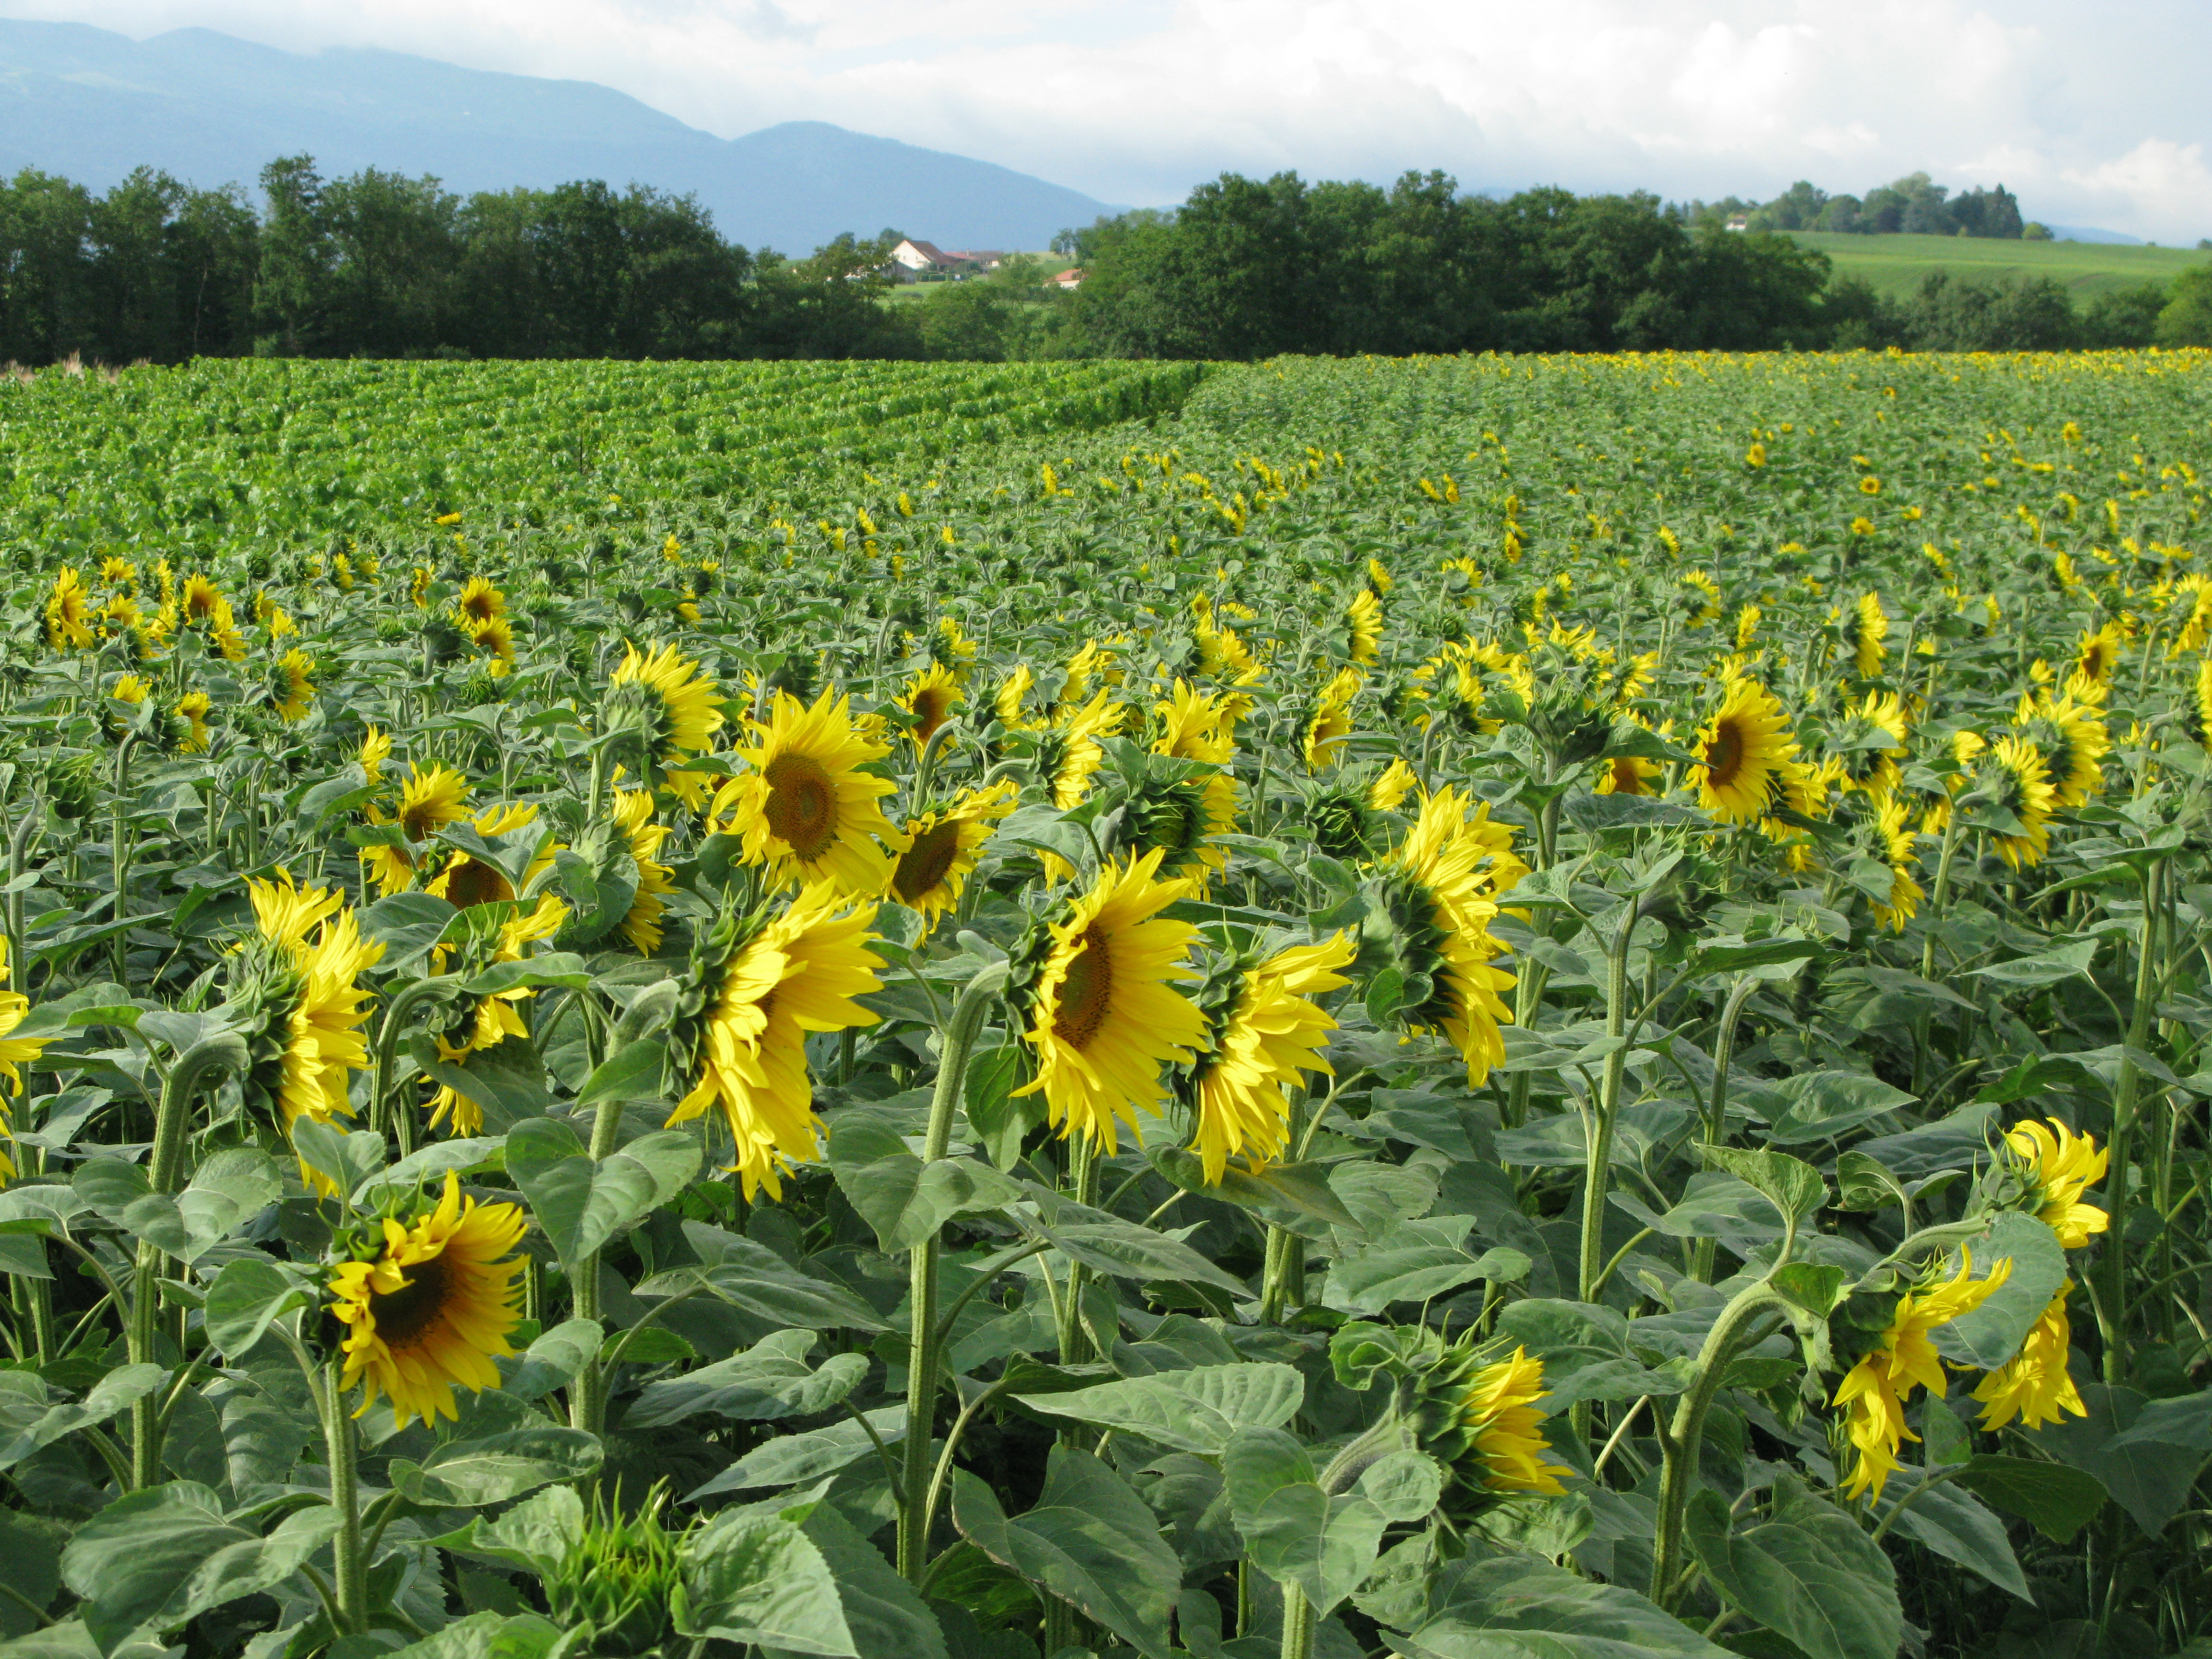
The four (known) fundamental forces of nature
Quantum field excitation | Fundamental forces/fields | Examples
 | Electromagnetic | Light, electrical power, chemistry, civilization as we know it.
 | Weak | Many natural radioactive processes, operation of sun, supernova explosions, formation of elements.
 | Strong | Holds nuclear particles together.
G (graviton) [?] | Gravitational | Astrophysical systems, large scale dynamics of universe.

Slide 15
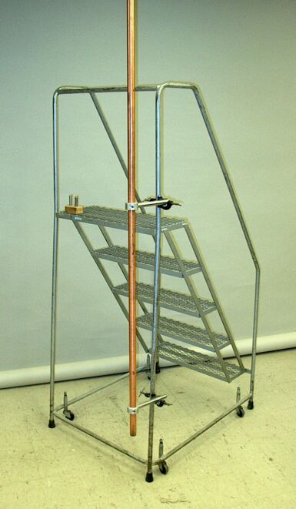
Electric and magnetic fields are unified!
Demonstration of Faraday’s Law,
showing the connection between
electric fields and magnetic fields.

Slide 16
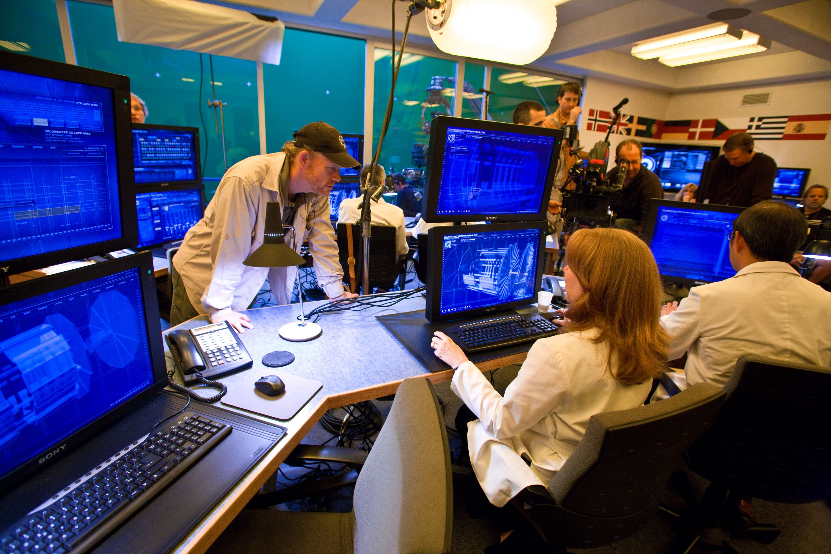

Angels & Demons and Tom Hanks:
What about antimatter?
Angels and Demons, © Sony Pictures.
(They also make computer displays.)

Slide 17
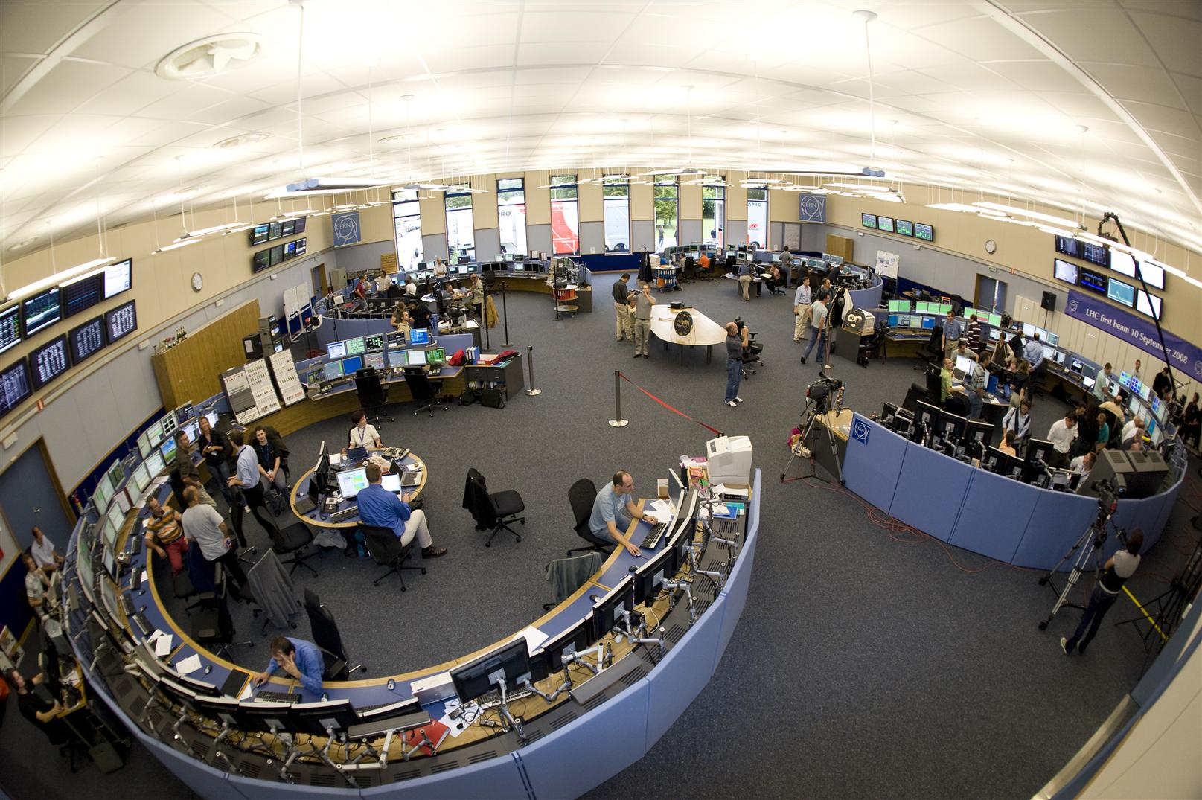
LHC Control Room: the real thing
Notes:
Actually, it looks more like this, with different sections of the room controlling different aspects of the machine.

Slide 18
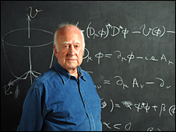
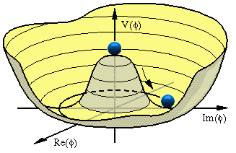
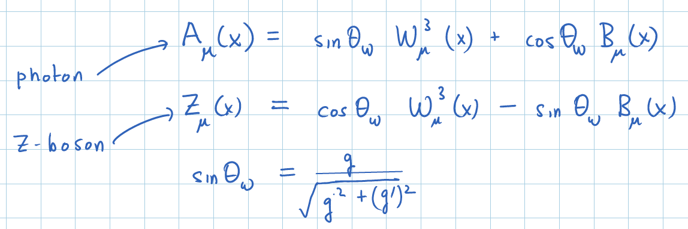
Peter Higgs and the origin of mass
Fundamental particles interact with the Higgs field, which exists throughout all space. This gives mass to particles!
See J. Richman, Physics 225b, Lectures 7-17.
Higgs potential

Slide 19
Large Hadron Collider C= 27 km (16.9 mi)
E(beam)= 3.5 to 7 TeV
Super Proton Synchrotron (SPS)
Geneva Airport
France
CERN main campus
Switzerland

Slide 20
Curnet
LHC ring: 2 separate magnetic “highways”
CMS Experiment,
(Cessy, France)
Proton beam
Proton beam

Slide 21
ATLAS Experiment Meyrin, Switzerland
Curnet
LHC ring: 2 separate magnetic “highways”
CMS Experiment,
(Cessy, France)
Proton beam
Proton beam
LHCb Experiment
Alice Experiment
9300 magnets, including 1232 15-meter dipoles.
Radio-frequency EM cavity devices to accelerate beams (8/beam; 40 MHz)

Slide 22
Curnet
What is a proton “beam”?
“Bunch train” w/1374 bunches of protons; 1 bunch=10¹¹ protons.
Beams make 11,245 turns/second
Stored for 10 hrs (round trip to Neptune!)
Designed for 600 M collisions/sec at each experiment.
The beam bunches travel at nearly the speed of light
(c−7 mph at 7 TeV). A pair of bunches arrives at the collision points every 50 ns (25 ns in future).
Stored energy per beam at design is 350 MJ, enough to melt 500 kg of Cu

Slide 23
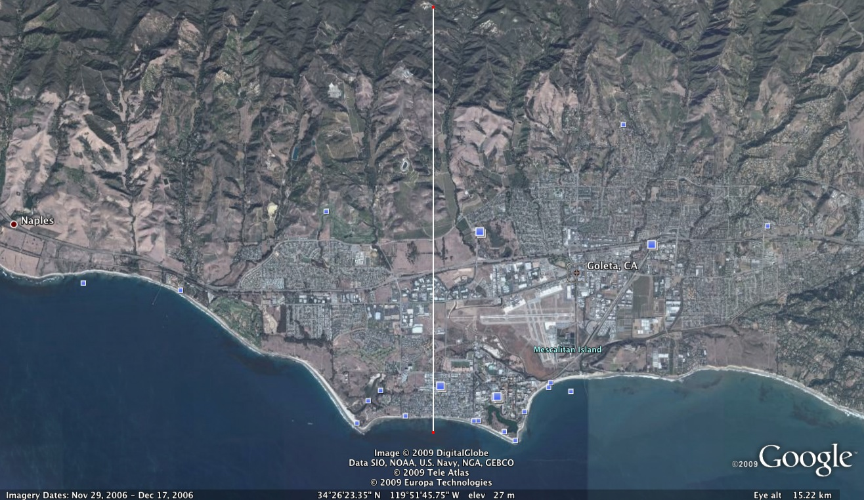
This place should look familiar!
d = 5.3 miles

Slide 24


LHC Interaction Region
100 m
Proton beam
Proton beam
Detector to observe outcome
of the proton-proton collisions.
The detector is like a giant camera – or an observatory!

Slide 25
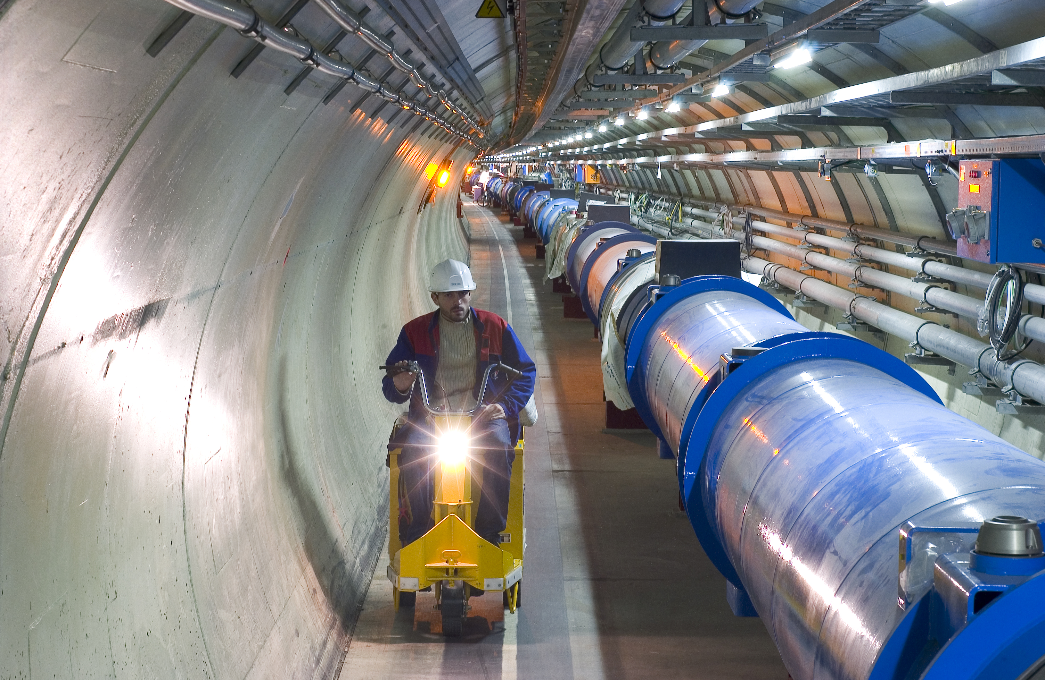
Inside the LHC Tunnel
Total magnets | 9593
Num. main dipoles | 1232 (L=15 m)
Num. main quadrupoles | 392 (L= 5 to 7 m)
RF cavs/beam | 8
Bunches/beam | 2808
Protons/bunch | 1.1 10¹¹
Collisions/sec | 600 10⁶
Bunch spacing | 7 m (25 ns)
Dipole field | 8.33 T
Dipole op. temp. | 1.9 K
Dipole current | 11,850 A

Slide 26
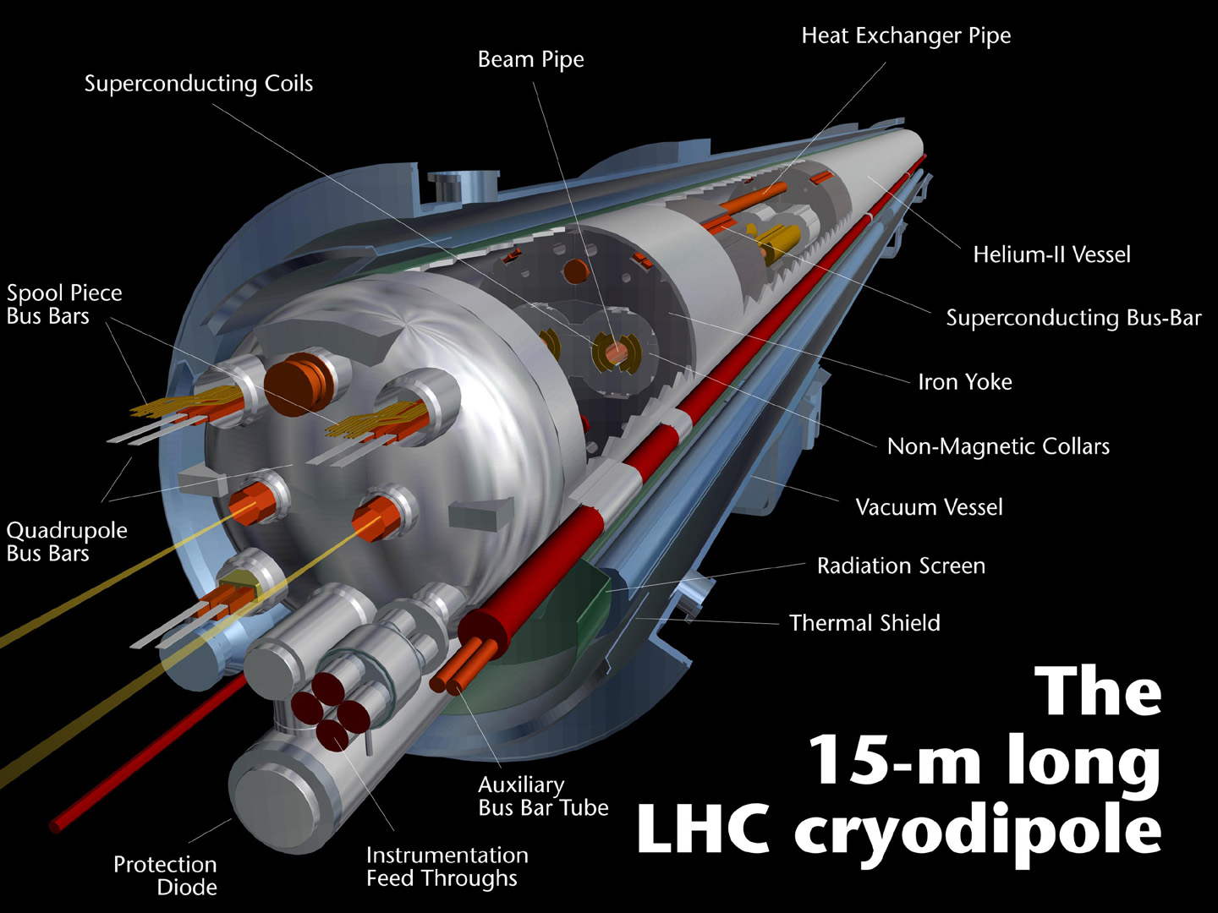

Slide 27
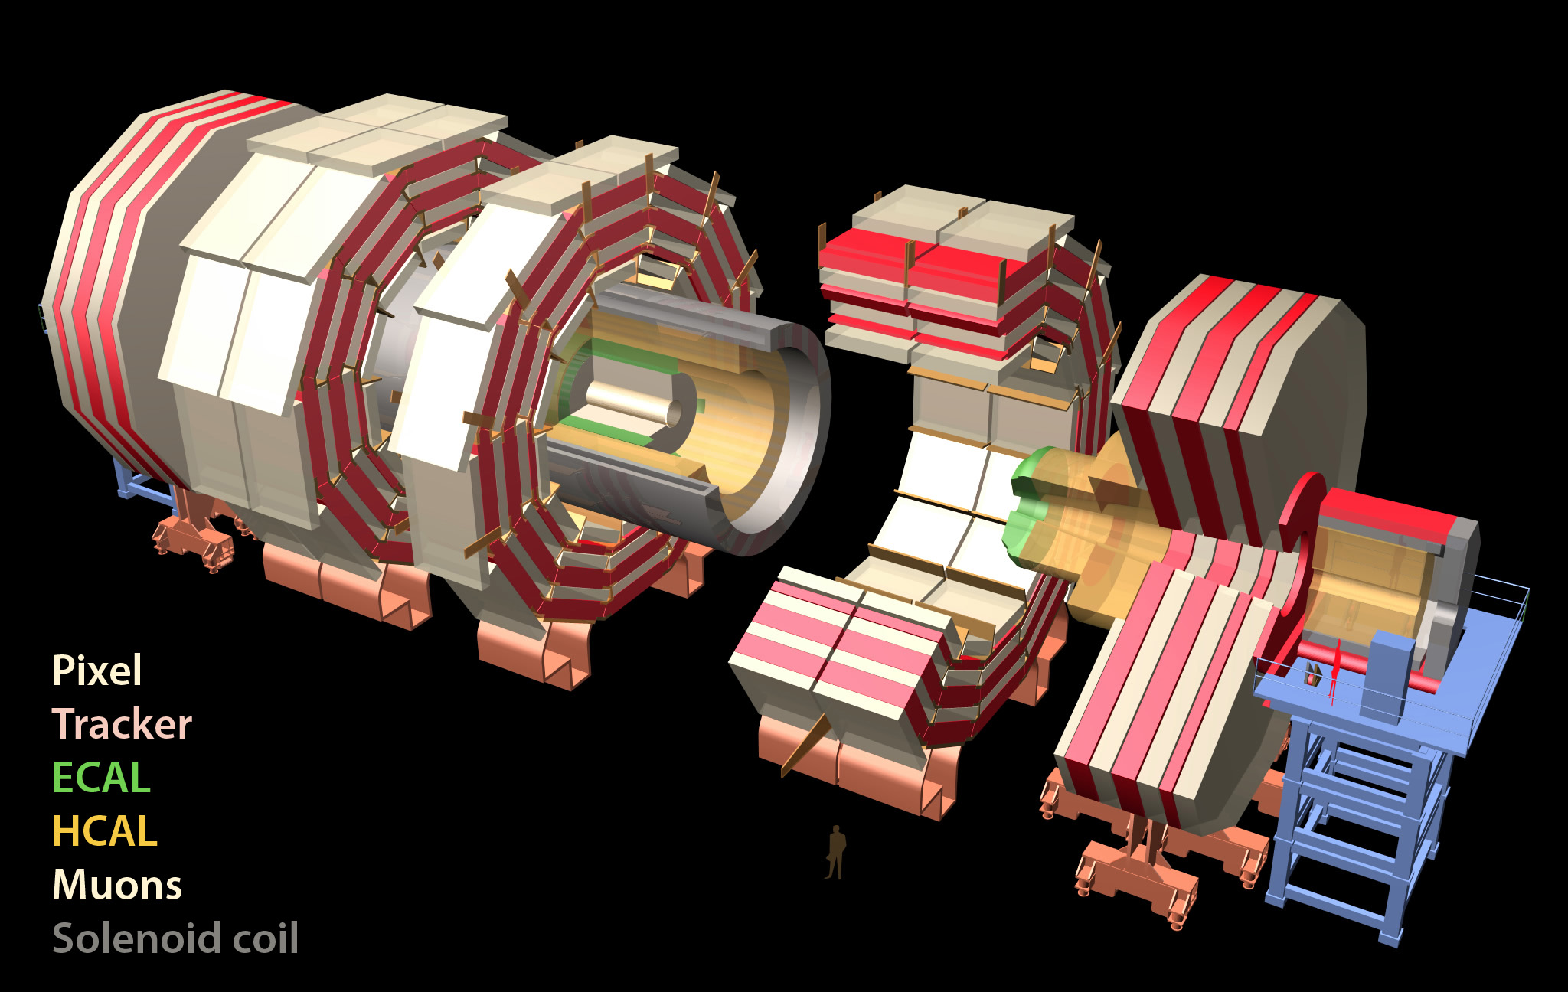
CMS Experiment
Total weight 14000 t
Overall diameter 15 m
Overall length 28.7 m
ECAL
76k scintillating
PbWO₄ crystals
MUON ENDCAPS
HCAL
Scintillator/brass
Interleaved ~7k ch
473 Cathode Strip Chambers (CSC)
432 Resistive Plate Chambers (RPC)
3.8T Solenoid
IRON YOKE
Preshower
Si Strips ~16 m²
~137k ch
YE1-3
YBO
Foward Cal
Steel + quartz Fibers ²~k ch
YB1-2
Pixels & Tracker
Pixels (100x150 μm²)
~ 1 m² ~66M ch
Si Strips (80-180 μm)
~200 m² ~9.6M ch
MUON BARREL
250 Drift Tubes (DT) and
480 Resistive Plate Chambers (RPC)
Notes:
Largest and most powerful SC Solenoid 3.8T
Houses All Silicon tracker 66 M channels
Crystal Calorimeter 76k

Slide 28
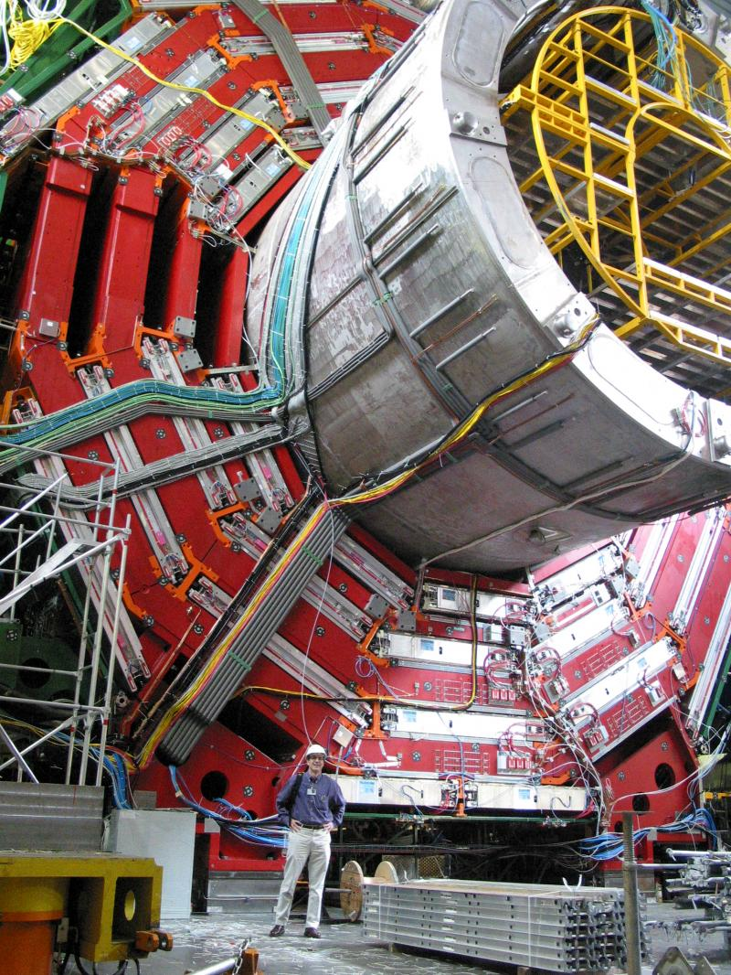

Slide 29
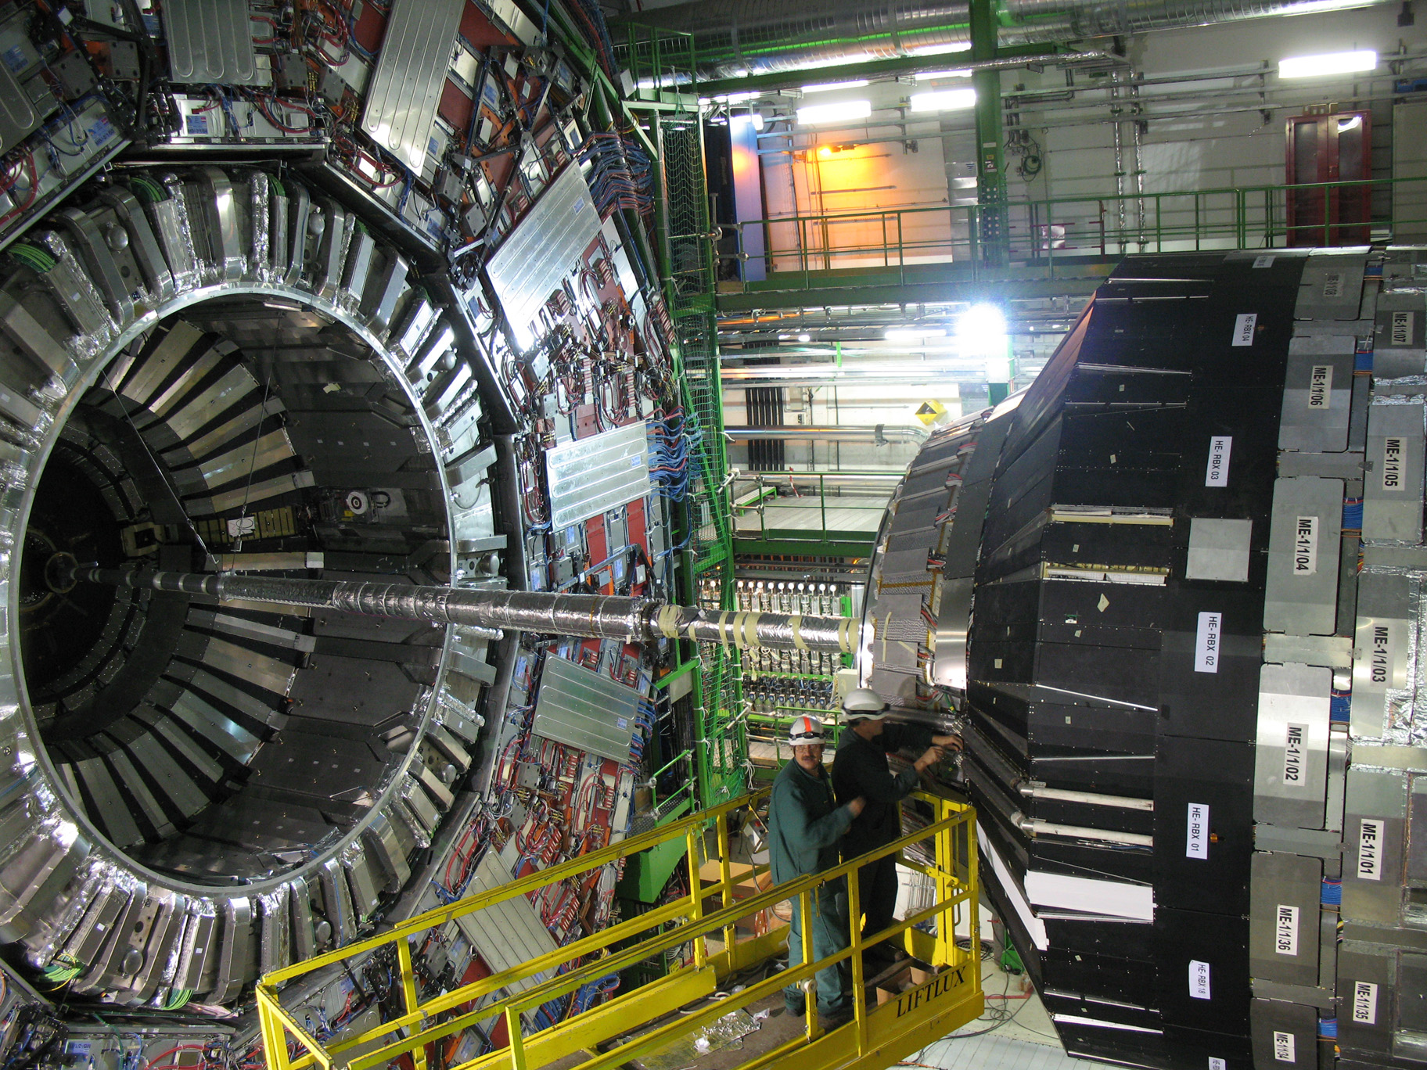
CMS Detector with Accelerator Beam Pipe

Slide 30
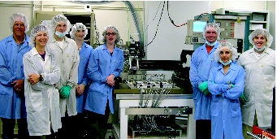
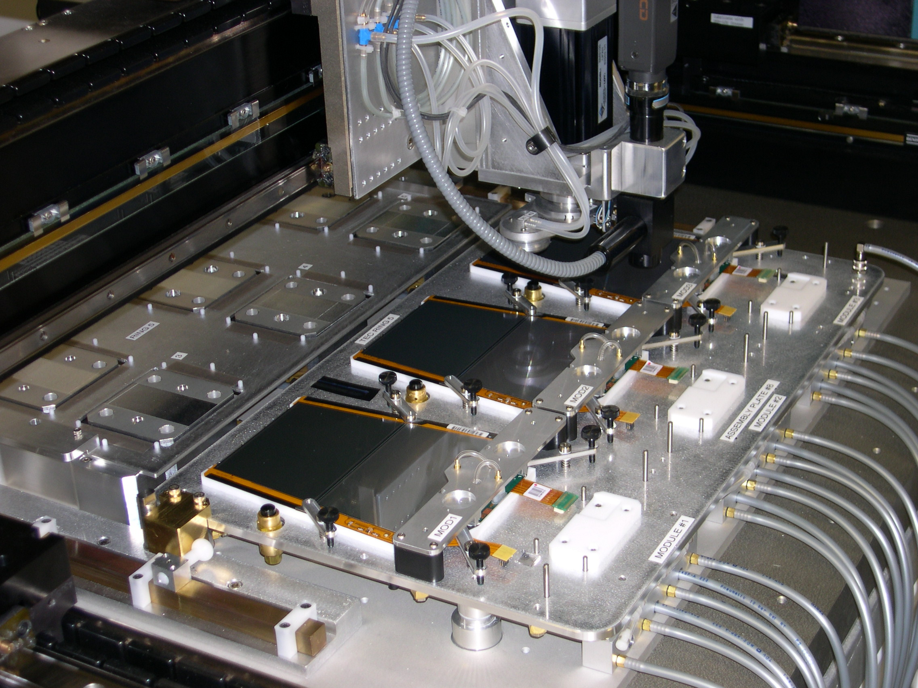
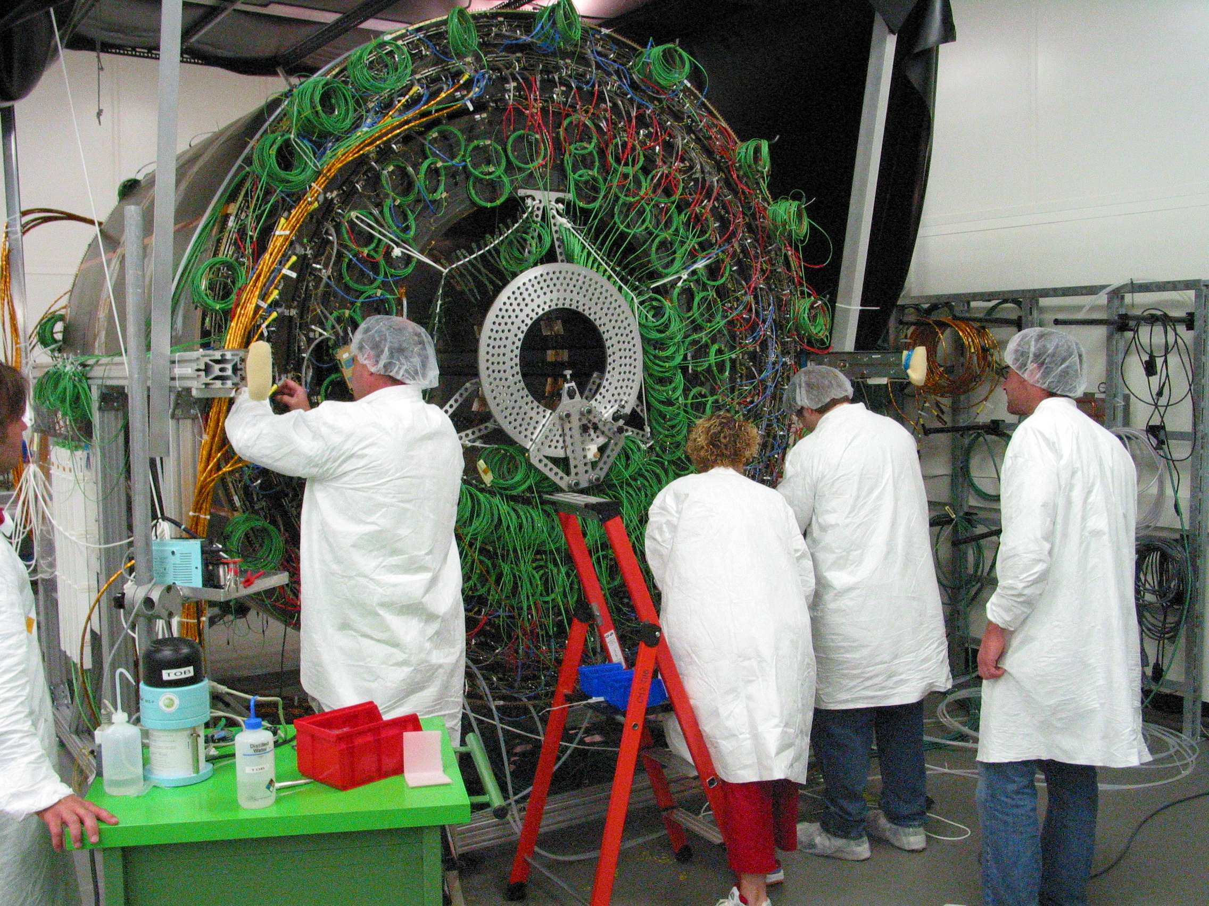
Working on the CMS Silicon Strip Tracker
UCSB silicon-strip module assembly team
Module
installation
at CERN
Module construction on ganty

Slide 31
CMS Silicon Tracker Installation: Dec 2007
Notes:
About 15 m across; 3.8 T B field

Slide 32
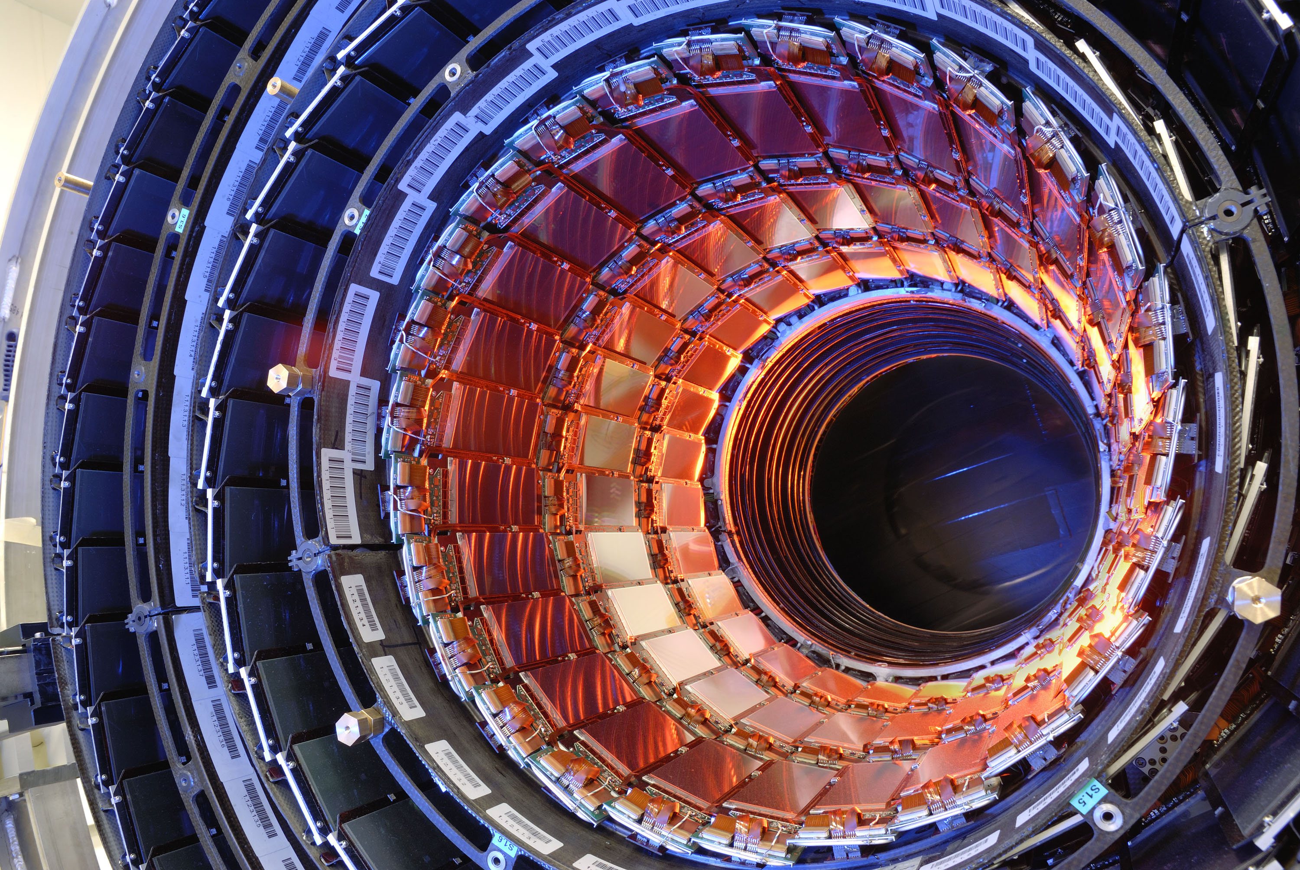
CMS Silicon-Strip Particle Tracking Detector
But

Slide 33
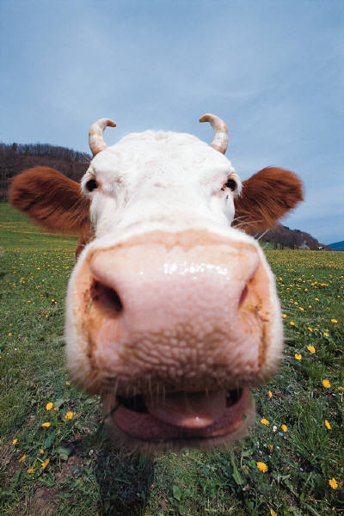
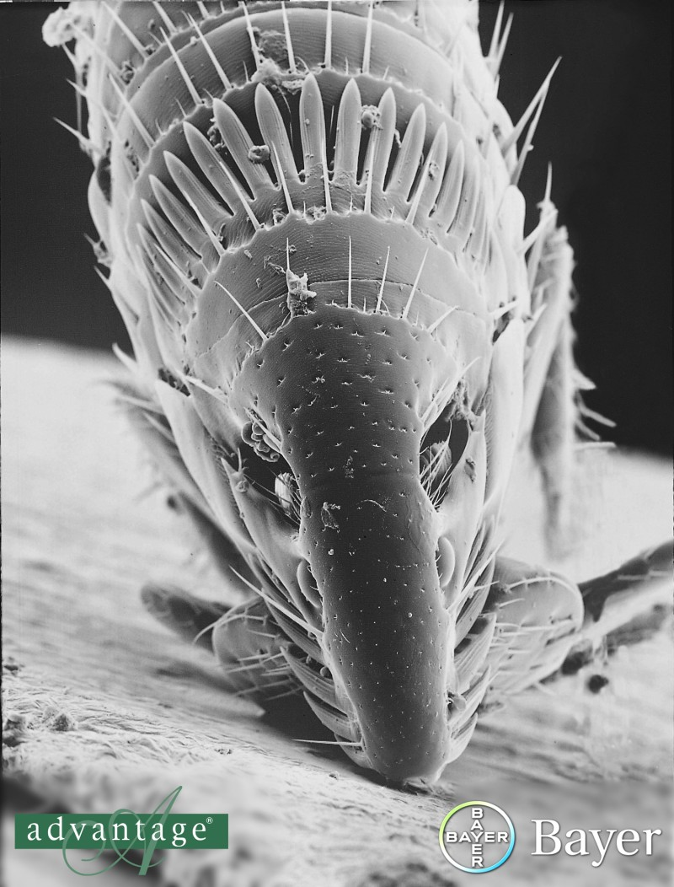
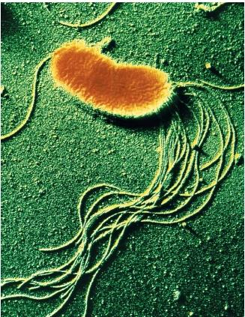
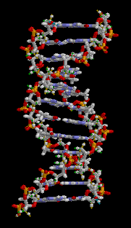
COW
L=3 m
Shrinking down: cow → atom
FLEA
L = 0.0025 m = 2.5 mm
BACTERIUM
L=0.002 mm = 2 μm (large variation)
MOLECULE
W = 0.002 μm = 2 nm
ATOM
R = 0.1 nm
= 100 pm
NUCLEUS
R=0.003 pm
COW
ATOMIC NUCLEUS

Slide 34
A first look inside of the proton
Quarks!
Rest energy (mass) of proton: 0.9 GeV
Energy of proton in LHC beam: 4000 GeV

Slide 35
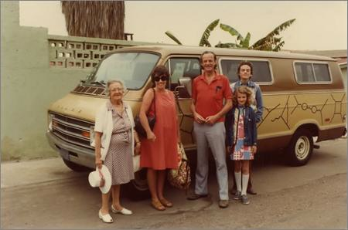
Feynman’s Van: Quantum Field Theory

Slide 36
Feynman’s Van: Quantum Field Theory
Fundamental forces don’t just produce “pushes” and
“pulls”. Each type of force allows a well-defined set of
transformations of matter.

Slide 37
Smashing Swiss watches together
...after all, this is Geneva

Slide 38
Smashing Swiss watches together
...out come two tennis rackets

Slide 39
Smashing Swiss watches together
...out come two tennis rackets
The fundamental forces
of nature can create
matter and antimatter!

Slide 40
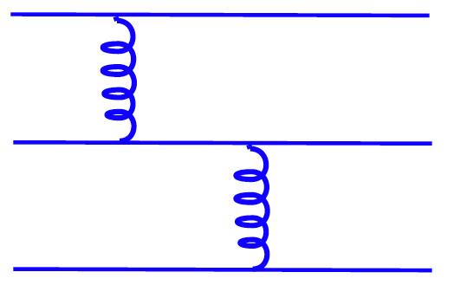
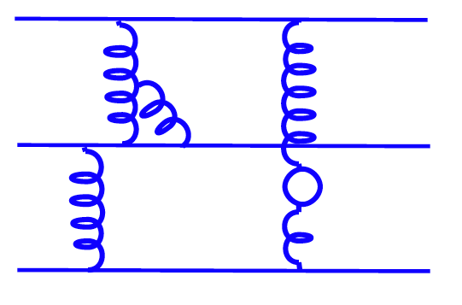
Two protons colliding
proton
proton
gluon
Gluons are the quanta of the strong field.
(Nobel Prize 2004: David Gross, David Politzer,
Frank Wilczek.)

Slide 41
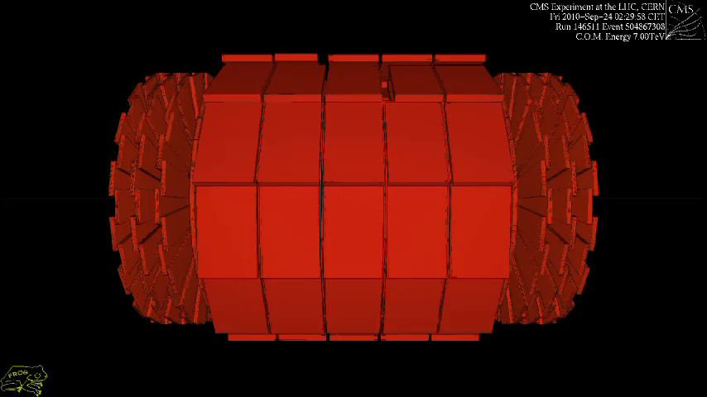
Can Matter be Created? (animation!)

Slide 42
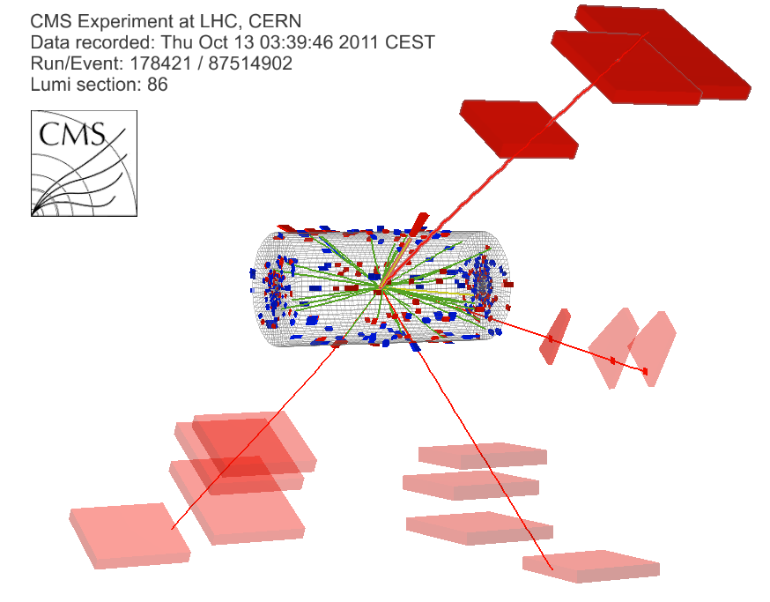
Higgs particle → two Z bosons → 4 muons
γ(Z₁) E_{T} : 8 GeV
μ⁻(Z₁) p_{T} : 28 GeV
7 TeV DATA
4μ+γ Mass : 126.1 GeV
μ⁺(Z₂) p_{T} : 6 GeV
μ⁻(Z₂) p_{T} : 14 GeV
μ⁺(Z₁) p_{T} : 67 GeV

Slide 43
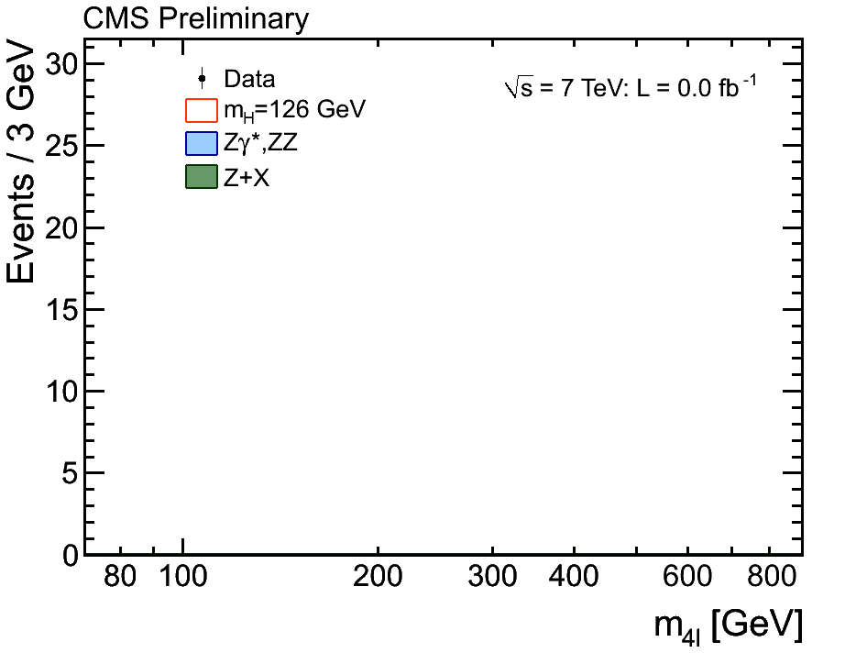
Higgs boson → two Z bosons → 4 leptons

Slide 44
Higgs boson → two Z bosons → 4 leptons

Slide 45
Higgs particle → 2 photons

Slide 46
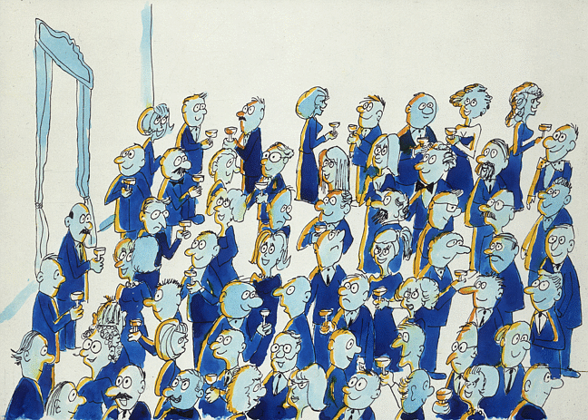
A quasi-political Explanation of the Higgs Boson; for Mr Waldegrave, UK Science Minister, 1993.
From David J. Miller, Physics and Astronomy, University College London (cartoons courtesy CERN)
Imagine a cocktail party of political party workers who are uniformly distributed across the floor, all talking to their nearest neighbors.

Slide 47
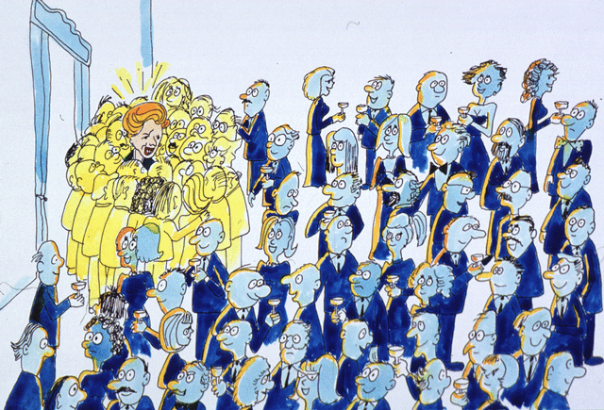
How the Higgs mechanism gives mass to massless particles

Slide 48
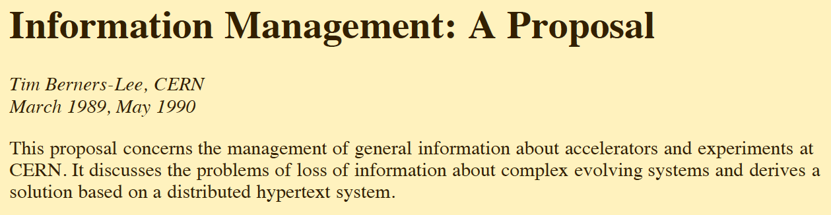
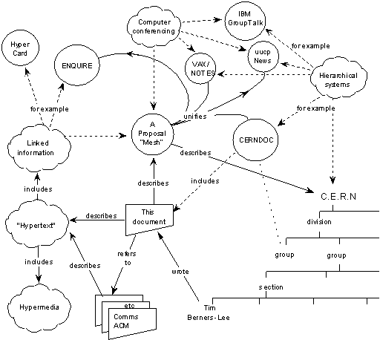
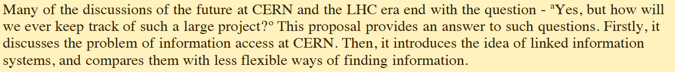

Slide 49
(Sir) Tim Berners-Lee and early development of the World Wide Web
Berners-Lee proposed the WWW in March 1989 while working at CERN and developed the first web site.

Slide 50
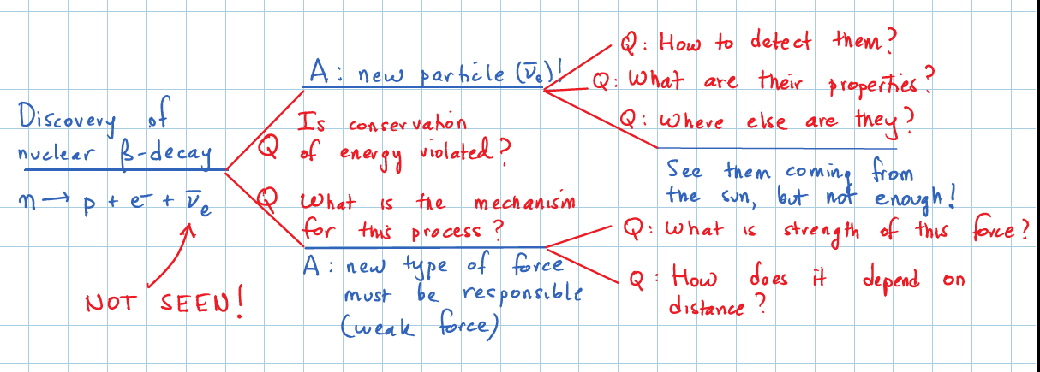
Questions, Answers, Theories, Discoveries

Slide 51
Questions, questions!
Asking questions is what scientists do for a living.
Usually, you can’t answer a big question in one big leap.
You have to break it down into little ones that you can make progress on.
One of the “little questions” might turn out to be more important than your first question!
How do you know if you got the right answer? (No answer book available!) Not simple! Lots of checking.
Getting the right answer on just one little question is big accomplishment!

Slide 52
After 3 years of running...
Over 200 physics papers published.
Our first major discovery: a “Higgs-like particle”.
Need to fully establish the properties of the new particle. There are scenarios with multiple Higgs bosons (e.g. five of them!).
Intensity search for particles that can explain the dark matter (“supersymmetric particles”).
Train the next generation of scientists!
The LHC project will continue for at least a decade.

Slide 53
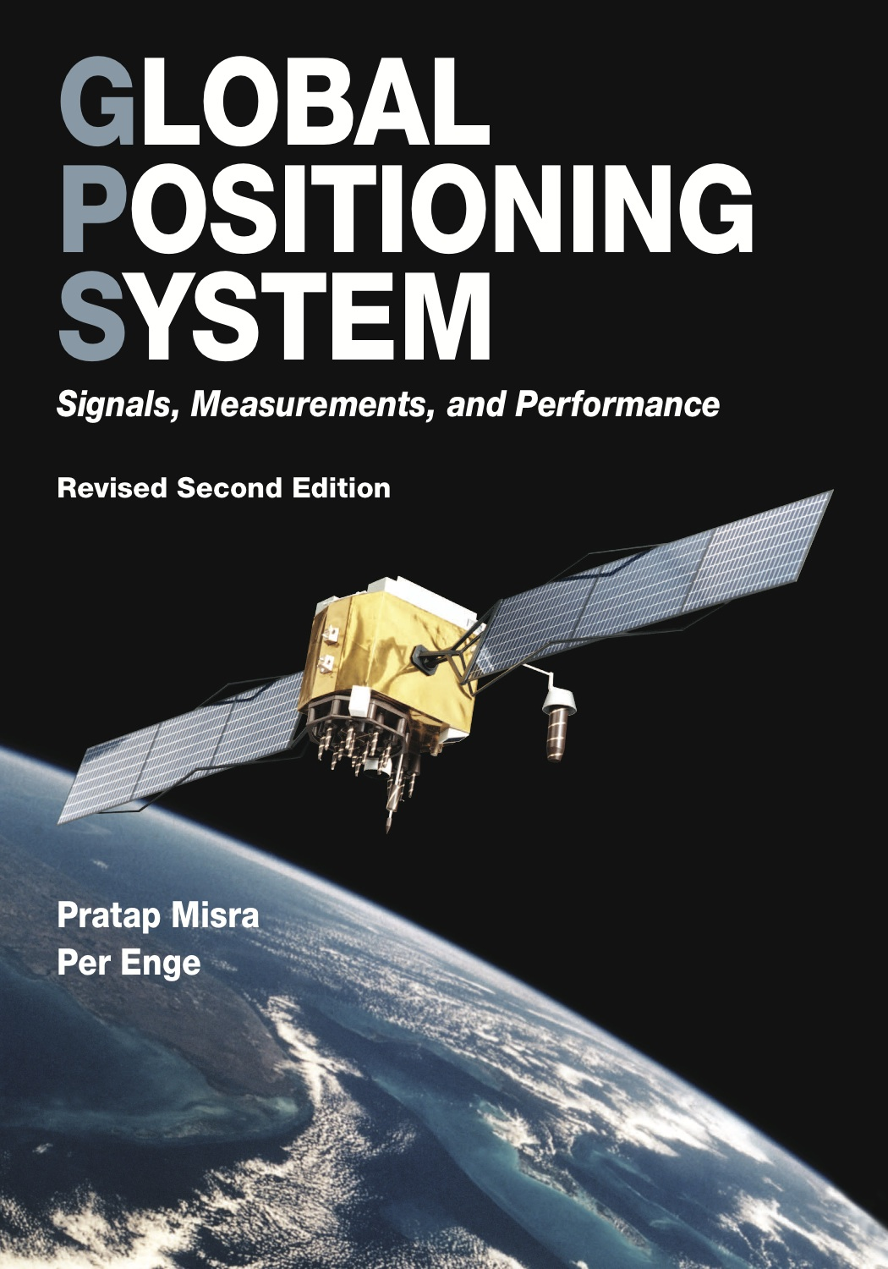
Albert Einstein and the geometry of space-time
Einstein taught us that matter causes the geometry of space-time to be curved.
Clocks run at very slightly different speeds at different heights in a gravitational field.
Tiny effect – who cares? We all do!

Slide 54
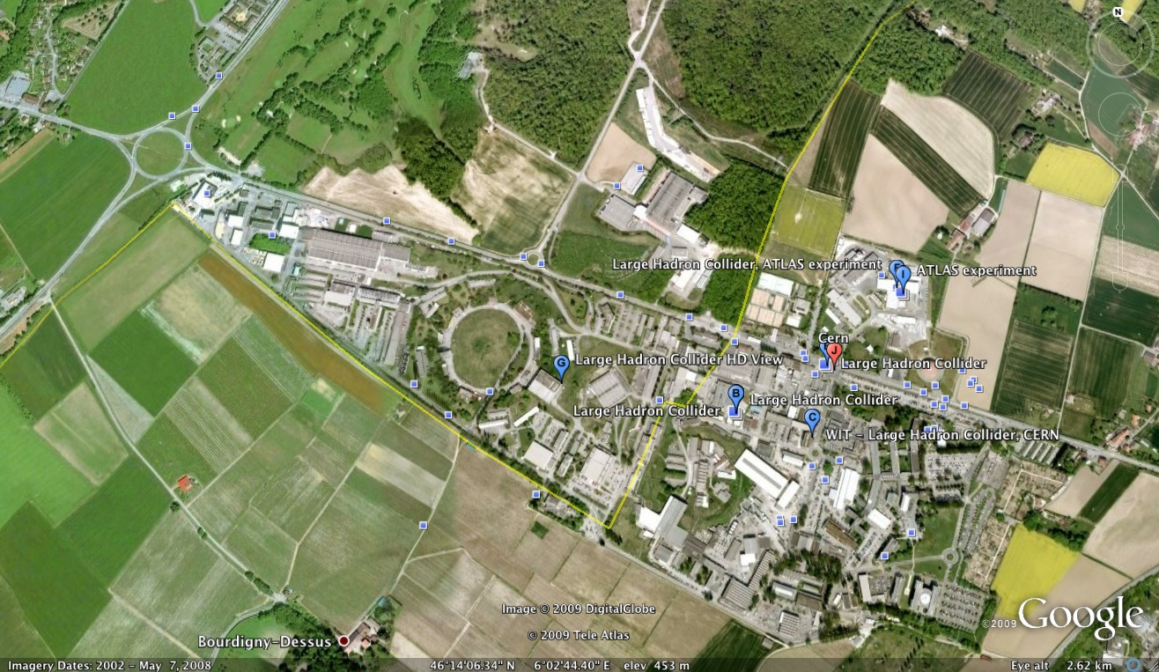
CERN main laboratory site
Border
France
Switzerland
Border
View towards
Mont Blanc
My office

Slide 55
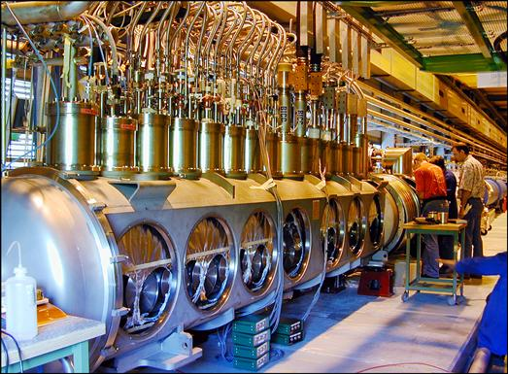
LHC Radio-Frequency Cavities

Slide 56
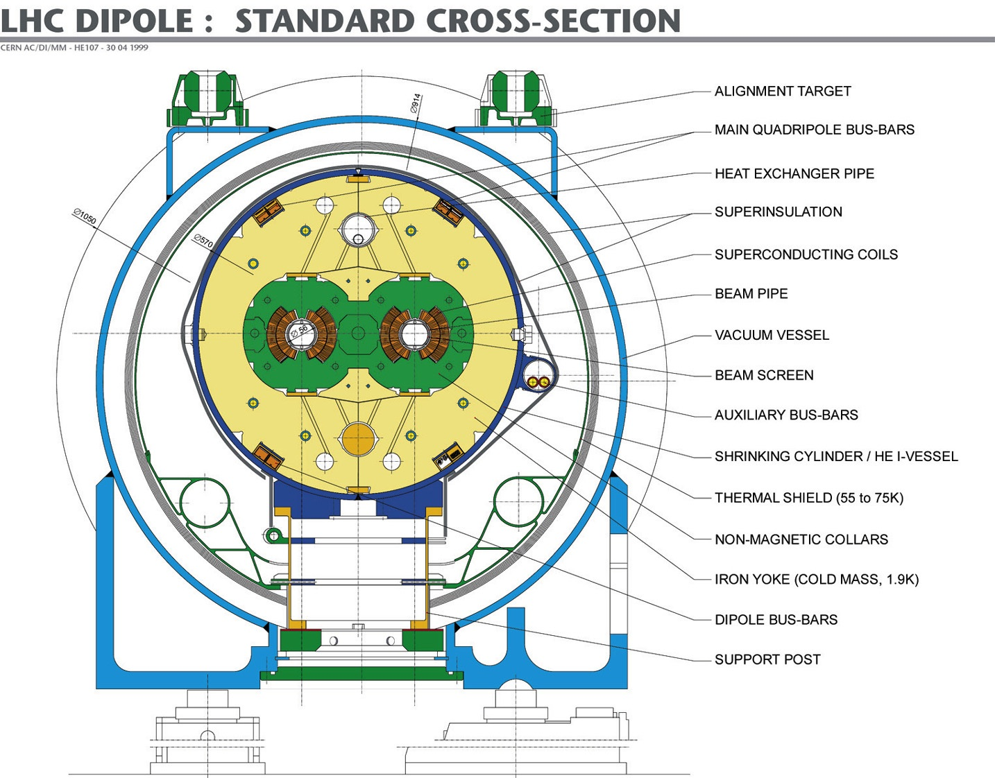
Mag. length: 14.3 m
Overall length: 16.8 m
Nb-Ti superconductor

Slide 57
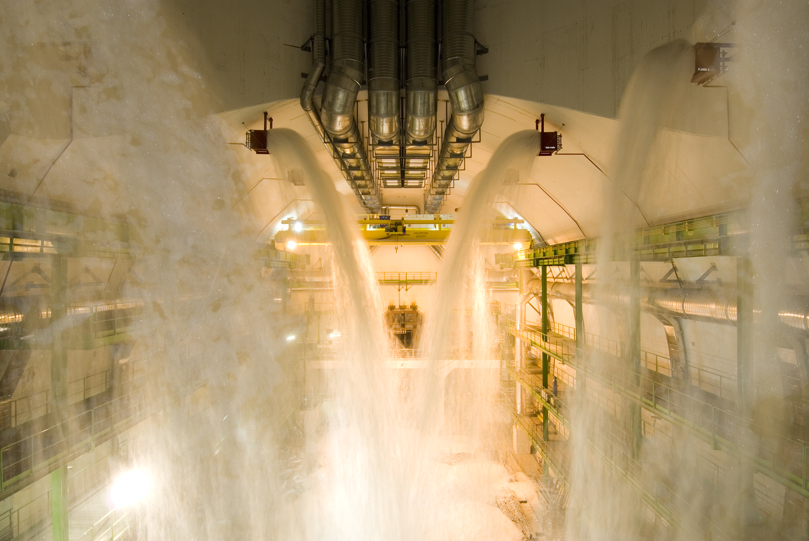
Practice run on putting out a fire

Slide 58
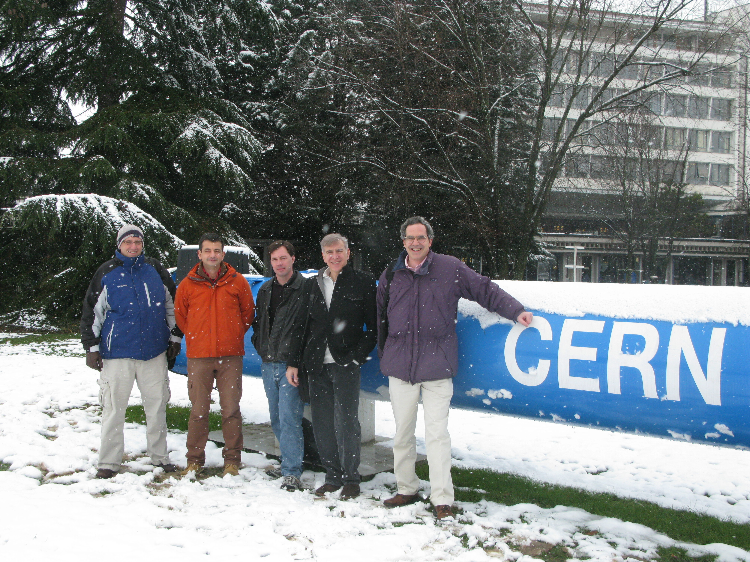
UCSB in the CMS Experiment
Guido
Magazzu
(Elec. Engineer)
Claudio
Campagnari
David
Stuart
Joe
Incandela
Jeffrey
Richman

Slide 59

Lowering one of the CMS endcap muon detectors into the cavern
But

Slide 60

Higgs boson branching fractions

Slide 61

Higgs particle → two photons
The mass of the Higgs particle can be inferred from the energies and
directions the two photons that the Higgs particle decays into.
Number of events observed
Mass in units of GeV

Slide 62


Slide 63
Leadership Roles in CMS: Faculty
Faculty member | Roles
Claudio Campagnari | Member of Physics Project Office (2011) Co-convenor of Top Physics Analysis Group (2008, 2009), Publications Board (2011), co-chair, Physics Dataset Working Group (2012)
Joe Incandela | Spokesperson (2012, 2013) Deputy Spokesperson (2010, 2011) -- previously Deputy Physics Coordinator) US CMS Tracker Project Leader
Jeffrey Richman | Collaboration Board Advisory Group (2013), Publications Steering Board (2012), Co-chair Exotica Pub Comm (2012), Co-convenor of Supersymmetry (SUSY) Physics Analysis Group (2009, 2010)
David Stuart | Co-convenor of Supersymmetry Physics Analysis Group (2011, 2012); previously co-convenor of leptonic SUSY subgroup.

Slide 64
CMS: Major roles of UCSB group
Area | Examples
Leadership/management | Top-level management, physics & software convenorships
Silicon Tracker Construction | Silicon detector module construction at UCSB, detector testing and assembly at CERN, project management
Silicon Tracker Commissioning | Cooling systems; calibration & commissioning
Silicon Tracker Upgrade and SLHC Electronics Development | Endcap muon electronics, readout electronics development, tracker & trigger studies
General Physics Analysis Tools Development | Fireworks Event Display, Physics Datasets & Trigger Menu Development, Physics Analysis Toolkit (PAT) Development, Missing Transverse Momentum measurement, b-tagging studies, Conversion ID
Muon High Level Trigger | Development of Muon High Level Trigger Software
Tracking Software | Development of Tracker Reconstruction Software
Muon Reconstruction Software | Development of Muon Reconstruction methods
Physics Analysis | Broad range of analyses: Top, SUSY, Electroweak

